Slide 1
Training week 1 SKILLS4WATER Innovative Training Programme
EJWP7: March 2024 - August 2025
12-14 March 2024, Nis, Serbia

Slide 2

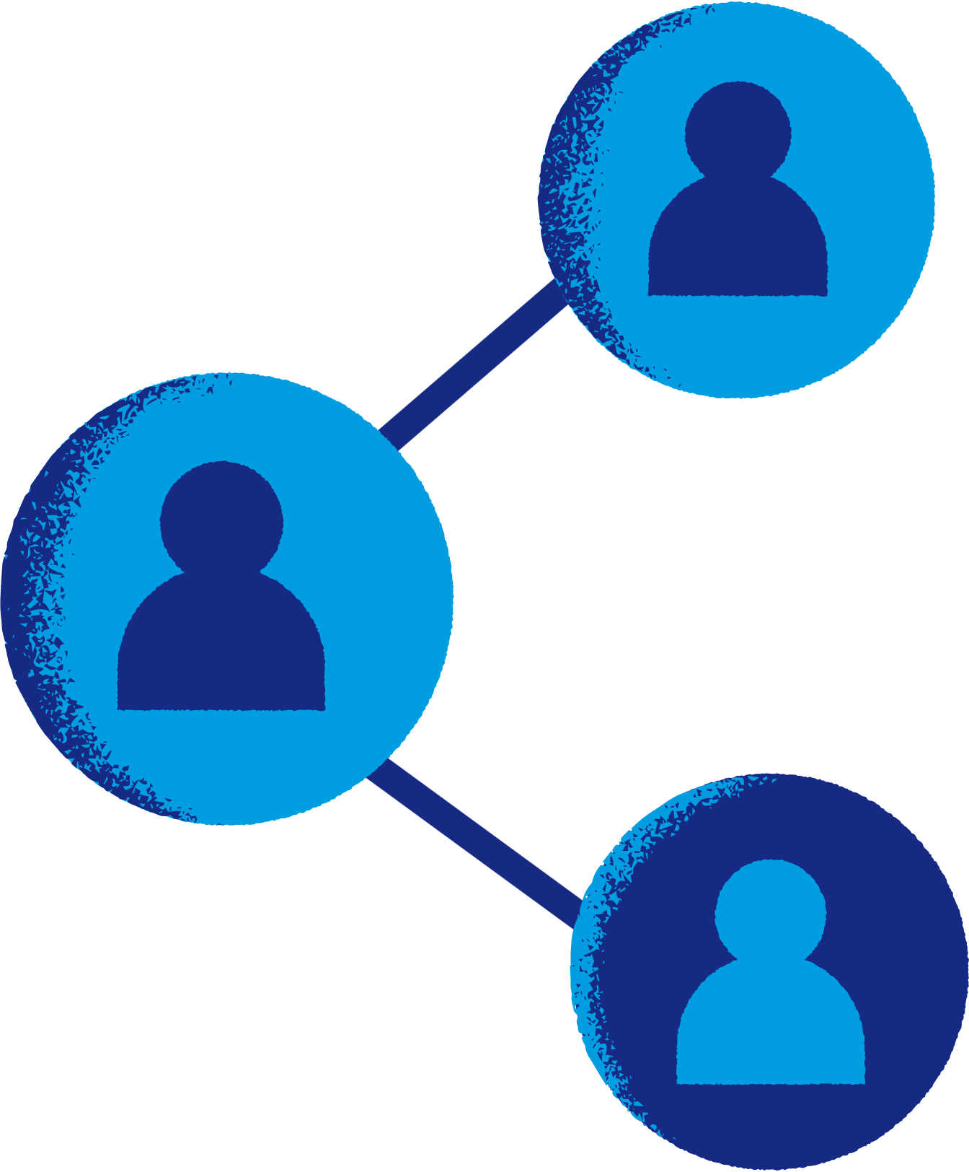


SKILLS4Water training program
Week 1
12-14 March 2024
Tuesday | Check in 1st EJWP Week Training Personal Leadership to Communication
Wednesday | Training InterCultural Communication InterVision
Thursday | Field Trip Multiplier Event Project Meeting Check out
Our Water Future Starts Here!

Slide 3
Programme training Day 1
Programme training Day 2
Recap day 1 & Check in
Challenges working with Diversity – LSP Workshop
Versatility in Communication
Inter-Cultural Communication
Using diversity in work
Setting objectives
InterVision
Check in
Personal Leadership
Life choices
Focus and priorities
Communication
Social Styles
Programme training Day 3
Field Trip
Multiplier Event on Soft Skills In EU Projects
Project Meeting

Slide 4







How do you sit here?
Why do you join EJWP7?
What are your expectations and needs of this first training week?
What are your fears for the programme?
What is something new that you recently learned?

Slide 5

Rules for these days:
Be proactive
Do what is important
Be focussed (make time for the programme)
Be prepared
Take care of oneself and the others
Confidentiality: what happens in the training, stays in the training

Slide 6

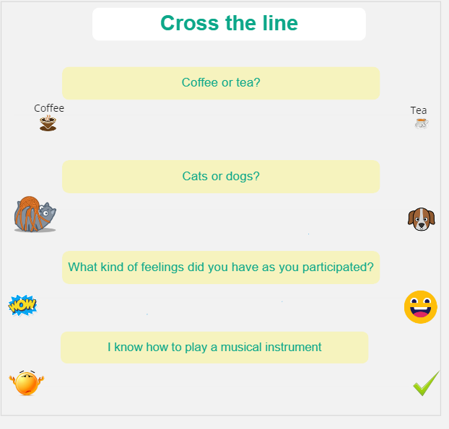
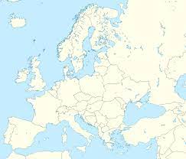

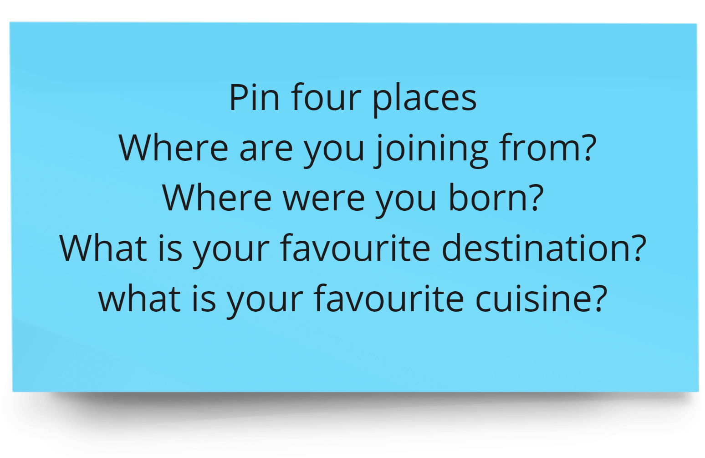
Getting to know each other
Our Water Future Starts Here!
Our Water Future Starts Here!

Slide 7
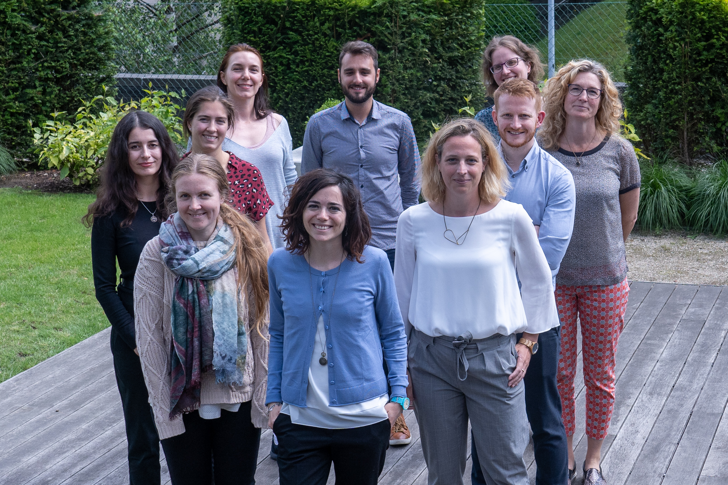
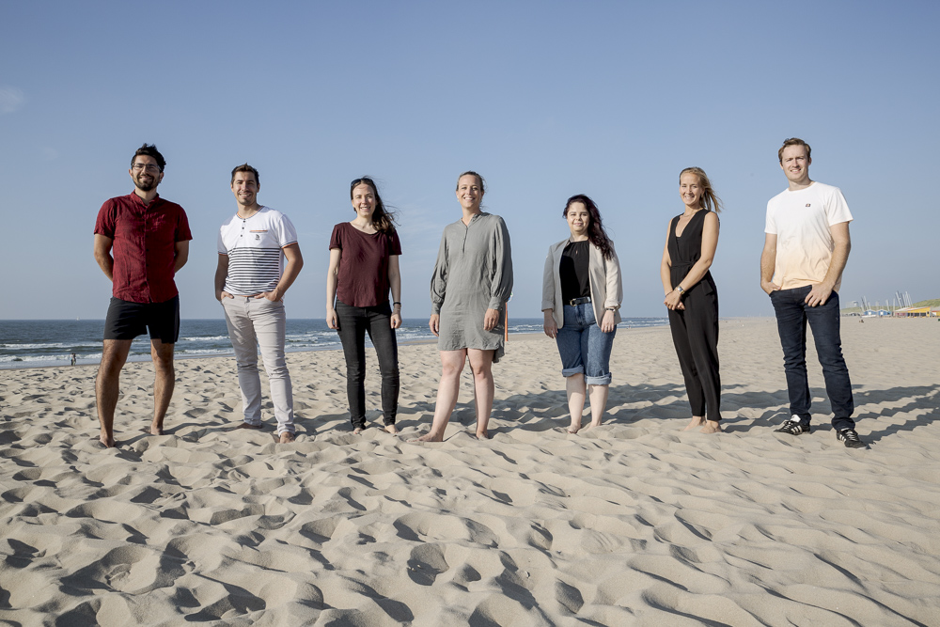
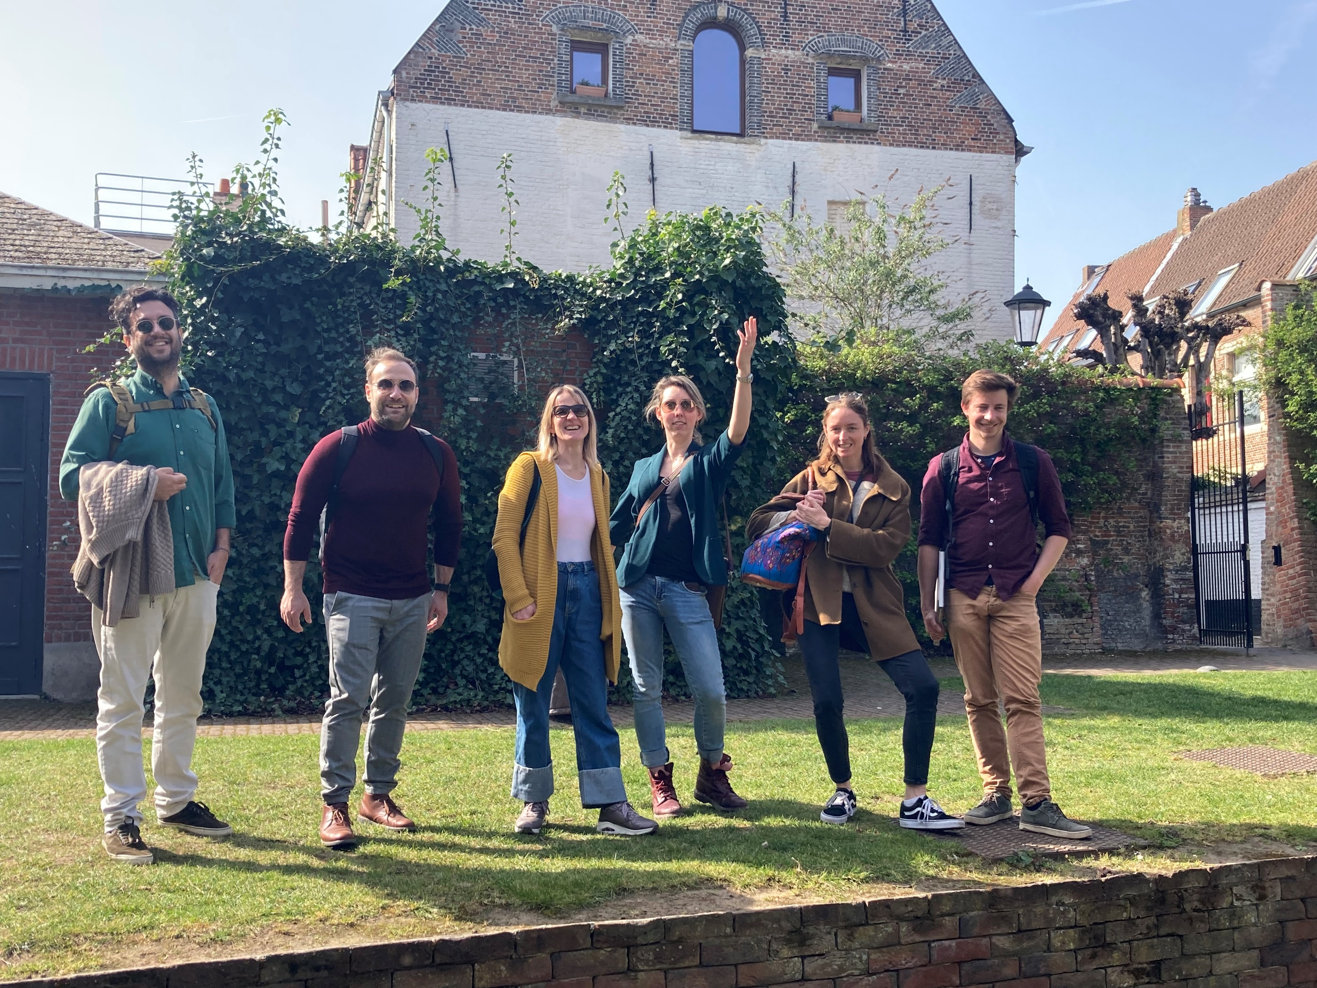
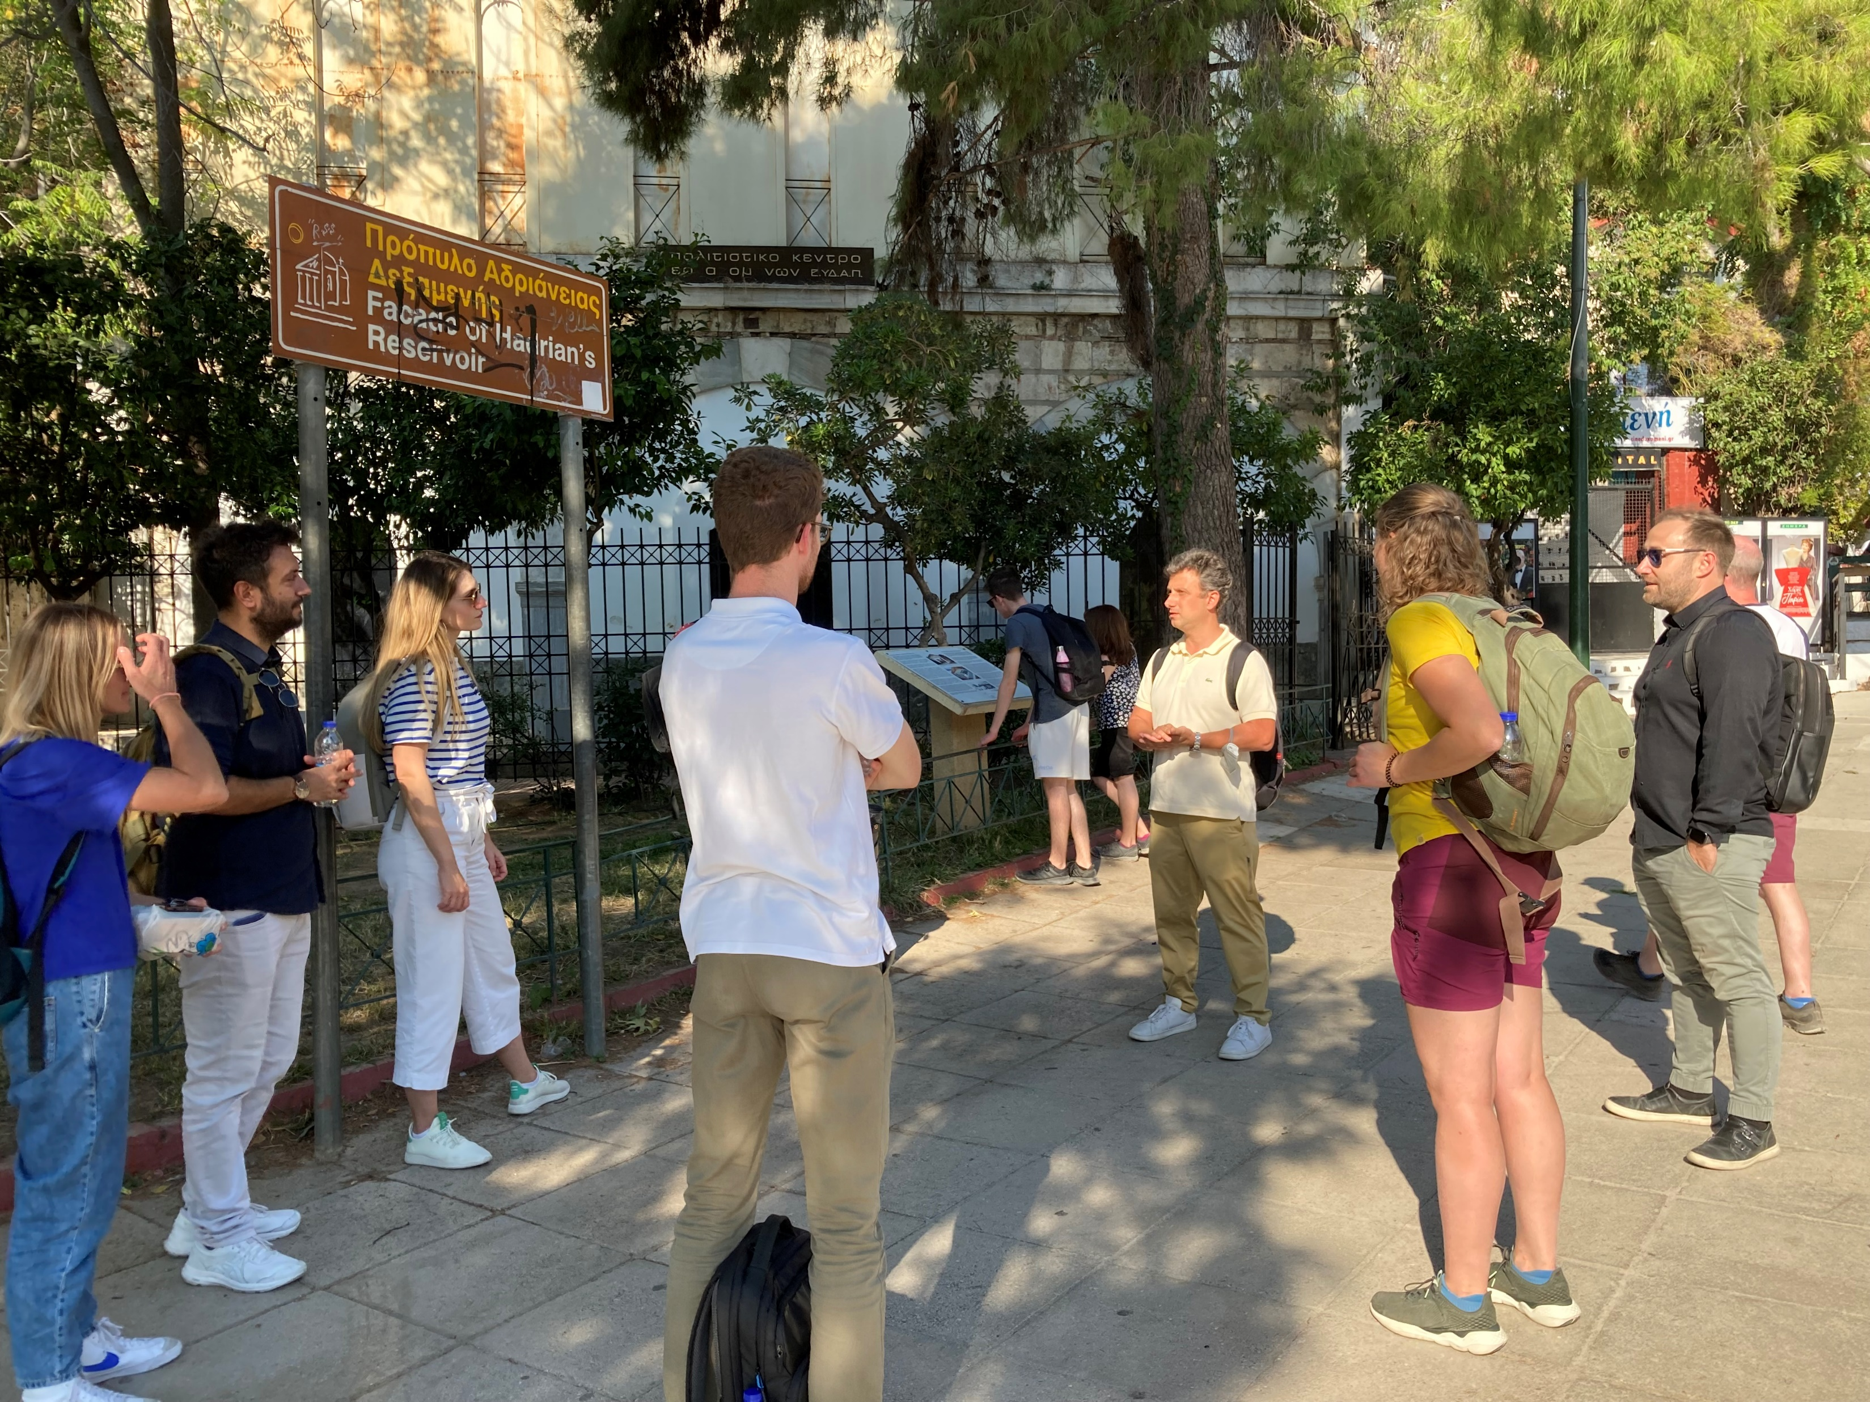

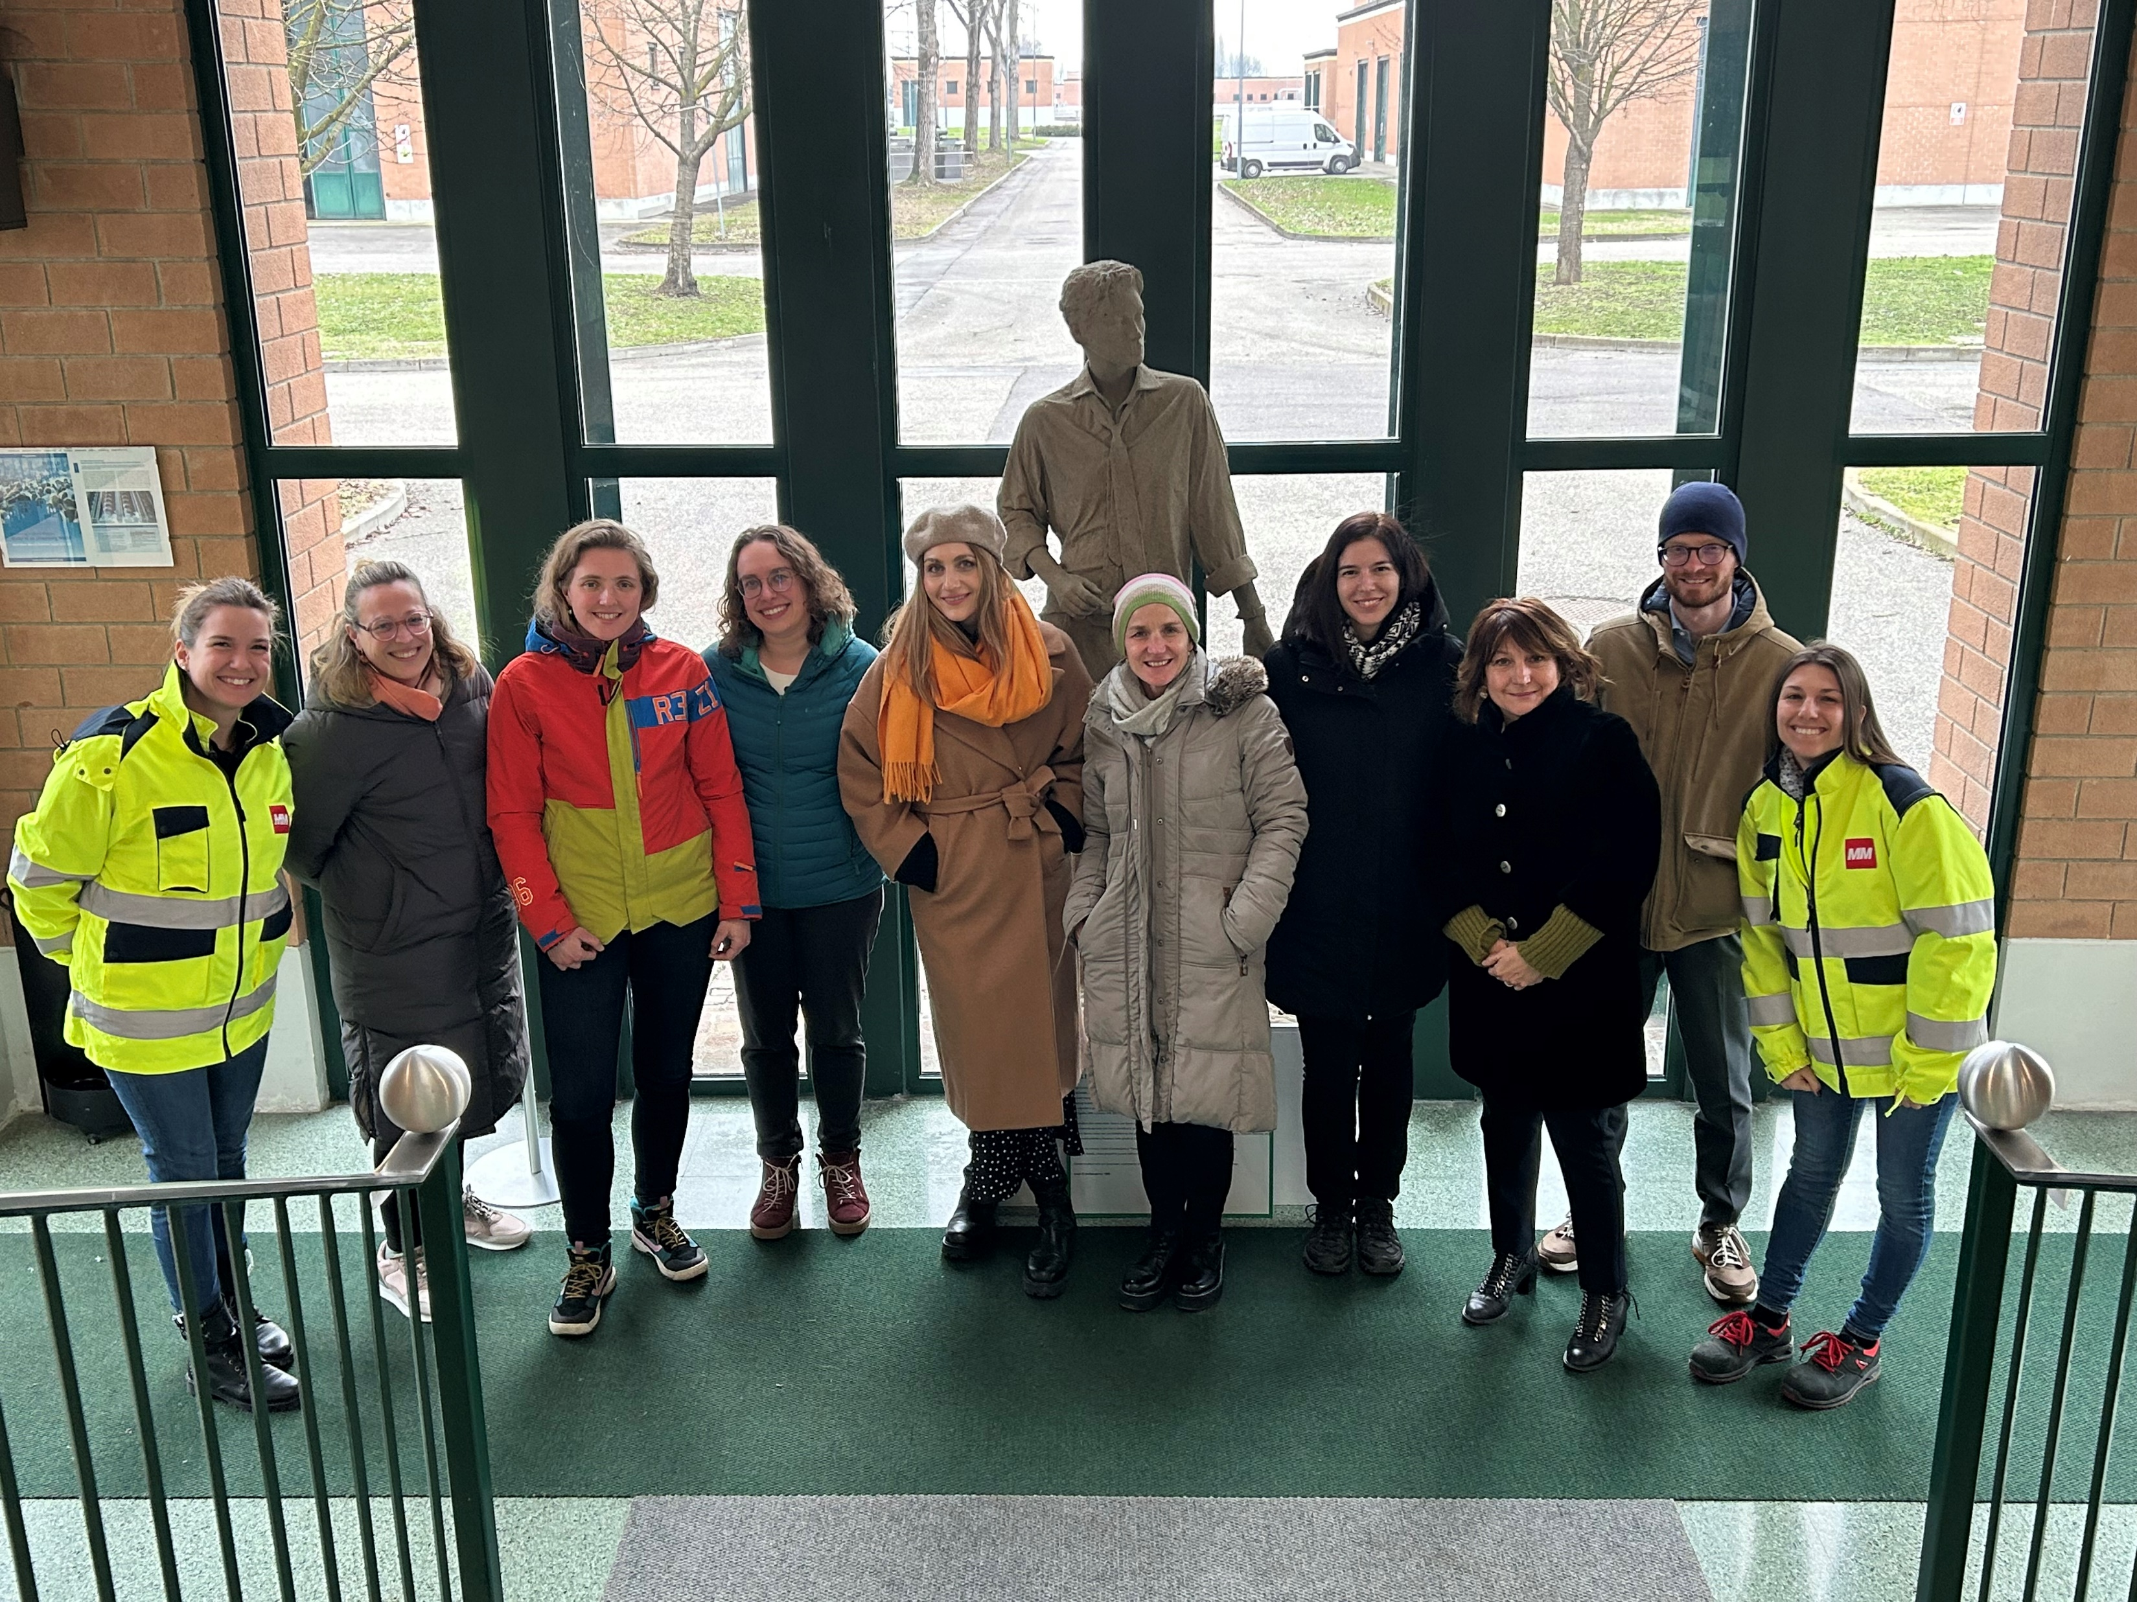
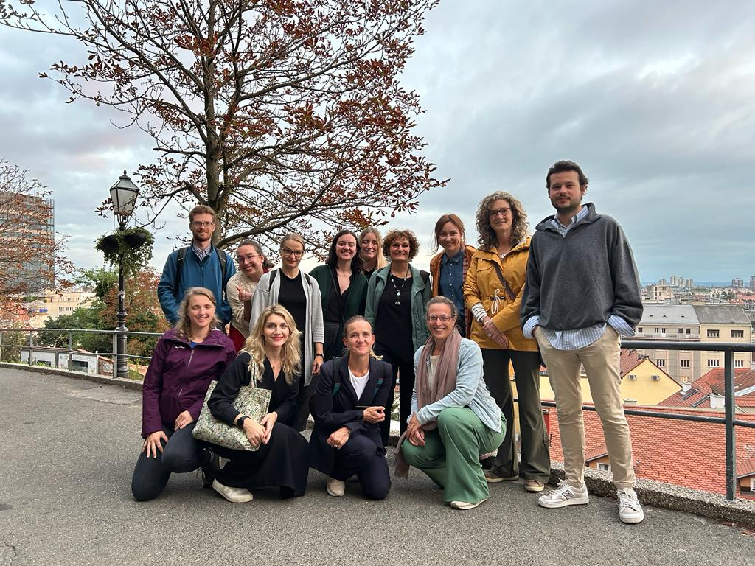
Welcome to the EJWP Community!
EJWP1: June 2029 – October 2021
EJWP3: November 2021 – October 2023
EJWP4: October 2022 – October 2023
EJWP2: October 2020 – December 2022
EJWP4: October 2022 – October 2024
EJWP5: September 2023 – October 2025
EJWP6: kick off May2024!
EJWP7: kick off March 2024!
Our Water Future Starts Here!

Slide 8
PERSONAL LEADERSHIP?
What is Personal Leadership?
What is Personal Leadership for you?
Why is it important?
Our Water Future Starts Here!

Slide 9
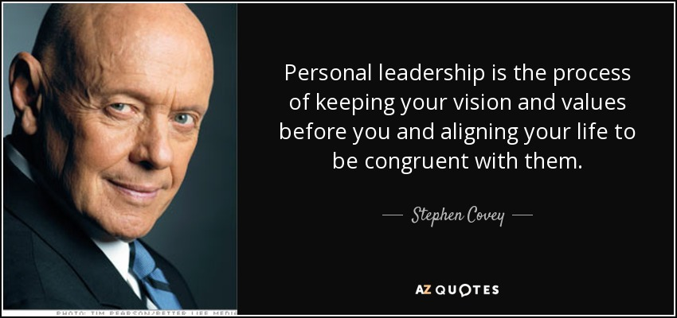

Slide 10
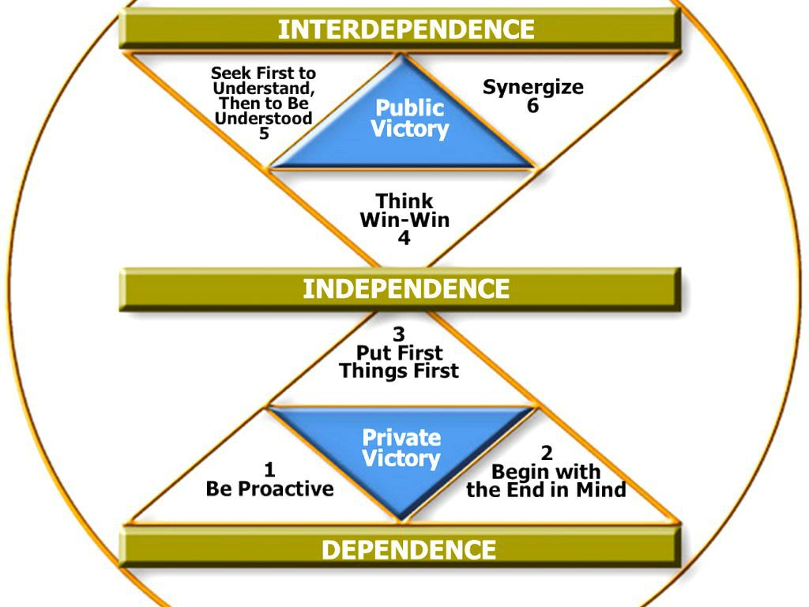
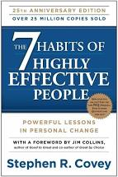
The Seven Habits…

Slide 11
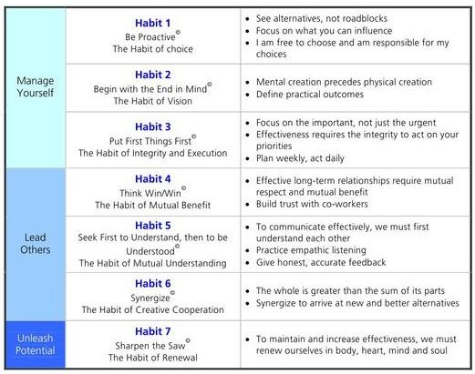

Slide 12

Habit 2: Begin with the end in mind The habit of vision

Slide 13
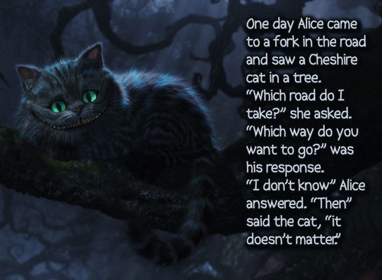

Slide 14
A twist to ‘begin with the end in mind’
Understanding oneself and each other through our life stories.
What kind of a child were you?
How would you describe yourself back then, or how would your parents describe you?
What was your position in the family? What kind of a roles did they have in your life, and you in theirs?
What did you enjoy to do when you were a child, what were you good at doing?
What was important for you when you were a child?
And these questions as a teenager?
And as an adult?

Slide 15
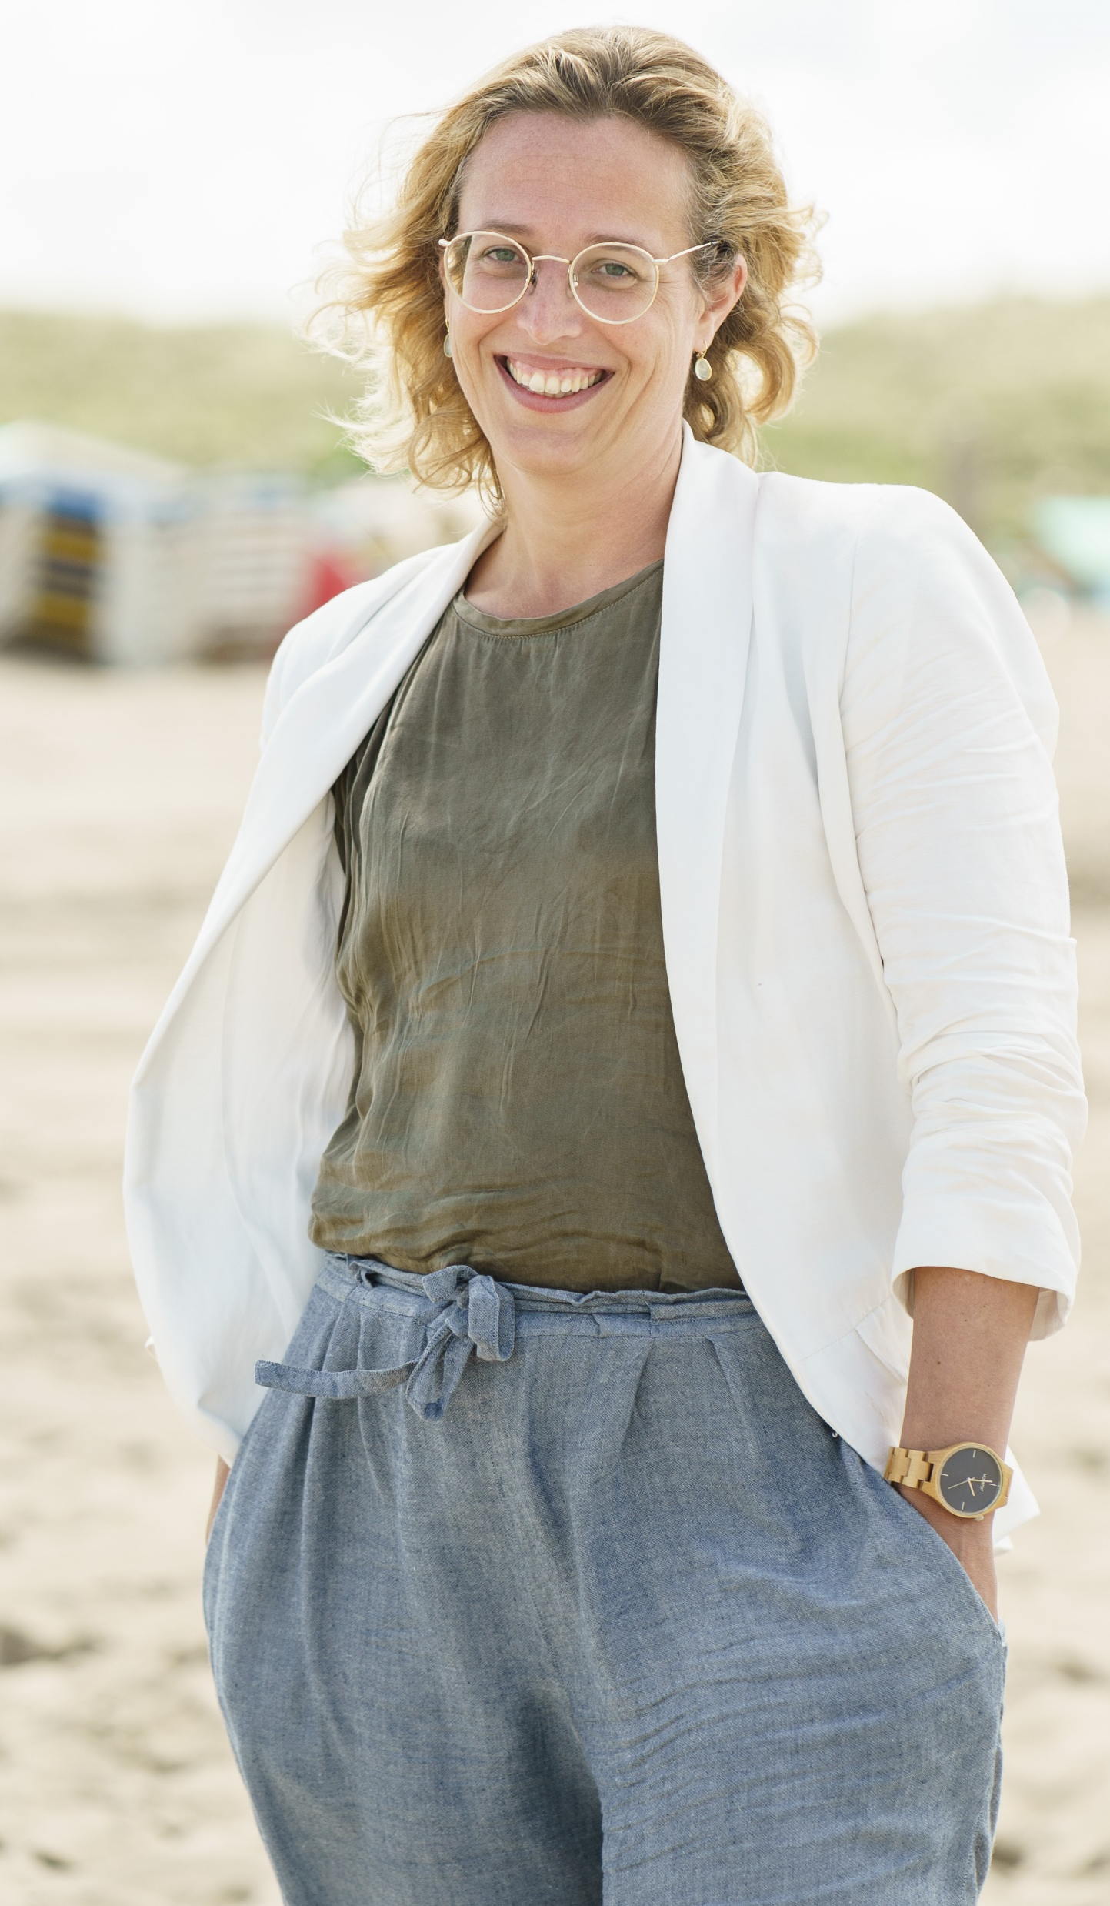
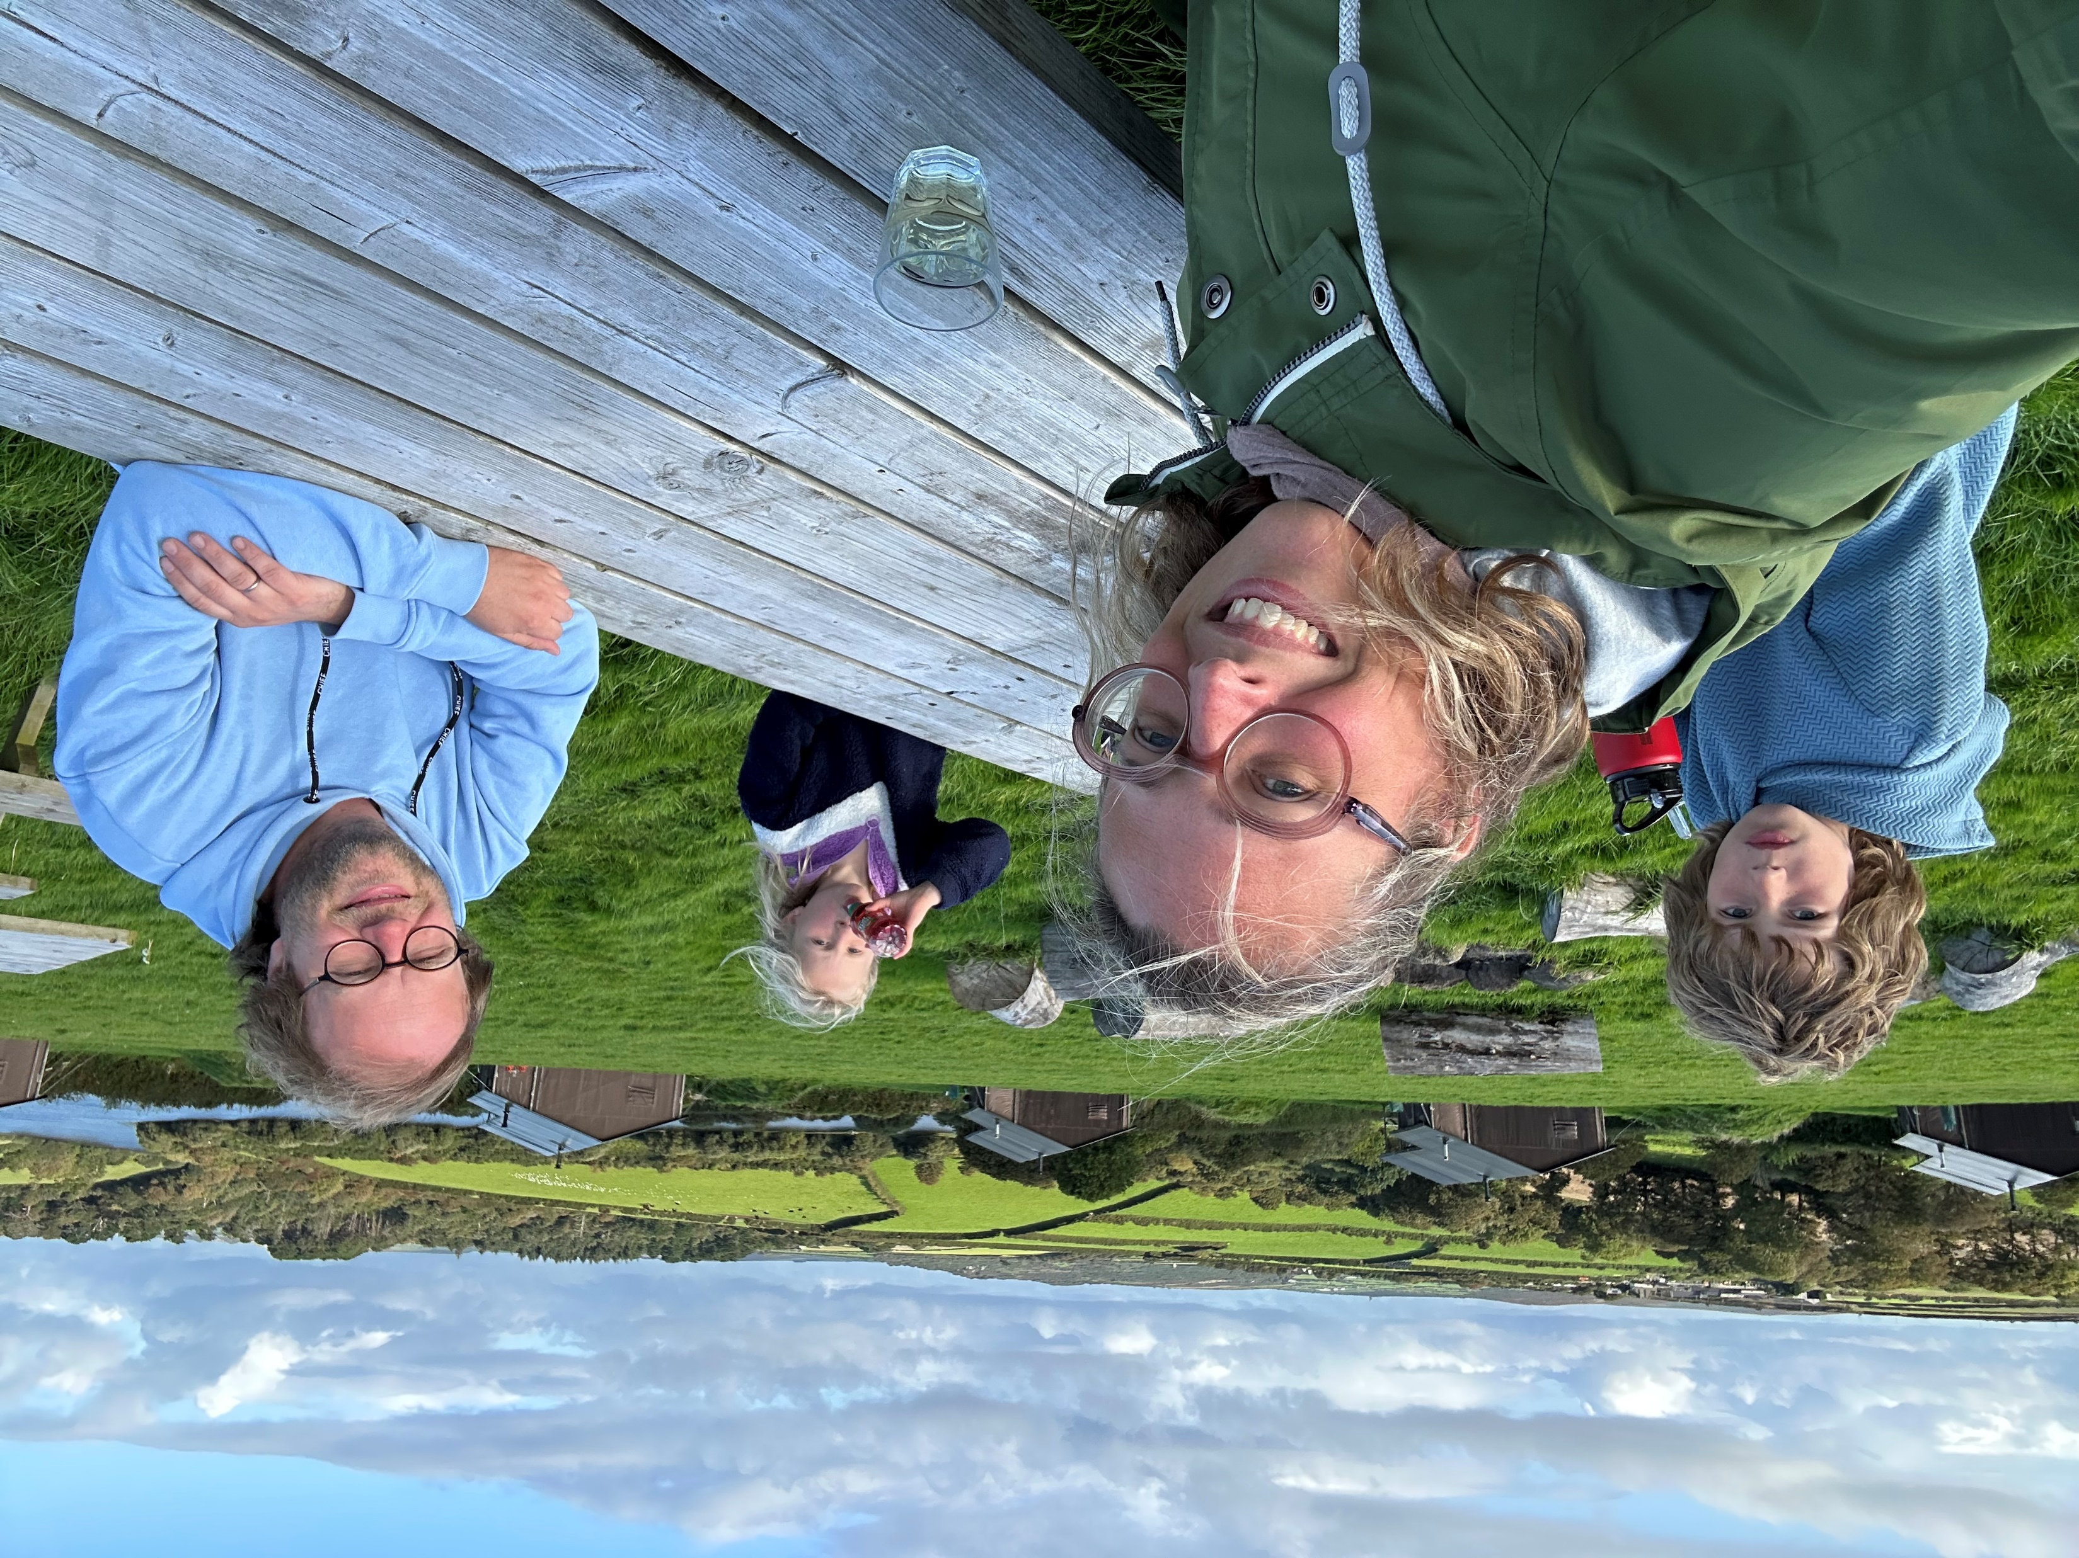
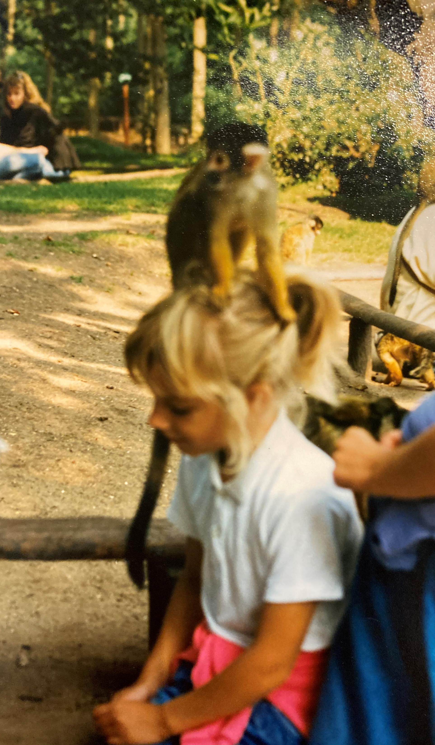
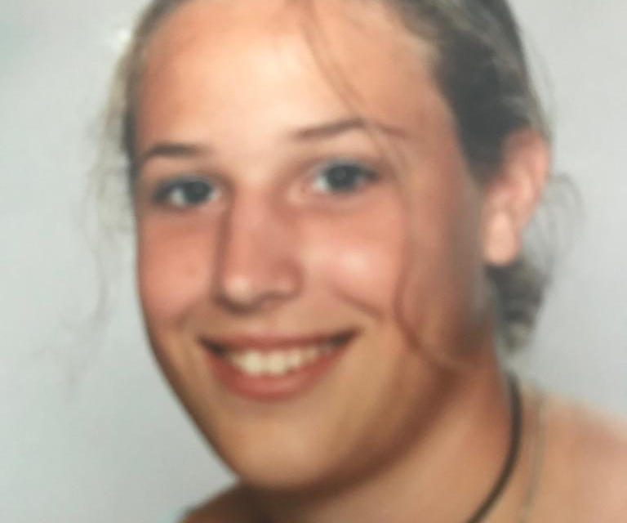
Notes:
I am Naomi Christianne Timmer, born in Amstelveen, The Netherlands? I have one older sister, Miriam; My parents are Peter, an accountant and Lidy, teacher in high school – first health and cooking at the lowest level in difficult areas, later she joing theology with me and became teacher philosophy / religion (past 2016, 4,5 yrs ago) – youngest, adventures.
I enjoyed climbing in trees, sports, ballet, outdoor, adventures, never to wild. I was also good in sports, smart/ intelligent (stopped at school when I realized)
Important for me was justice, fighting for those who were weaker, righteous - idealist
But I also had weak health when I was younger and got bullied in primary school, so I guess my parents worried about me on that.
As Teenager I freed myself from the bullies in a new school, after we moved to another place as well. I became very active in school (social stuff) and in this period my live was pretty easy. I was also an easy teenager. I do remember that I could became very angry when my health, ambitions and good advices from my parents (mainly mother) clashed. But after that we would always pick up the peace's together, in act and talking. She learned me how to move on when things got bad.
This is me now. Ambitious by myself and caring with the family. I am 41 now. Marcel my husband, Gijs is 9 and Myrthe 6. We moved 1,5 years ago from The Hague to Eesergroeb, from citylive to rural live and setting up a new business with my husband. Since end of 2019 independent entrepreneur, which has been a huge growing experience.
What do you see as the main thread in the story of your life, looking at your roles, your qualities and your values and your choices? The main thread in the story of my life is raising my voice when I feel something is not righteous. Still adventures and lucky with the place I life, been born and the people around me. I have been hurt in the process, insecurities, need for safety, but overall positive about worlds contribution and meaning in live. It creates a high amount of trust in people, open to the world, and fighter at the same time, based on equality and creativity we will find a way forward.

Slide 16
Habit 1: Be Pro active. The habit of choice

Slide 17

To be reactive or proactive?

Slide 18
Circle of influence
Direct influence (on our own behaviour)
Indirect influence (on the behaviour of others)
No influence (things we can’t change, e.g. our past, some aspects of our environment)
Serenity prayer of AA:
"God grant me the serenity
To accept the things I cannot change,
The courage to change the things I can,
And the wisdom to know the difference."

Slide 19
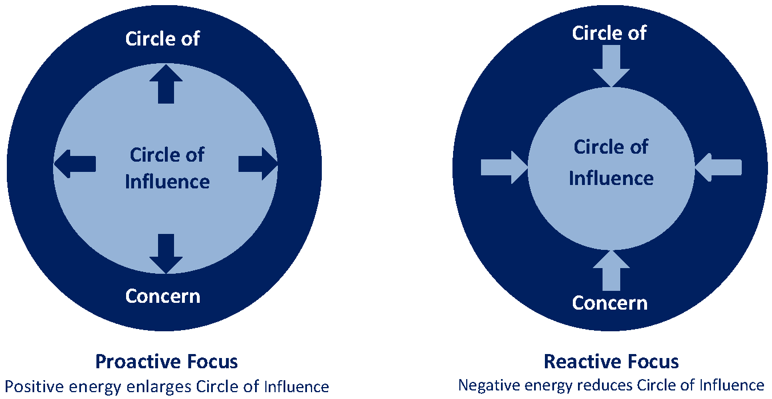
Circle of influence and circle of concern

Slide 20
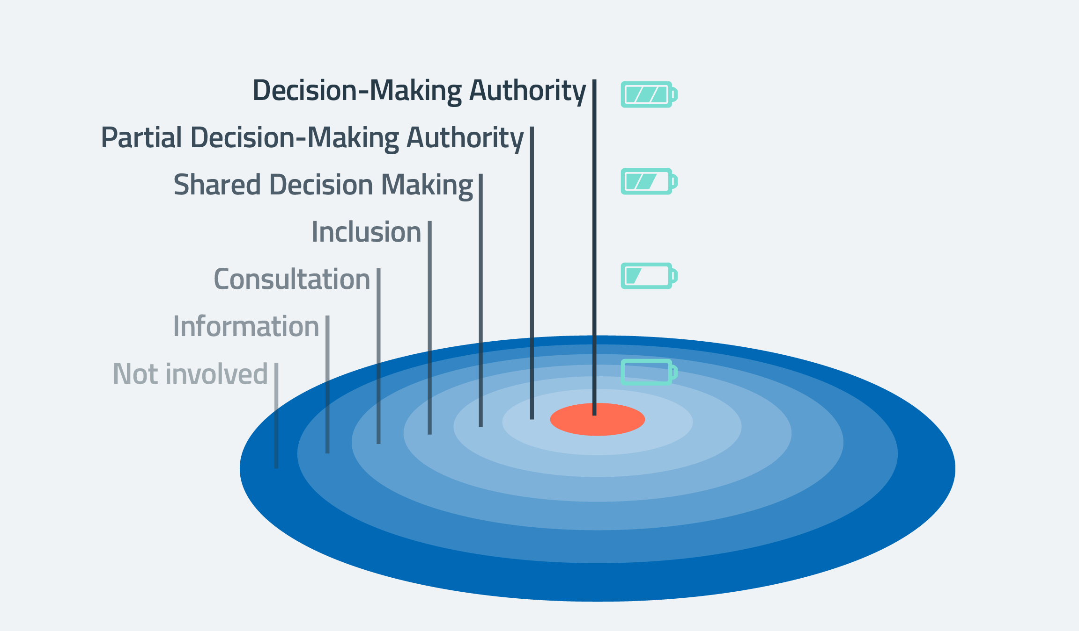
Why focus on circle of influence: energy

Slide 21

Difference between managing time and life
How do you manage your time?
How do you lead your life?

Slide 22
Habit 3: Put first things first. The habit of integrity and execution

Slide 23
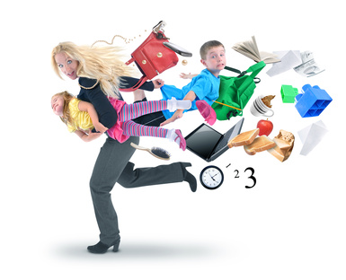
Focus and prioritizing
Now we will look at how we spend our time.
Make a list of activities that you spend time on regularly.
Write these on cards. Give it structure with colour coding. E.g.: work, private activities, voluntary work etc.
Put them in an order of how much time you spend on them.

Slide 24
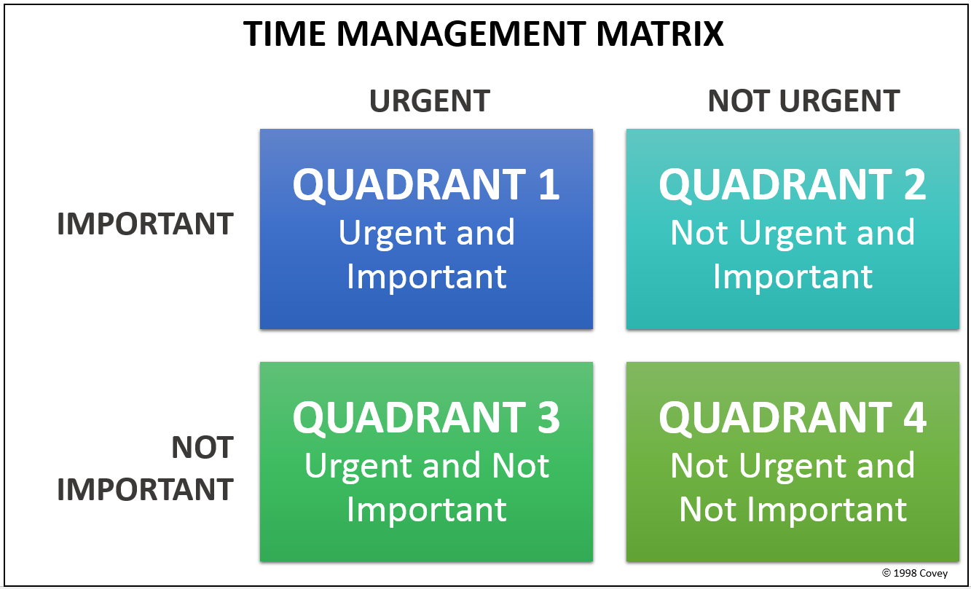
Eisenhower

Slide 25
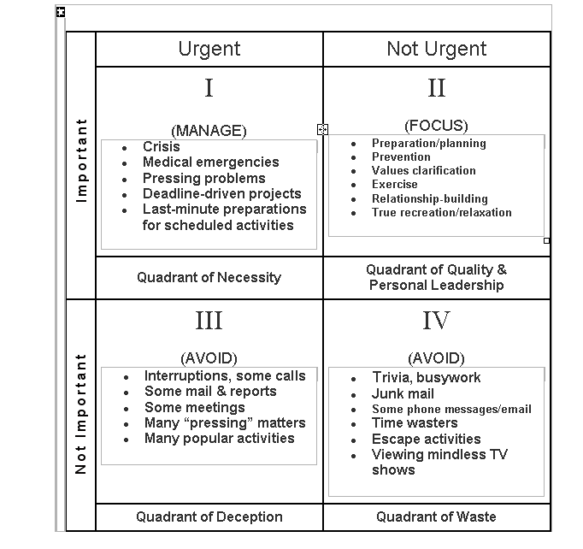
Examples
The sweet spot

Slide 26
Where can you do better?
Rearrange your cards in such a way that they make more sense to you in terms of spending time and energy.
What & How….can you change?
Name one thing that you can do (and don’t do yet) which would have an enormous positive effect on your work if you would do it regularly
Name one thing that you regularly do (and you beter should avoid) which has an enormous negative effect on your work
How do we gain and waist energy?
Make a list of activities/ responsibilities that give you energy and joy
Make a list of activities/ responsibilities that drain your energy and make you grumpy

Slide 27

Basic communication rules
Watzlawick Most well known of his axiom’s:
One cannot not communicate, therefore one cannot not influence.
Every communication has a content and a relationship aspect
=> Meta communication: communication about the communication. Relationship messages are always the most important in the communication.

Slide 28
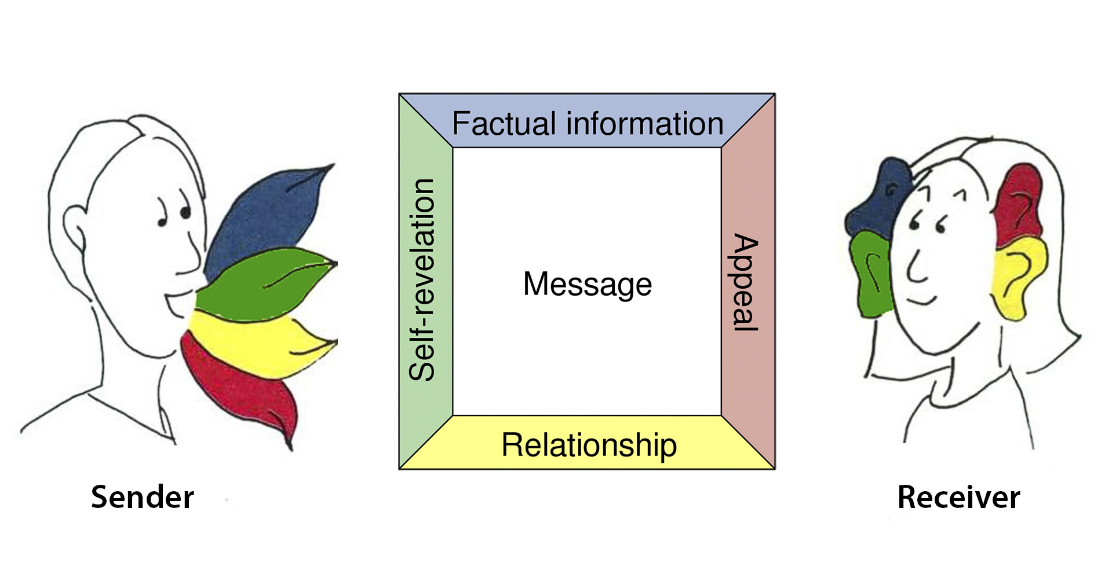
Schultz Von Thun

Slide 29
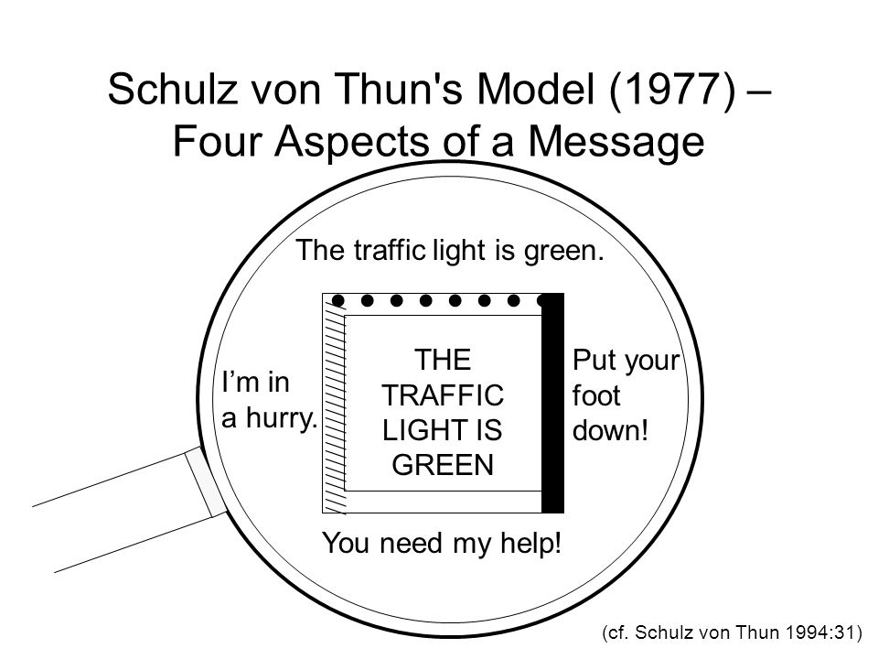

Slide 30
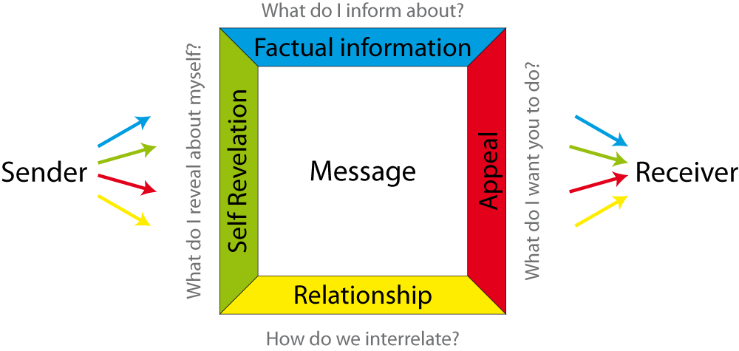
4 Dimensions in “Active Listening”

Slide 31
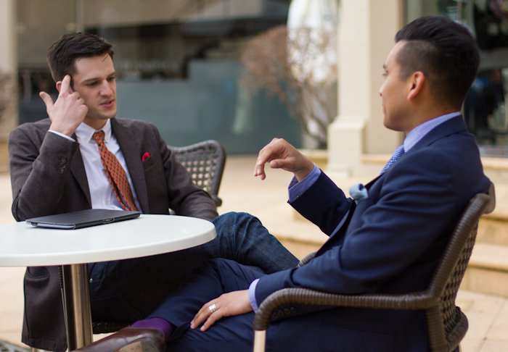
Verbal and non-verbal communication

Slide 32


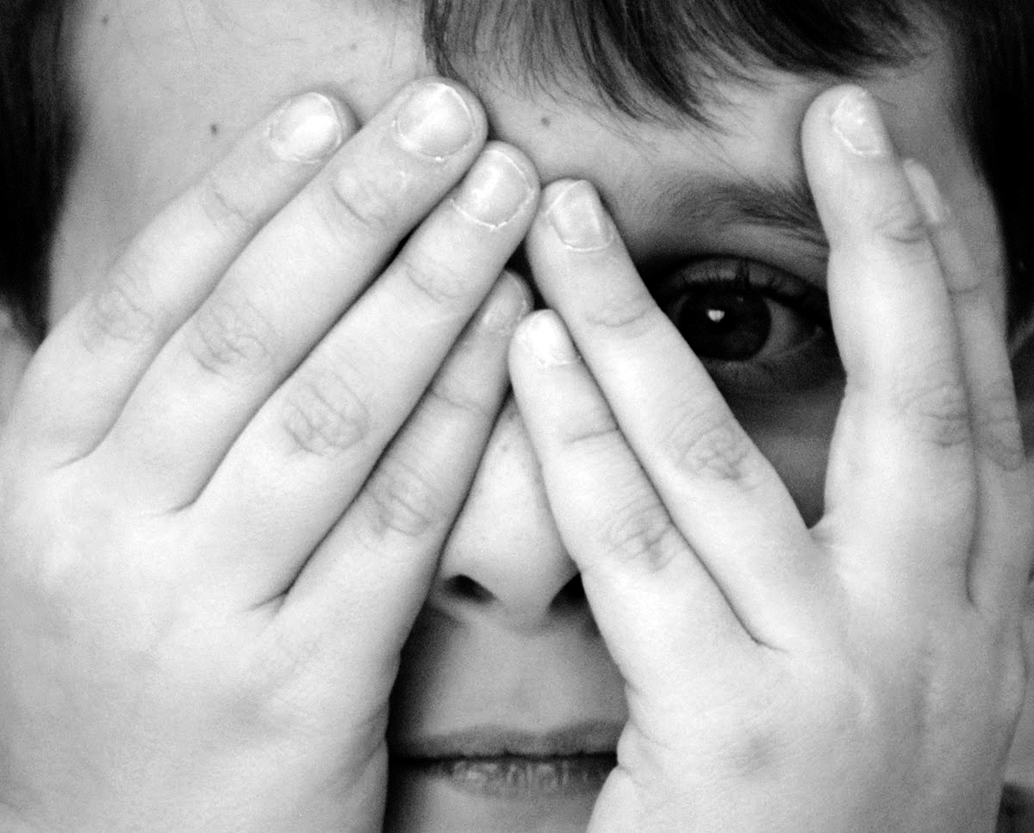
Reading emotions is culturally defined.

Slide 33
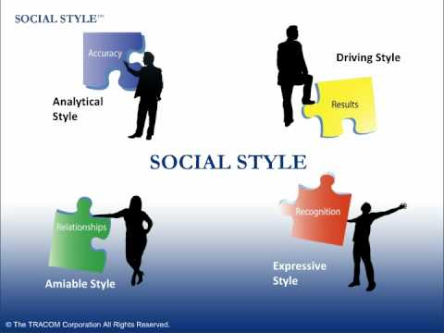
Social Styles

Slide 34
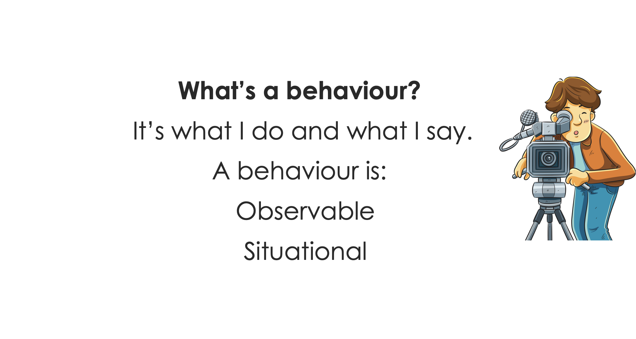
Social Styles

Slide 35
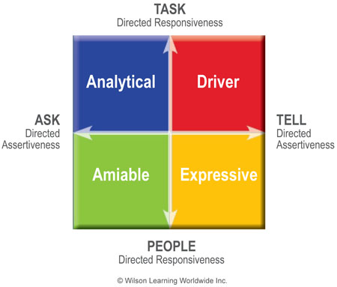
Social Styles

Slide 36
Social Styles
TASK
Process - Result Focused

Slide 37
Social Styles
TELL
Result - Ideas

Slide 38
Social Styles
People
Ideas-People

Slide 39
Social Styles
ASK
People-Process

Slide 40
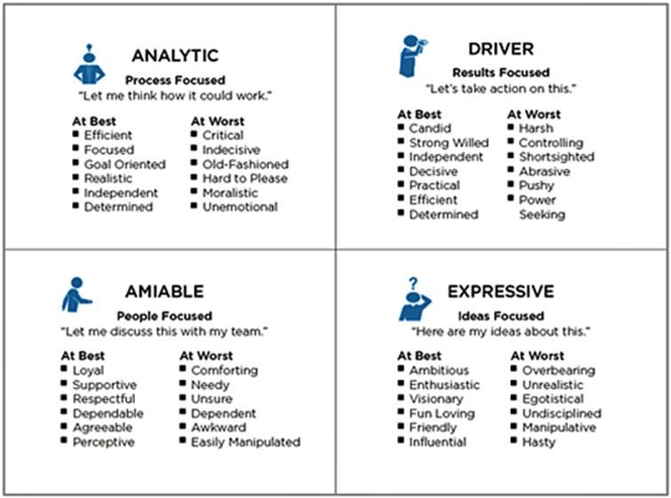
Characteristics of each style

Slide 41
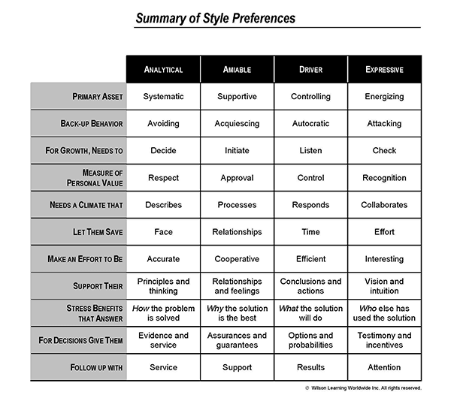

Slide 42
Programme training Day 1
Programme training Day 2
Recap day 1 & Check in
Challenges working with Diversity – LSP Workshop
Versatility in Communication
Inter-Cultural Communication
Using diversity in work
Setting objectives
InterVision
Check in
Personal Leadership
Life choices
Focus and priorities
Communication
Social Styles
Programme training Day 3
Field Trip
Multiplier Event on Soft Skills In EU Projects
Project Meeting

Slide 43
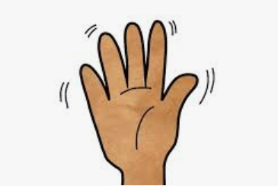
Check out
What will you keep from today?
What do you need to close this day?
Are there needs for a good start?
Notes:
How do you sit here?
What are your hopes and fears of this week?
What do you expect to walk away?
What will make this day successful – how would it contribute to your goal of the week?

Slide 44
Check in
How do you sit here today?
What was your biggest take away of yesterday?
What would you like to be different then yesterday
What are you’re expectations, hopes & fears of today?

Slide 45
Programme training Day 2
Recap day 1 & Check in
Challenges working with Diversity – LSP Workshop
Versatility in Communication
Inter-Cultural Communication
Using diversity in work
Setting objectives
InterVision
Programme training Day 3
Field Trip
Multiplier Event on Soft Skills In EU Projects
Project Meeting

Slide 46
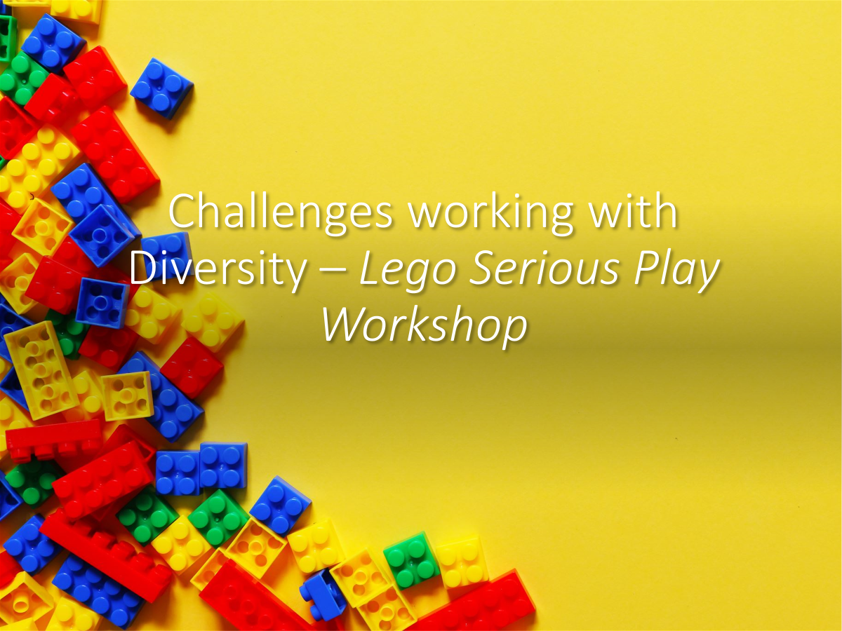

Slide 47
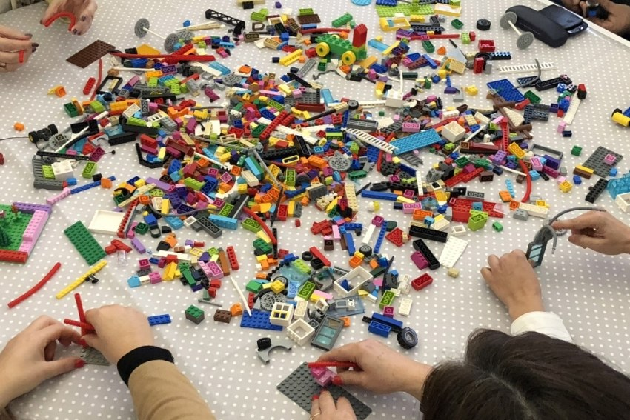
Workshop Agenda
Introduction to Lego Serious Play
Warming up…
Building a bit…
Storytelling…
Building a bit more…
Our vision to challenges and opportunities of working in divers teams
Deze foto van Onbekende auteur is gelicentieerd onder CC BY-SA

Slide 48
Stage 1
- every one bag with own bricks
- Invite all to build their own individual tower. Any tower…
- you might want to play some music while building is taking place
- Allow 3-4 minutes for the exercise
- Engourage people to build by reminding them: there is no right or wrong; if you don’t know what to build, just start and the story will emerge.
- Ask group to tell the story of what they have built. Each person must have a turn to tell their story without interruption from anyone else.
- you may ask about the models if you have time: why did they use a certain color brick OR why they have included a certain unique brick in their model
- Debrief with the group:
What did they notice about the models?
Were there any similarities?
What were the different approaches?

Slide 49
Stage 2: Modify the Lego Brick models
Ask group to adapt or modify their models in response to this challenge question:
What are the strenghts that you bring to this team?
What do you bring to this organization in terms of your skills, esperience & knowledge?
Give participants 3-5 minutes to build their repsonse to the challenge question individually
Share the stories again

Slide 50
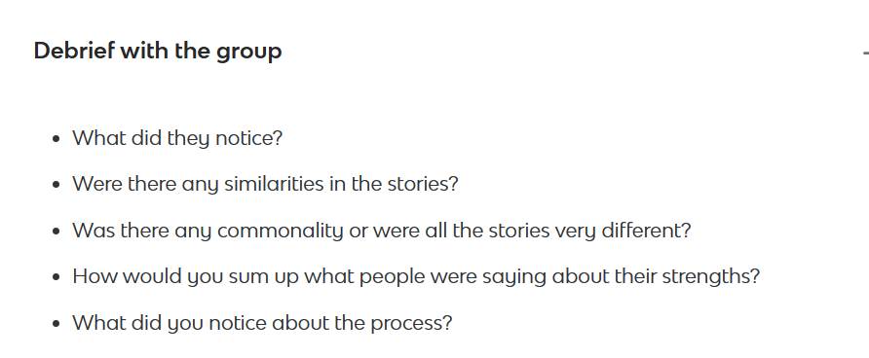
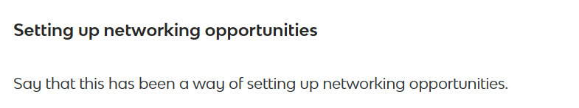
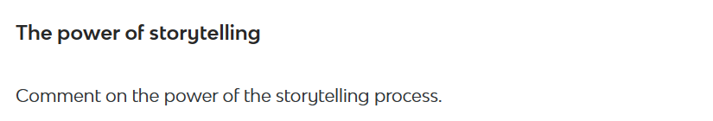
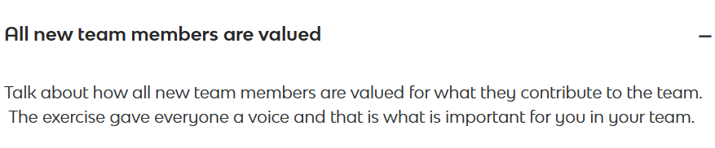
Stage 3: Final step - debrief

Slide 51
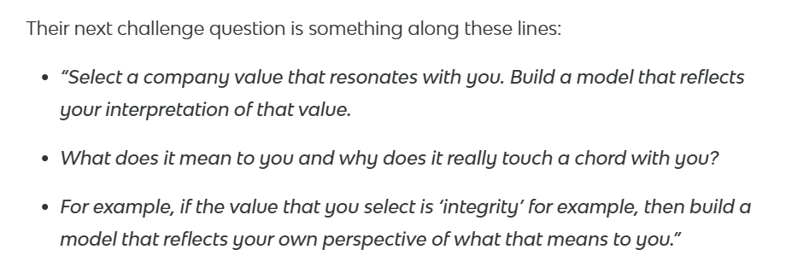
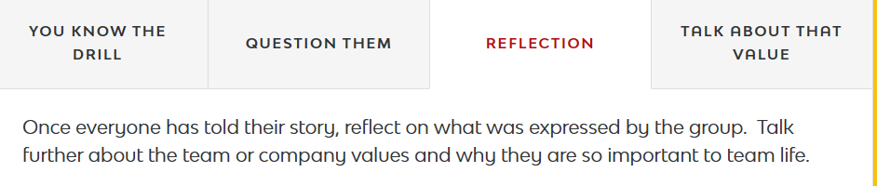
Another challenge question
Ask group to take down their models in preparation for building a new model. They might want to take a photo to remember
Write down/ have slide with organizations values on it
Select next challenge question
Work on it 5-6 minutes to build models
Share/ exchange

Slide 52
Optional: Take one step further
Invite all models at the centre of the table
Ask to form the models into a ‘super-story’that includes all individual models. Can be in circle or straight line for example.
No model can be left aside.
Agreement – invite one person to share collective story
Powerful way to bringing sessions together: it requires people to work together, reach consensus and themn rely on the power of story-telling + embeds story in long term memory. People wo have participated in the activity will never forget their stories and how they are alligned with your values.

Slide 53

Wrap up

Slide 54
Social Styles

Slide 55
Communicative versatility
Focus on content not on emotions
Talk less, listen more
Restrain enthusiasm
Make decisions based on facts not a 'hunch'
Stop and think
Get to the point
Don’t be vague or ambiguous
Be willing to disagree
Take a stand
Initiate conversation
Ask for other’s opinion
Acknowledge their viewpoint
Listen without interruption
Let other direct the flow of the conversation
Be deliberate, don’t rush
Verbalise feelings
Express enthusiasm
Give personal compliments
Spend time on relationship
Use non-verbal communication

Slide 56
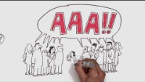

Slide 57
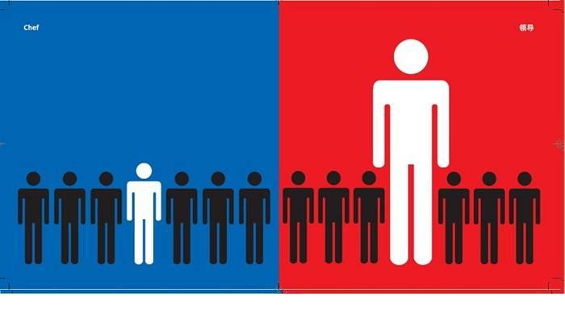
Training Intercultural communication

Slide 58

6 ways of decicion making in teams
Authority rule: leader makes the decision
Minority rule: small amount of team members dominate the discussion and ‘railroad’ the team.
Majority rule: Polling or voting
Consensus: like majority rule but with more sharing of views and discussion.
Unanimity: all members agree
Delegated decision making: authority is assigned to specific team members for specific issues.
Notes:
Timbuktu exerzise

Slide 59
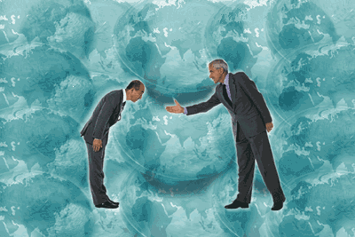
Framework for Communication, Culture & Behavior
“In their nature all people are the same, it is their habits which makes the difference” Confucius

Slide 60
What is Culture?
A social system, which influences;
The way we live
The way we think
The way we communicate
The way we organize
The way we perceive

Slide 61
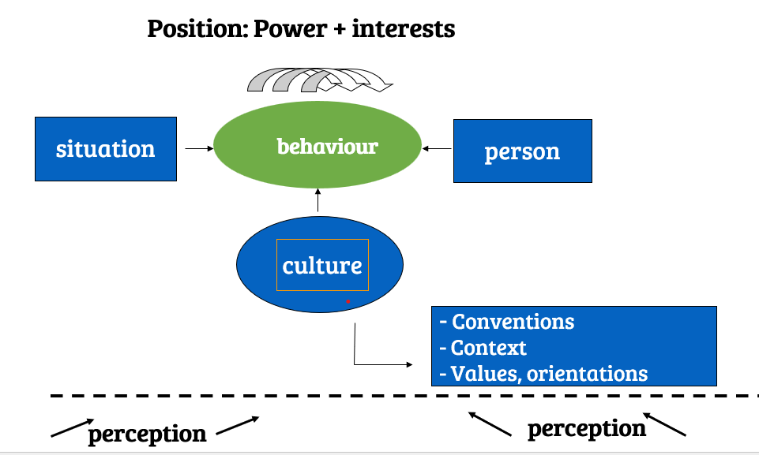
Intercultural Explanation Model
How we behave and how we perceive the behaviour of others is defined by several aspects:
The situation
The characteristics of the person him/herself
The power/ position of the person and his/her interests
The expectations defined by cultural aspects like values and conventions.
Note that all in in the eye of the beholder. It’s all about perception!

Slide 62
Intercultural perception processes
1. Social categorization: Ingroup versus outgroup: we see individuals as members of a group
2. Stereotypes & prejudice: Ethnocentrism: “The feeling that one's group has a mode of living, values and patterns of adaptation that are superior to all others” (M.H.Bond, 1995).
3. Attribution: What do I make of the behaviour that I perceive? What is my interpretation?

Slide 63
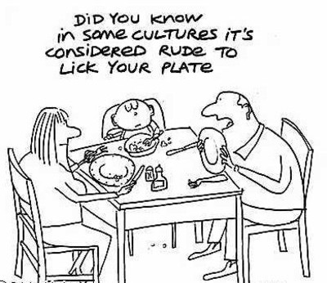
Culture as a basic set conventions, norms, habits & rules
Conventions
are agreements about how to behave in specific situations
are related to interpretations of behaviour

Slide 64
Scripts
A sequence of events which takes place along the line of implicit and explicit conventions
Scripts coordinate social actions: in case of differences in or misunderstanding about scripts cooperation becomes difficult

Slide 65
Characteristics of conventions & scripts
Pertain to behaviour
Situation specific
Vary across nations, regions, groups
Have an obligatory character
Infringement is noticed
Infringement results in surprise embarrassment, sanctions

Slide 66
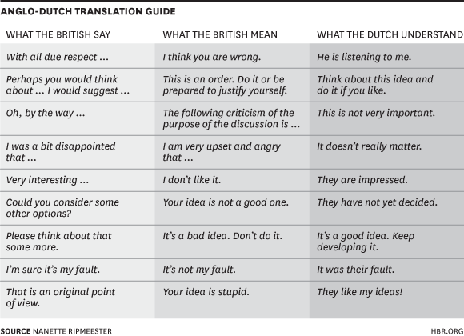
Language

Slide 67
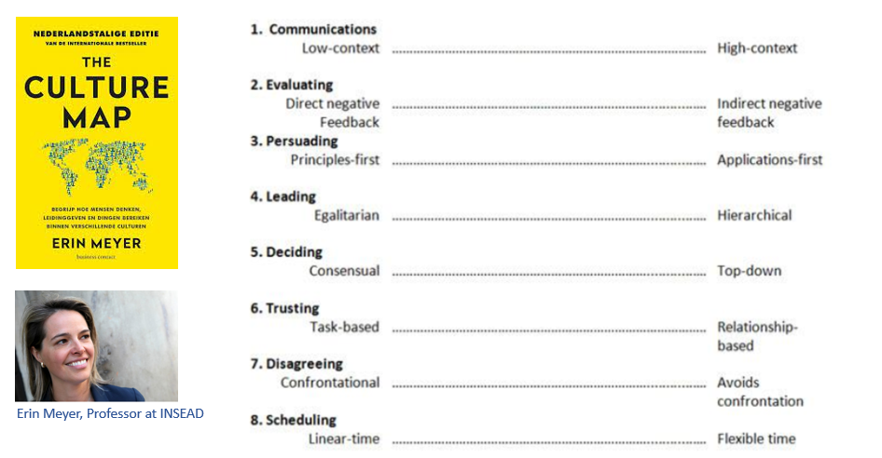
The Culture Map: Erin Meyer

Slide 68


Slide 69


Slide 70


Slide 71


Slide 72


Slide 73


Slide 74


Slide 75



Slide 76

Mapping the SKILLS4Water Consortium

Slide 77

Using Diversity
Inclusion: Beyond Us and Them
What happens when someone who is different then the rest joins your team?
For one, it creates discomfort, whether you like it or not. After all, we like people who are similar to us.
But these 'natural' preferences can cause fragmentation. This might be one of the major pitfalls for future transformation into adapting to a through NEXUS approach.

Slide 78
Assignment
Figure out for yourself to what degree do you feel in sync with your own cultural background? Where does it align, where does it differ? What is the effect of that in your (working) life?
Try to relate the social styles to the cultural dimensions.
Where do you see characteristics of Driver, Expressive, Aimiable and Analytic –styles in the cultures?
Name one country per style that you find very fitting and explain why.

Slide 79

Using Diversity

Slide 80

Making Use of the Wisdom of the Minority

Slide 81

Do’s & Don’ts of Inclusion

Slide 82
Using Diversity for Change
How do we create true collaborations?
How do we start co-creation and co-responsibility in divers teams?
How do we find solutions that include existing diversity up to and throughout the convergent phase of decision-making? And up to execution?
You have to keep everyone on board, but can't make everyone happy - hard choices have to be made.
How to be sure your taking all knowledge of the community into consideration?
Do we make enough use of all the knowledge there is?

Slide 83


Slide 84

Conflict and / or Diversity?
Tension and conflict is given a bad reputation; they are however opportunities for transformation.
Myrna Lewis has designed the 'U+Me Let's Talk' process to enable you to face foes, resolve the conflict, improve the relationship and gain personal growth.
Myrna is a leading thinker and practitioner in the field of transformative leadership and facilitation.
She together with her late husband Gregory Lewis a co-founded the Lewis Method of Deep Democracy whilst assisting South Africa's utility company transform from an Apartheid driven organization to align with South Africa's new democracy.
In the Netherlands this is made accessible for organizations by Cultural Anthropologist: Jitske Kramer

Slide 85


Slide 86
Diversity & Inclusion in a Jam Session
Magnifying the differences is the best way to make them manageable.
Focus on the contradictions.
Inclusion is a joint effort.
Openly support the person in the group who dares to stick their neck out.
Say what you do want. It doesn't have to be either-or; it can be both.
Change up the rhythm. Treat it like a Jam Session and Improvise (Jitske Kramer)

Slide 87
How to deal with miscommunication? – Towards inclusion
Postpone your interpretation
Check: ask the things you don’t understand
Decide where and how you can adapt to the other person
Indicate your own boundaries and communicate when necessary: what feels right and what not

Slide 88

Check out
2 min. in silence reflection
Circle.
When you recognize take one step forward.
Pop-it-when-you-re-hot.
- Biggest take away? - Needs to close this session?

Slide 89

What is interVision?
Definition interVision (co-worker consultation)
A systematic approach to work related issues.
With a small group of people.
It is a means to improve the quality of the profession.
The focus is on the personal aspects of the issue, not on the content. ,,Why is this an issue for me, at this moment in my career?’’

Slide 90

Objectives for interVision
Learning together.
Empowering a person by focussing on what lies within your circle of influence.
Signalling general issues and addressing them where they can be solved.

Slide 91

General structure for process
Choosing a case
Analysing the issue
Reflection on the core of the issue
Exploring possible actions/advice.
This structure ensures depth and prevents solving symptoms instead of dealing with the true issue at hand.

Slide 92
Five step-method
Phase | Description | Time indication:
 | Introduction to the method
0 | Inventory of the cases: The group does an inventory of the cases. A selection is made and prioritised on a flip chart. | 10 minutes
1 | Round 1: The case owner tells about the context of his/her case and concludes with a short formulation of the question. | 5 minutes
2 | Questioning: Participants ask questions that are directly answered by the case owner. After answering the questions, reflect as a group if the all levels of the Iceberg were covered. If not, additional questions can be asked. | 10-15 minutes
3 | Reflection: The participants give their view on the core of the issue. These are noted on a flip chart. The case owner reflects on these and gives his/her own (new) view on the core of the issue. Also, the case owner tells whether he/she wants advice in this. (It might already be enough to reframe the core of the issue. | 10 minutes
4 | If wanted: Advice: The participants give short, clear advices. These are noted on a flip chart. | 5 minutes
5 | Round up: The case owner shares what these advices mean to him/her and what (s)he is going to do now. Other participants share what they have learnt from the session. | 5 minutes
 | Time needed: | 45-60 minutes

