Slide 1

Training week 3 SKILLS4WATER Innovative Training Programme
EJWP7: March 2024 - August 2025
19-21 November 2024, Muenster, Germany

Slide 2



SKILLS4Water training program
Week 3
19-21 November 2024
Tuesday | Check in & Introduction ACEEU Training Leadership the basics Field trip Muenster
Wednesday | Training Cooperation & Co-creation
Thursday | Innovative Sprints on Skills4Water Workpackages Using Methodologies for the project, incl InterVision Check out

Slide 3
Programme training Day 1
Programme training Day 2
Recap day 1 & Check in
Leading a Team
Collaboration & Cocreation
Check in
Views on Leadership
Focus on Professional vs Manager
Who needs which support?
Field Trip
Programme training Day 3
Innovative Sprints on WP5, 1, 3 & 4
Including
new methodologies
using Soft Skills in Project Work
InterVision
Check out

Slide 4

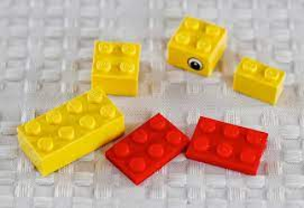
What pond do you come from?
How do you sit/ swim here?
What are your expectations and needs of this training week?
What are your hopes & fears for the programme?
Tell us about your duck and where would you place your duck in the EJWP Pond
Check in
- What the Duck…???

Slide 5
Rules for these days:
Be proactive
Do what is important
Be focussed (make time for the programme)
Be prepared
Take care of oneself and the others
Confidentiality: what happens in the training, stays in the training

Slide 6

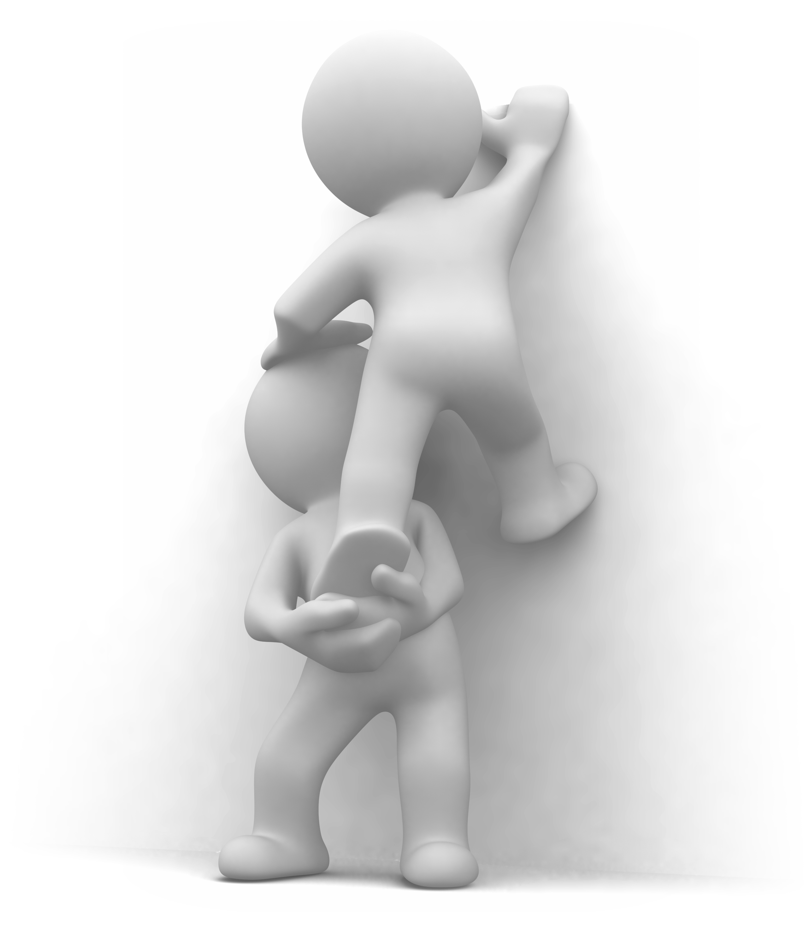

Leadership

Slide 7
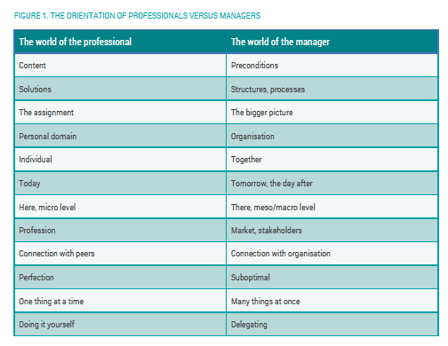
Focus

Slide 8
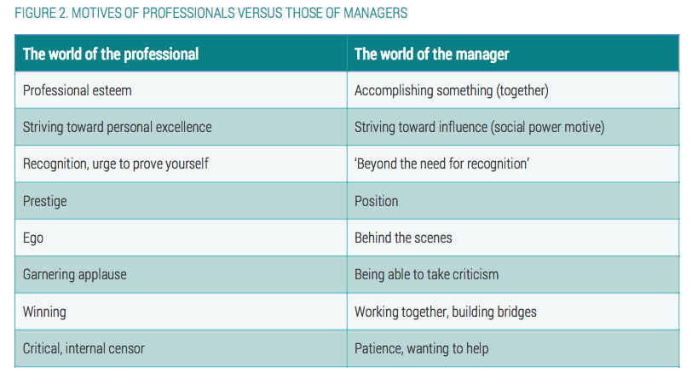
Focus

Slide 9

So, which shift does the professional becoming manager need to take?

Slide 10

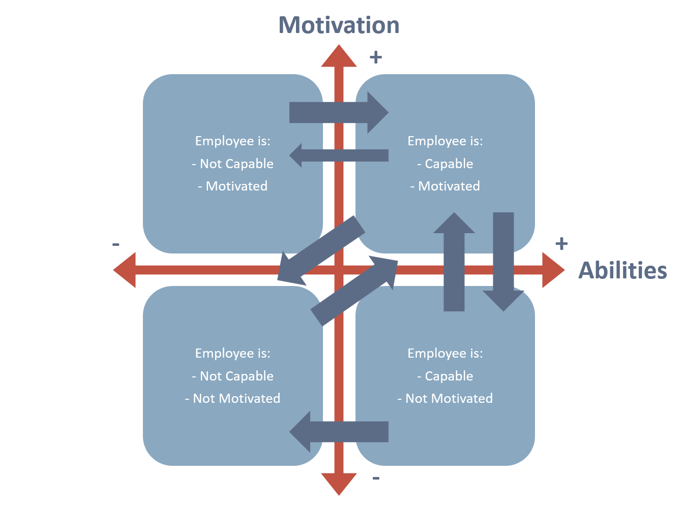
Situational leadership: Skill/will matrix

Slide 11
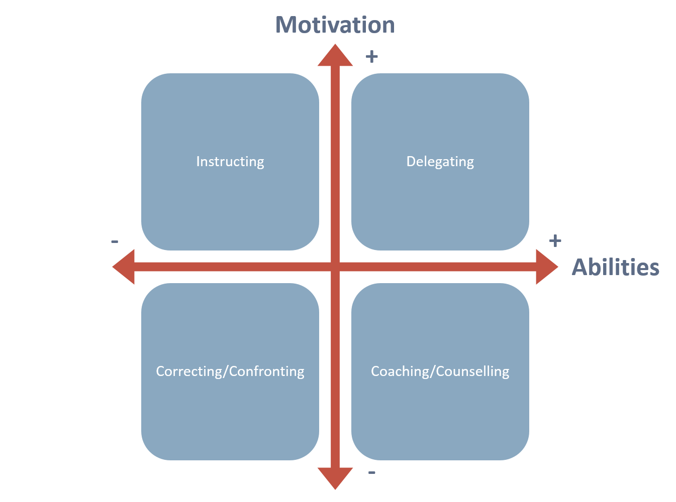
Situational leadership: Supporting styles

Slide 12
Instructing
Share overall goal
Check knowledge/skill already acquired
Describe or show steps to take
Ask other to repeat
Let other perform, supervise
Check extra needs

Slide 13
Delegating
Share overall goal
Ask for ideas how to attain goal
Check willingness to act
Check if further support is needed
Share with others that task is delegated to this person
Let go

Slide 14
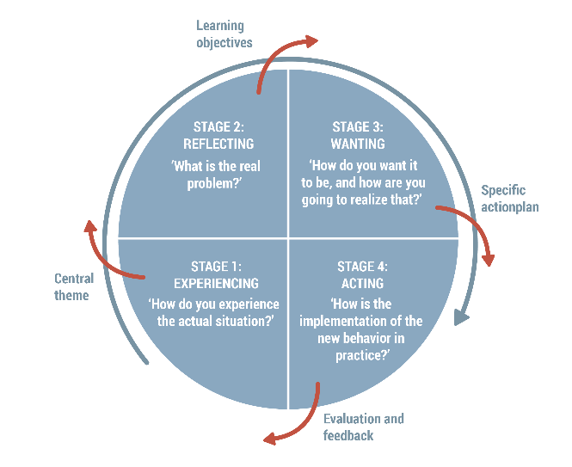
Coaching

Slide 15
Coaching circle stage 1 questions: Find out facts
‘Who? What? When?’ questions
What is/was happening?
Can you give an example?
What is/was the situation?
Who is/was involved?
What did you do?
What happened?
What did you say then?
And then?
What was the reaction?
What do/did you want to achieve?
What was your task?

Slide 16
Coaching circle stage 2 questions: Expand/investigate
What is/was the problem?
What are you experiencing/did you experience?
What is/was actually happening?
What is holding you back/held you back?
What is it doing to you/did it do to you?
What do you/did you feel?
What would happen if...?
What is bothering you?
What are you afraid of?
What is your (true) dilemma?
What makes you...? Why is...?
What is actually the core?
Possible end of stage 2: mirroring/’mild confrontation’

Slide 17
Coaching circle stage 3 questions: Explore options
What are the options?
What does your heart say?
What are you thinking of?
What could you do?
What would it be like if...?
What are the advantages/disadvantages of A or B or C?
What would happen if...?
What gives you the most satisfaction?
What fits best with you?
Possible end of stage 3: give advice (do not prescribe but suggest)

Slide 18
Correcting/ Confronting
Behavior
Effect of this
Your feeling about this
Wished actions
Give feedback
Check if undesired behavior is due to lack of guidence from your/organisations side!

Slide 19

Wrap up

Slide 20
Training week 3 SKILLS4WATER Innovative Training Programme
EJWP7: March 2024 - August 2025
19-21 November 2024, Muenster, Germany Day 2

Slide 21
Programme training Day 2
Recap day 1 & Check in
Leading a Team
Collaboration & Cocreation
Team development
Phases
Role of team lead
Role of team members
Cross boundary teamwork
Dysfunctions of a team
Self organising teams and the role of team leader
Extra challenges for intergroup cooperation
Flock management
Evening: InterVision

Slide 22

Check in
How do you sit here today?
What was your biggest take away of yesterday?
What would you like to be different then yesterday
What are you’re expectations, hopes & fears of today?

Slide 23
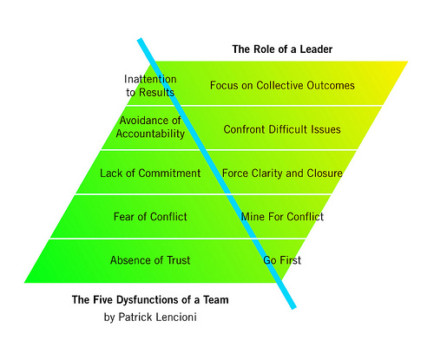
Lencioni: 5 dysfunctions of a team

Slide 24
Steps to discuss team interactions
Clarify goal
Define roles
Discus rules of conduct
Interdependence

Slide 25
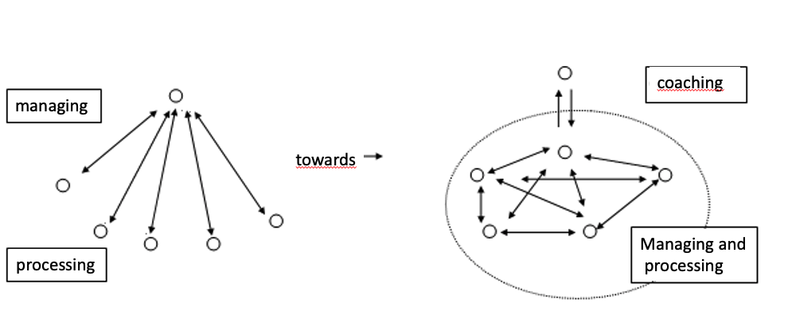
Towards self organizing team

Slide 26

Team development

Slide 27
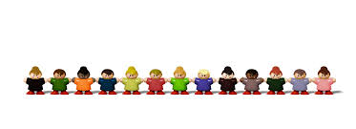
Team excercise
Lost at sea

Slide 28
First assignment
You boat has sunk.
You are on a life raft together.
A few items have been salvaged.
Put them in the order of importance.

Slide 29
Lost at sea
Sextant
Shaving mirror
10 liter jerry can of water
Mosquito net
1 pack of army provisions (canned meat, ship's rusks, coffee, sugar, salt).
Map Pacific Ocean
Seat / float cushion
3 liter bottle of flammable liquid (oil/gas mix)
Compact transistor radio
Anti-shark spray
10 m2 opaque plastic
300 ml of Puertorico rum (80% alcohol)
10 meters of nylon rope
2 boxes of chocolate bars
Set of fishing materials.

Slide 30
Steps to discuss team interactions
Clarify goal
Define roles
Discus rules of conduct
Interdependence

Slide 31
Summary: Without signal features there is little chance of being rescued, most rescues take place within the first 36 hours, then it is possible to survive without water and food.
1) Shave mirror To signal for air and sea rescuers.
2) 3 liter bottle of flammable liquid (oil/gas mix) Also to send signals, will float and can be lit
3) 10 liter jerry can of water Moisture replenishment 4) 1 pack of army provisions (canned meat, ship's biscuit, coffee, sugar, salt). Ration
5) 10 m2 of opaque plastic Can be used to collect water and to protect natural elements
6) 2 boxes of chocolate bars Ration
7) Set of fish material Food supply, but less certain than the chacolade
8) 10 meters of nylon rope
Can be used to tie stuff together so it doesn't fall overboard
9) Seat / float cushion
Can be used as a rescue device if someone falls overboard
10) Anti-shark spray
You will only come across one
11) 300 ml of Puertorico rum (80% alcohol)
To be used as a disinfectant, do not drink, causes dehydration
12) Compact transistor radio
Is not a transmitter, unfortunately
13) Map Pacific Ocean
Without other navigational aids without much value
14) Mosquito net
There are no mosquitoes in the middle of the sea
15) Sextant
Without tables and chronometer of little value.

Slide 32
Team forming

Slide 33


Slide 34
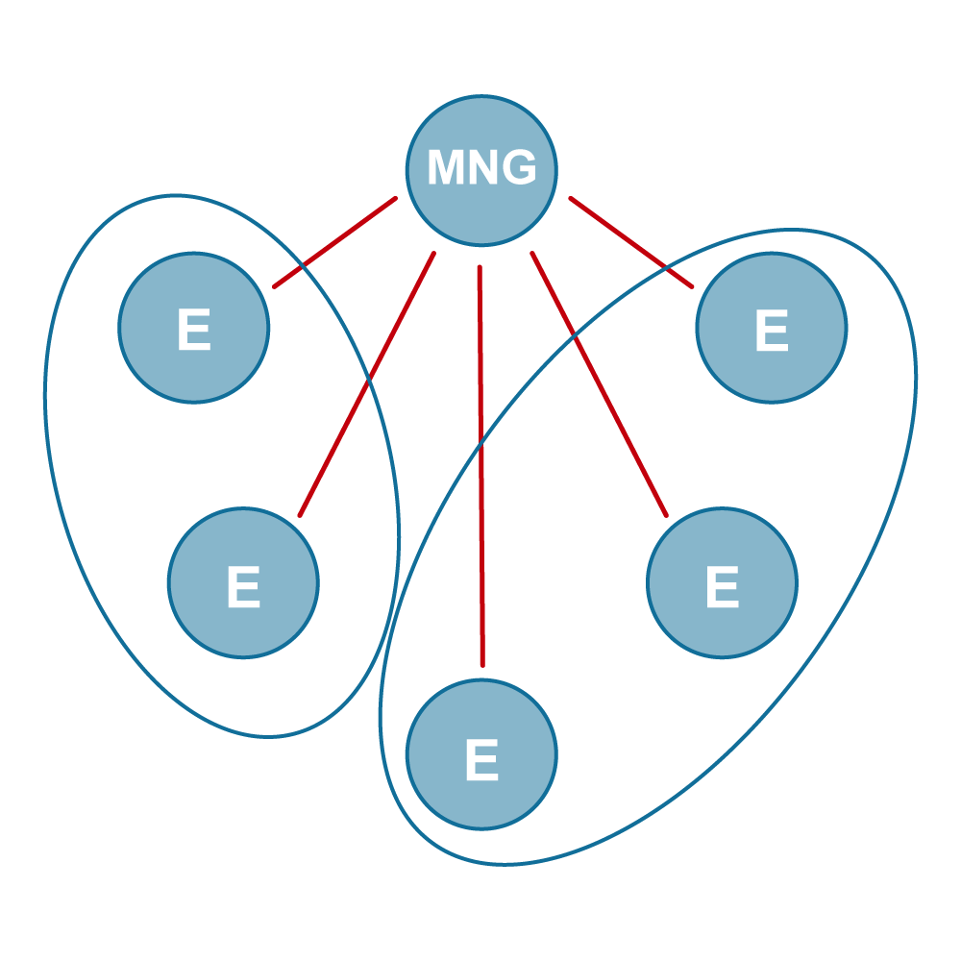
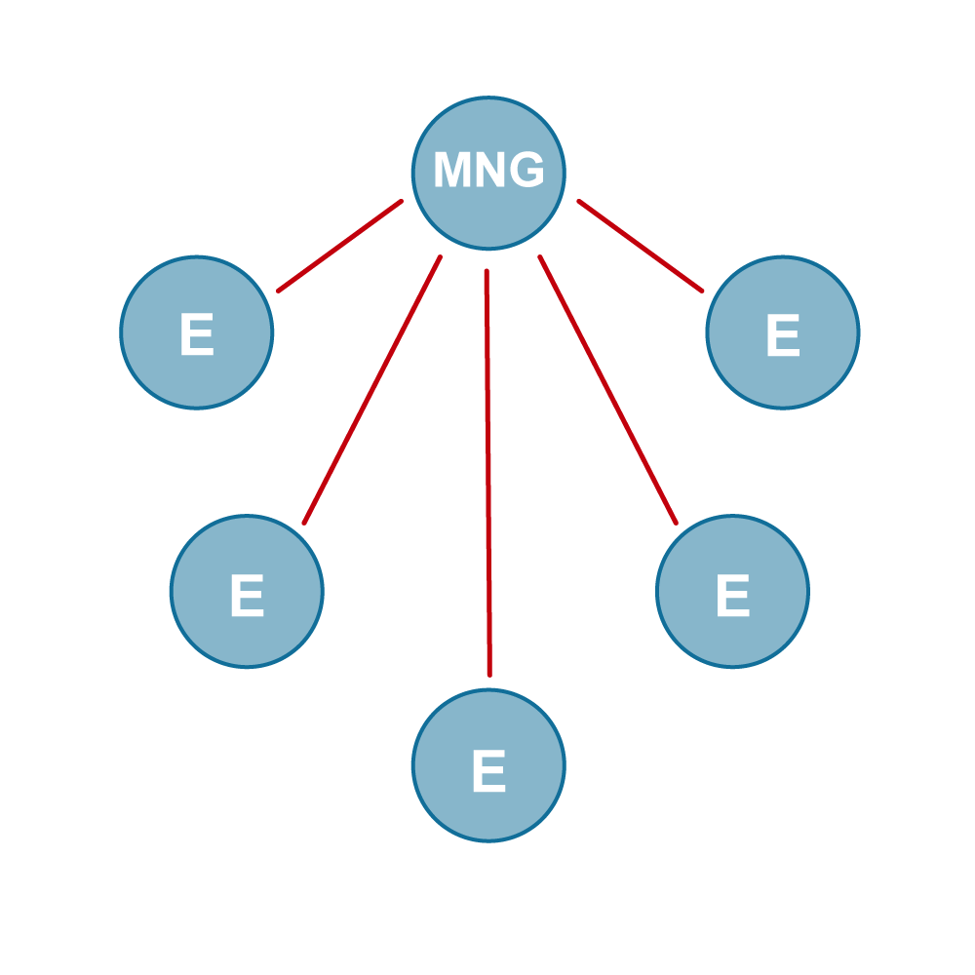
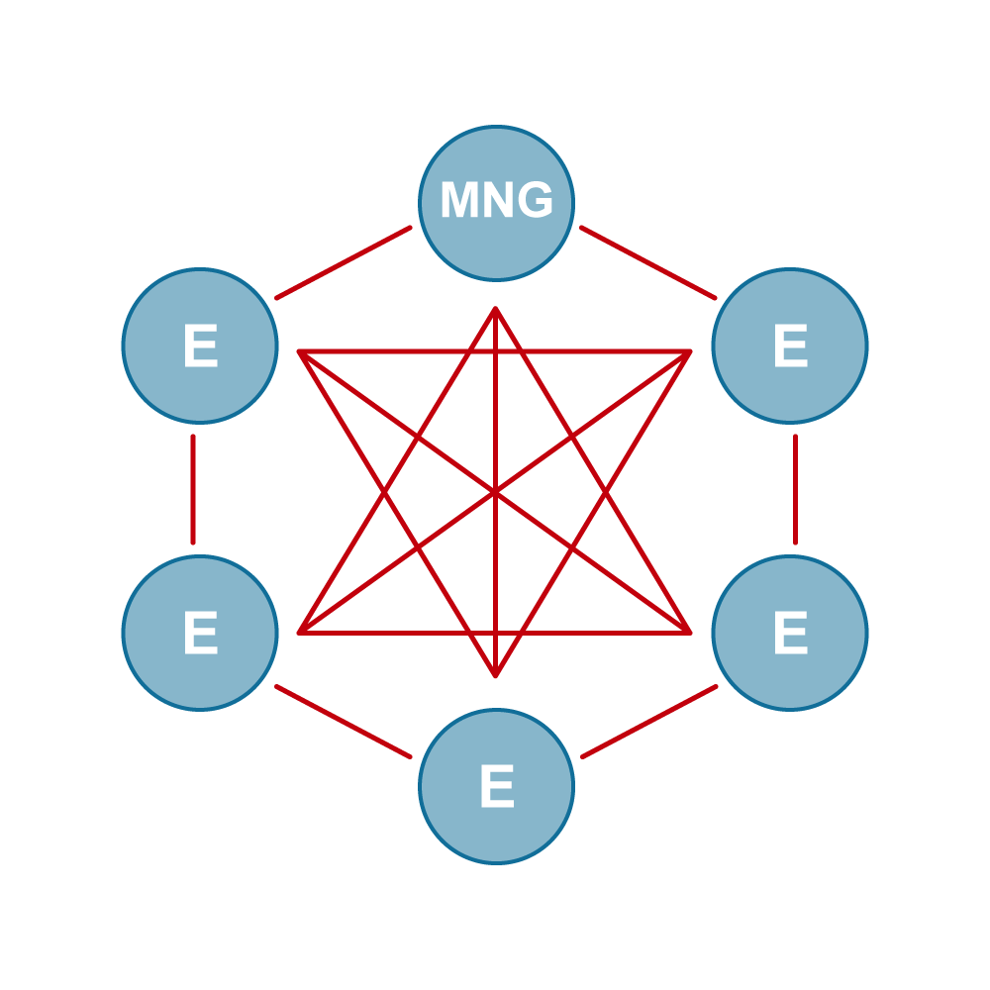
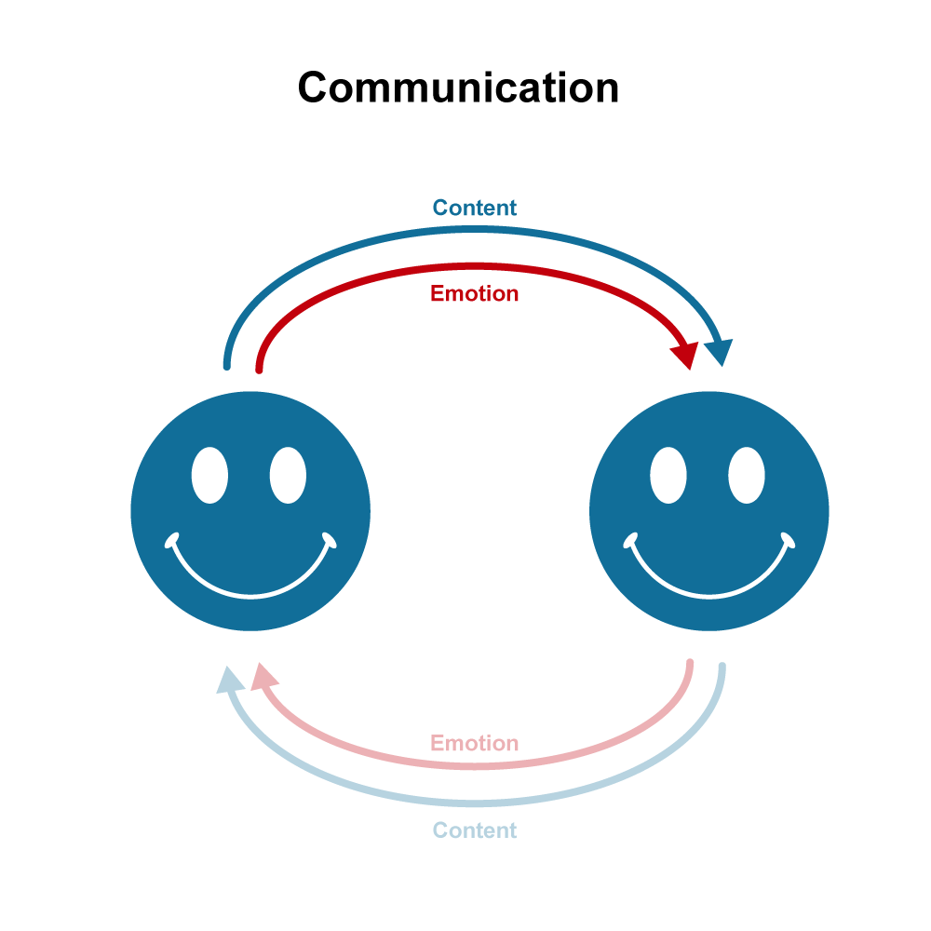
Teamforming
Isolating
Forming
Storming
Giving and receiving feedback
Endure tension to solve problems

Slide 35

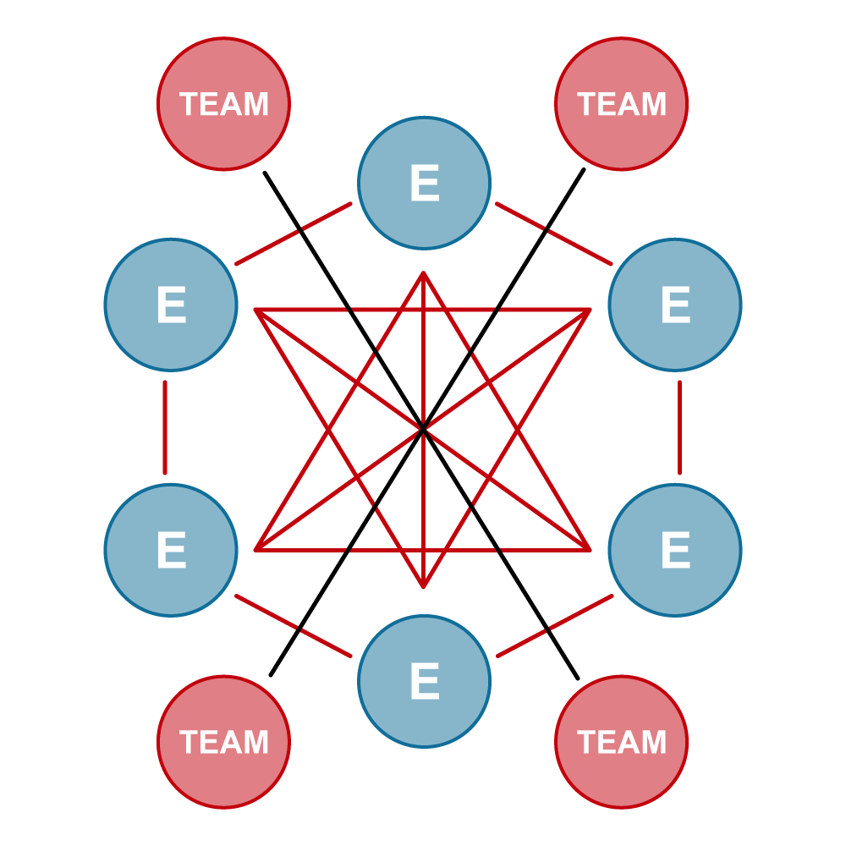
Teamforming
Norming
Performing
Collaborate in and outside
of the team

Slide 36


Slide 37
Team phases
Start position
Isolating
Forming
Storming
Norming
Performing
Listen, ask questions, summarise
Emotion

Slide 38
Team excercise
Ball game

Slide 39
Team phase: forming
Behaviour to be learned
Listening to each other
Ask and summarize questions
Effect
Increased trust, safety and appreciation
To guard:
Content
Process
Interaction
Emotions (only by manager/competent teammember)

Slide 40
Team phase: isolating
Behaviour to be learned
Listening to each other
Ask and summarize questions
Effect
Release from mutual judgments
Being open to relationship
To guard:
Content
Process
Interaction
Emotions (only by manager/competent teammember)

Slide 41
Team phase: forming
Behaviour to be learned
Listening to each other
Ask and summarize questions
Effect
Increased trust, safety and appreciation
To guard:
Content
Process
Interaction
Emotions (only by manager/competent teammember)

Slide 42
Team phase: storming
Behaviour to be learned
Give and receive feedback
Endure tension
Solving together
Effect
Enlarge the team's own resolving power
To guard:
Content
Process
Interaction
Emotions

Slide 43
Team fase: norming
Behaviour to be learned
Collaborate with other teams
Effect
No We – Them thinking anymore
To guard:
Content
Result
Process
Emotions

Slide 44
Team Fase: performing
Behaviour to be learned
Optimal functioning within the own team and individually
Collaboration with other teams
Effect
Entrepreneurship towards other team is created
To guard:
Content
Result
Process
Emotions

Slide 45
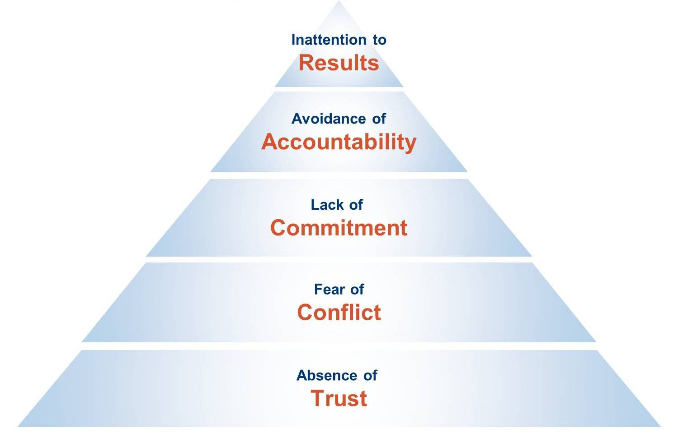
Lencioni
5 dysfunctions of a team

Slide 46
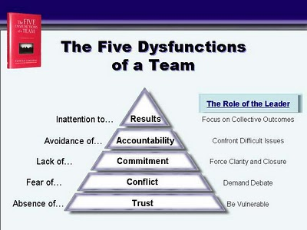

Slide 47
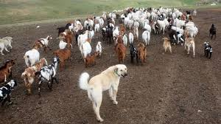
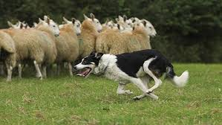
Flock management
Safe space
Leading and directing

Slide 48

Flock management
4 principles:
Involve the whole system
Explore the greater whole before narrowing it down
Be future and action focussed, and focus on the common ground
Create space for self- management and taking responsibility amongst the participants

Slide 49

Whole system
Insiders and outsiders
All stakeholders
All opinions

Slide 50

Focus on the bigger picture All perspectives count, but don’t get lost in the complexity.

Slide 51

Goal
Inform about initial goal
Request openness about other goals
Come to common goal

Slide 52
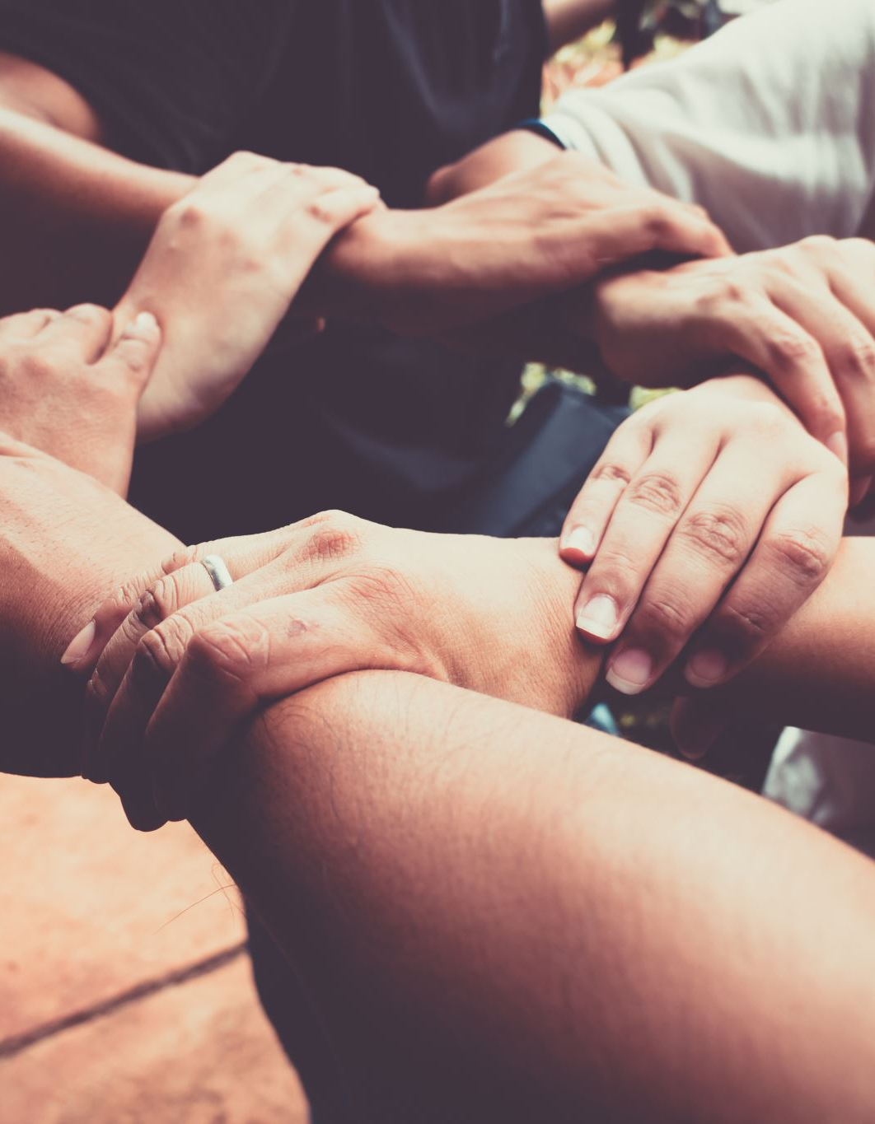
Engagement
Make and guard rules of conduct together
Stimulate self management in smaller teams
Make taking responsibility visible to all and give appreciation to it.
Let participants feel that their input is valued and used
Make clear that all input is of value
Let people with a divergent opinion notice that they are not alone when expressing it.
Stimulate talking to each other, not only to the facilitators
Ask the group for advice/opinion if you do not have an answer or doubts about the next step.

Slide 53

Context
Live, online or hybrid meetings?
Inspiring location and surrounding
Very clear planning and time management

Slide 54

Your experiences and questions

Slide 55

Break

Slide 56

Cross boundary teamwork, why?

Slide 57
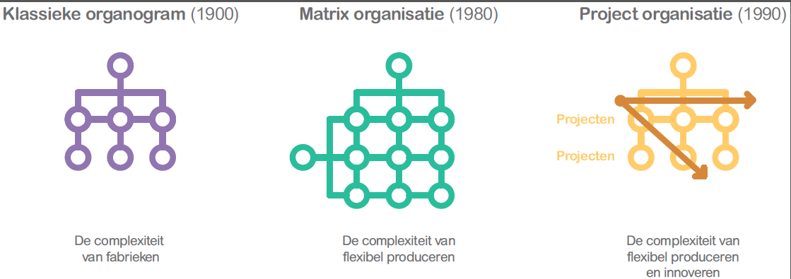
Organising

Slide 58

Network Organisation

Slide 59

Self organisation: emerges organically

Slide 60
Roles are defined by value, not by position

Slide 61
Self-organisation requires
Ownership
Autonomy
Interdependency
Personal Leadership
Social skills

Slide 62
Extra challenges for intergroup teamwork
Aligning ambitions
Clear view on interests
Building relationships
Organising intergroup cooperation
Guiding the process and being part of the process

Slide 63
Team excercise
Municipal advisory commitee

Slide 64
Extra challenges for intergroup teamwork
Aligning ambitions
Clear view on interests
Building relationships
Organising intergroup cooperation
Guiding the process and being part of the process

Slide 65
1) Aligning ambitions
Opportunities
Risks
Inspiring perspective
Mobilising effect
Creating synergy and action
Shallow significance
Depletion of original source of inspiration
Illusion of cooperation

Slide 66
2) Clear view on interests
Opportunities
Risks
Intrinsic motivation
Use of diversity
Proactive behaviour
Perseverance of conflict of interests
Permanent negotiation
Defensive behaviour

Slide 67
3) Building relations
Opportunities
Risks
Constructive dynamics
Transparency
Flexibility
Adequate conflict management
Underlying power play
Unexpected undertow
Instable relationships

Slide 68
4) Organisation
Opportunities
Risks
Hygiene rules for cooperation
Decisive power
Predictability
Underperformance in organisation
Illusion of cooperation
Tendency to control too much

Slide 69
5) Guiding the process while being part of the process
Opportunities
Risks
Reliability
Resilience
Attractiveness and identity
Follow-through
Identity stays unclear
Emergence of subgroups
Stagnation

Slide 70
Break

Slide 71

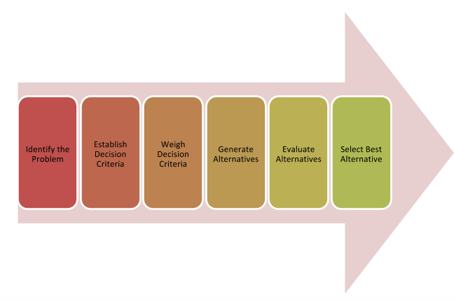
Decision making
Process

Slide 72
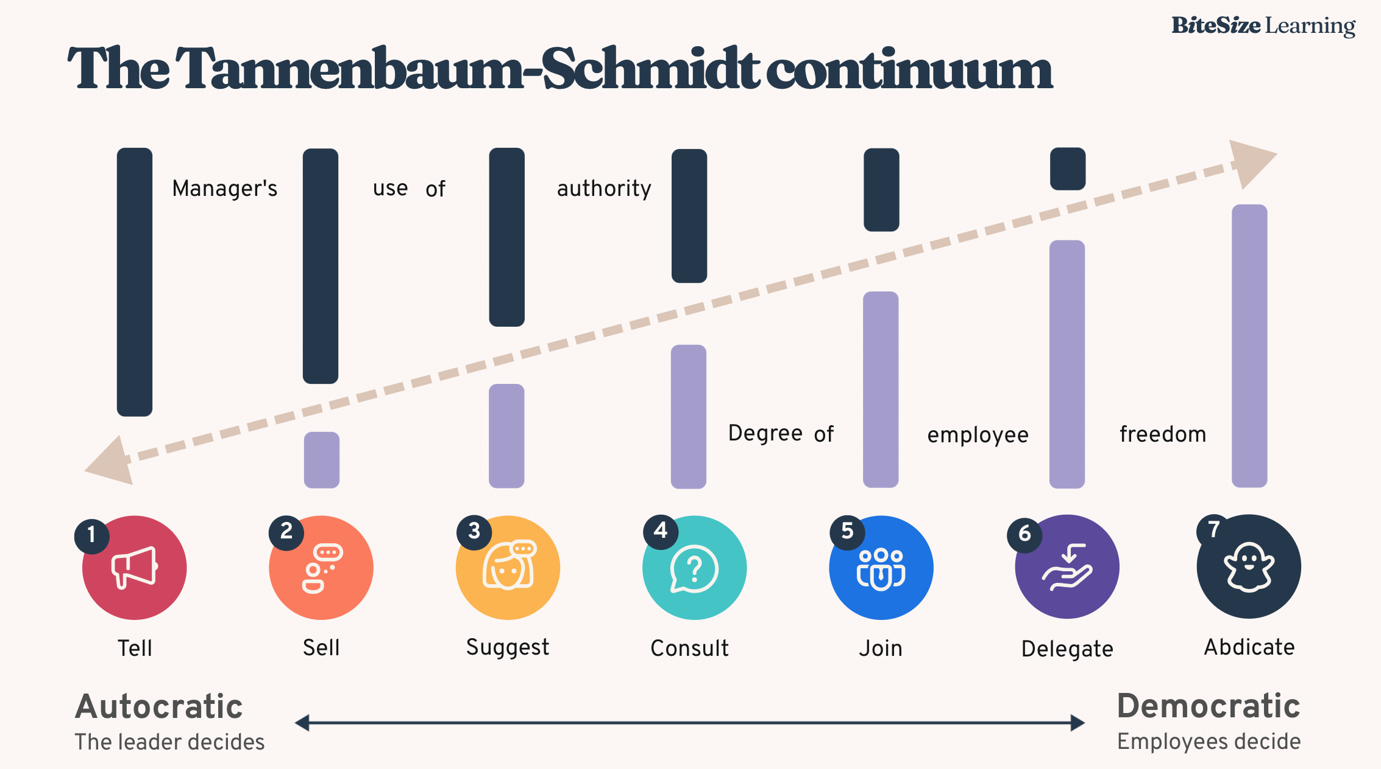
Decision making leadership styles

Slide 73
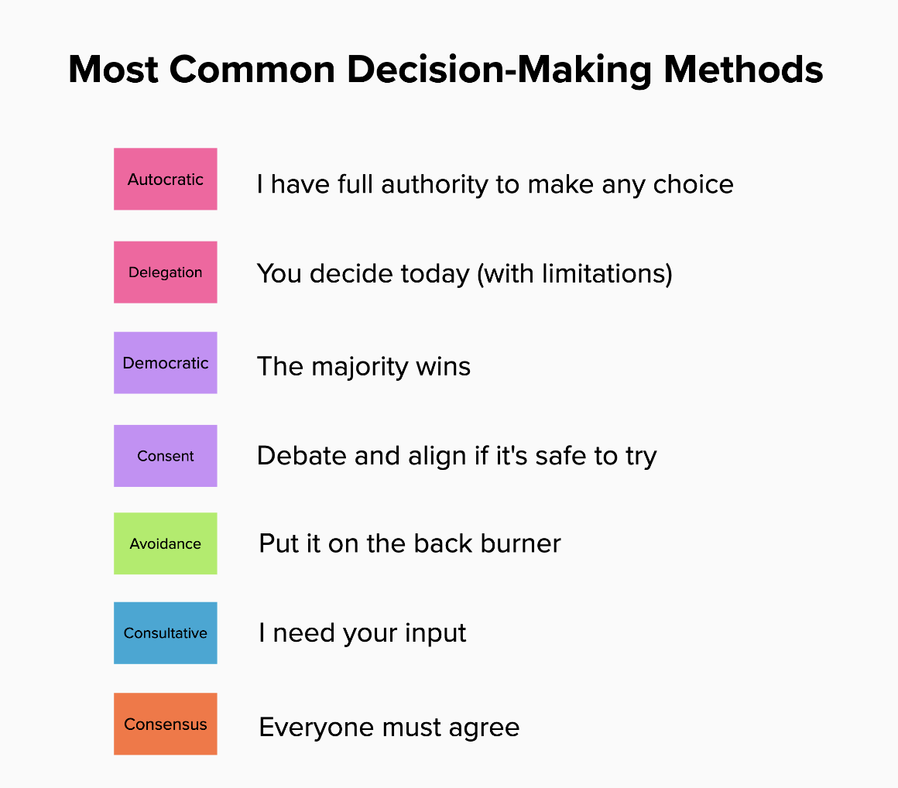

Slide 74
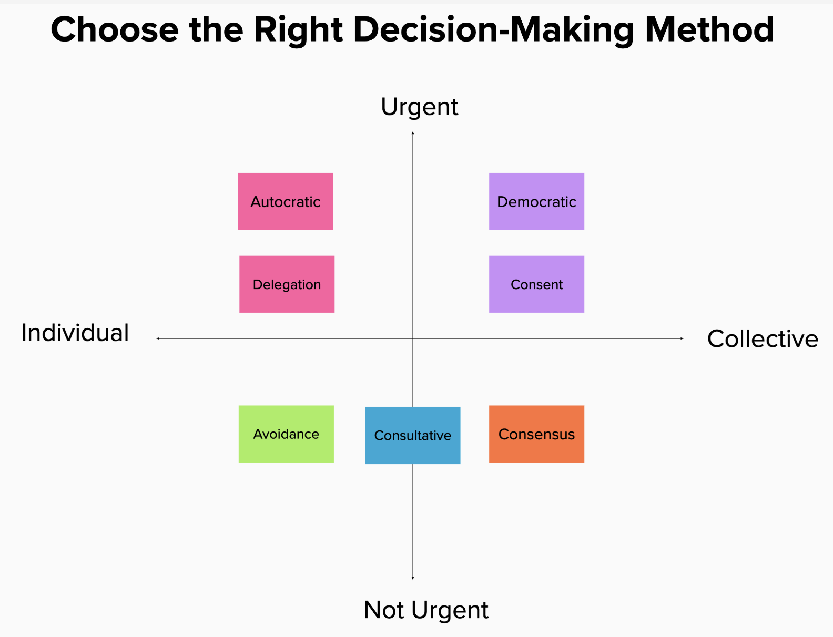

Slide 75

My take aways are …
Strength lies in differences, not in similarities
Stephen R. Covey.

Slide 76
Wrap up

Slide 77
Training week 3 SKILLS4WATER Innovative Training Programme
EJWP7: March 2024 - August 2025
19-21 November 2024, Muenster, Germany Day 3

Slide 78
Programme training Day 3
Innovative Sprints on WP5, 1, 3 & 4
Including
new methodologies
using Soft Skills in Project Work
InterVision
Check out

Slide 79
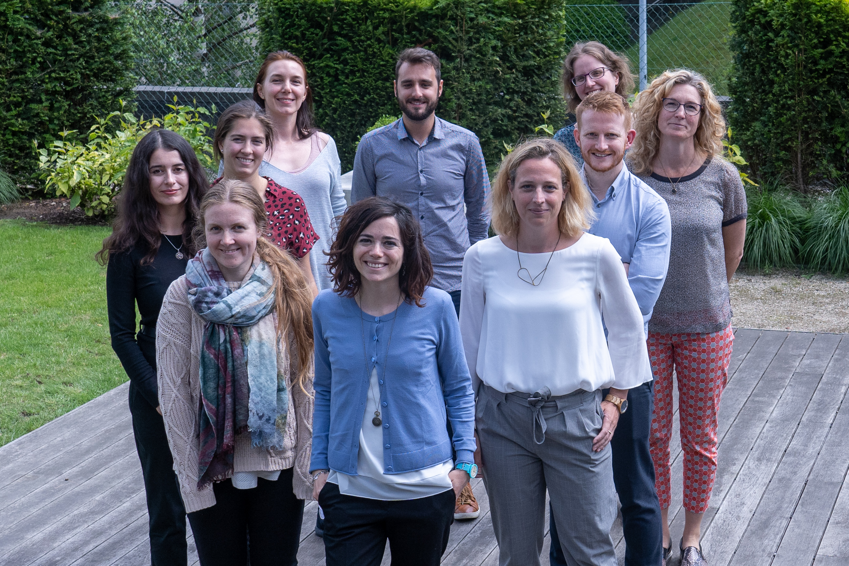
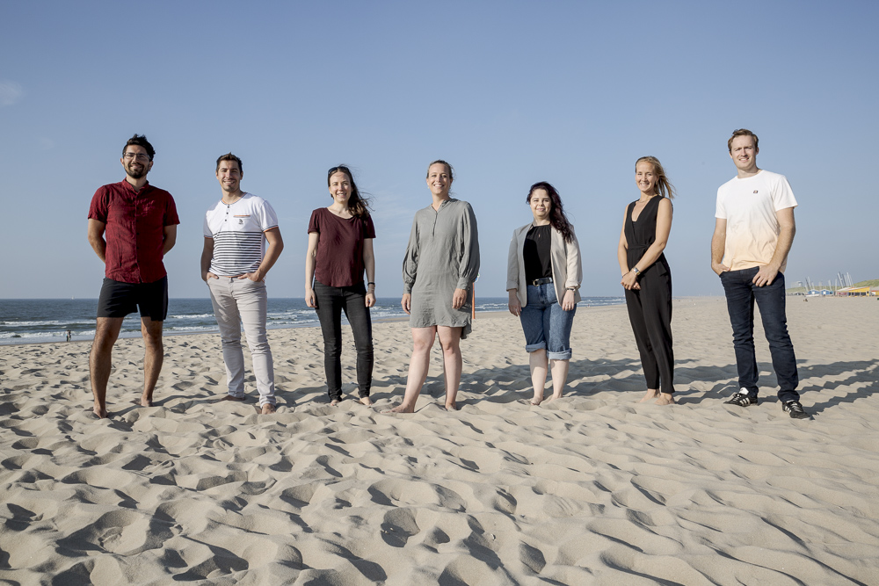
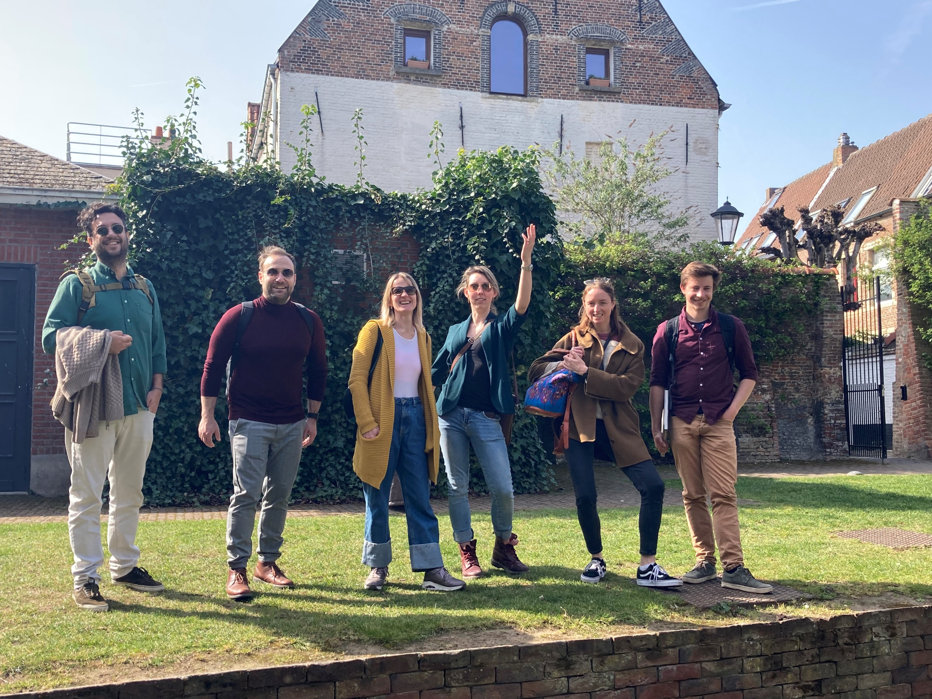
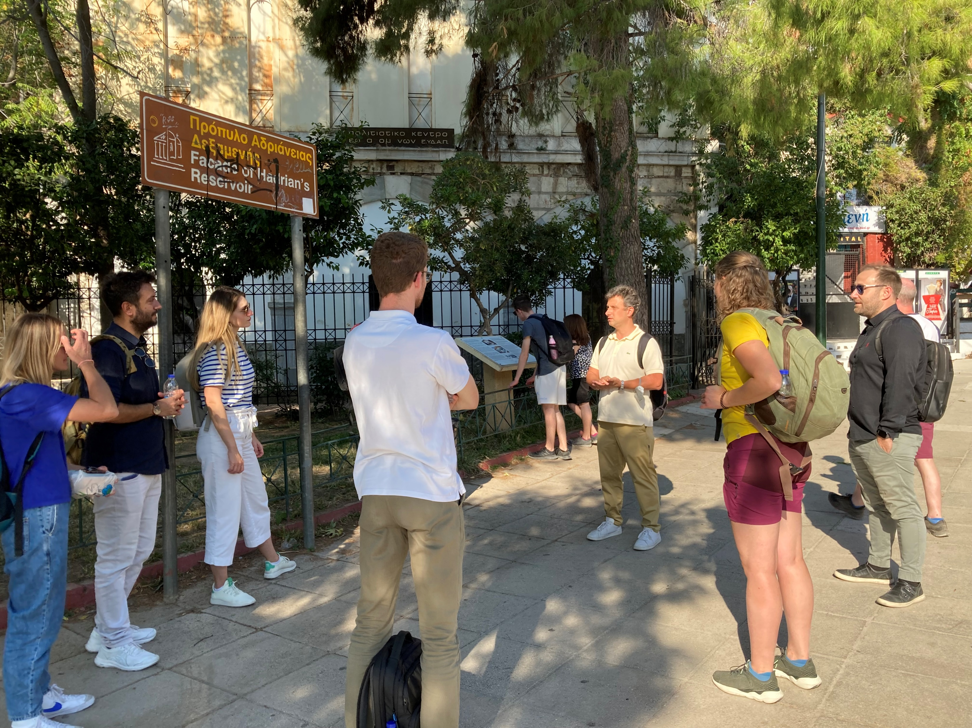

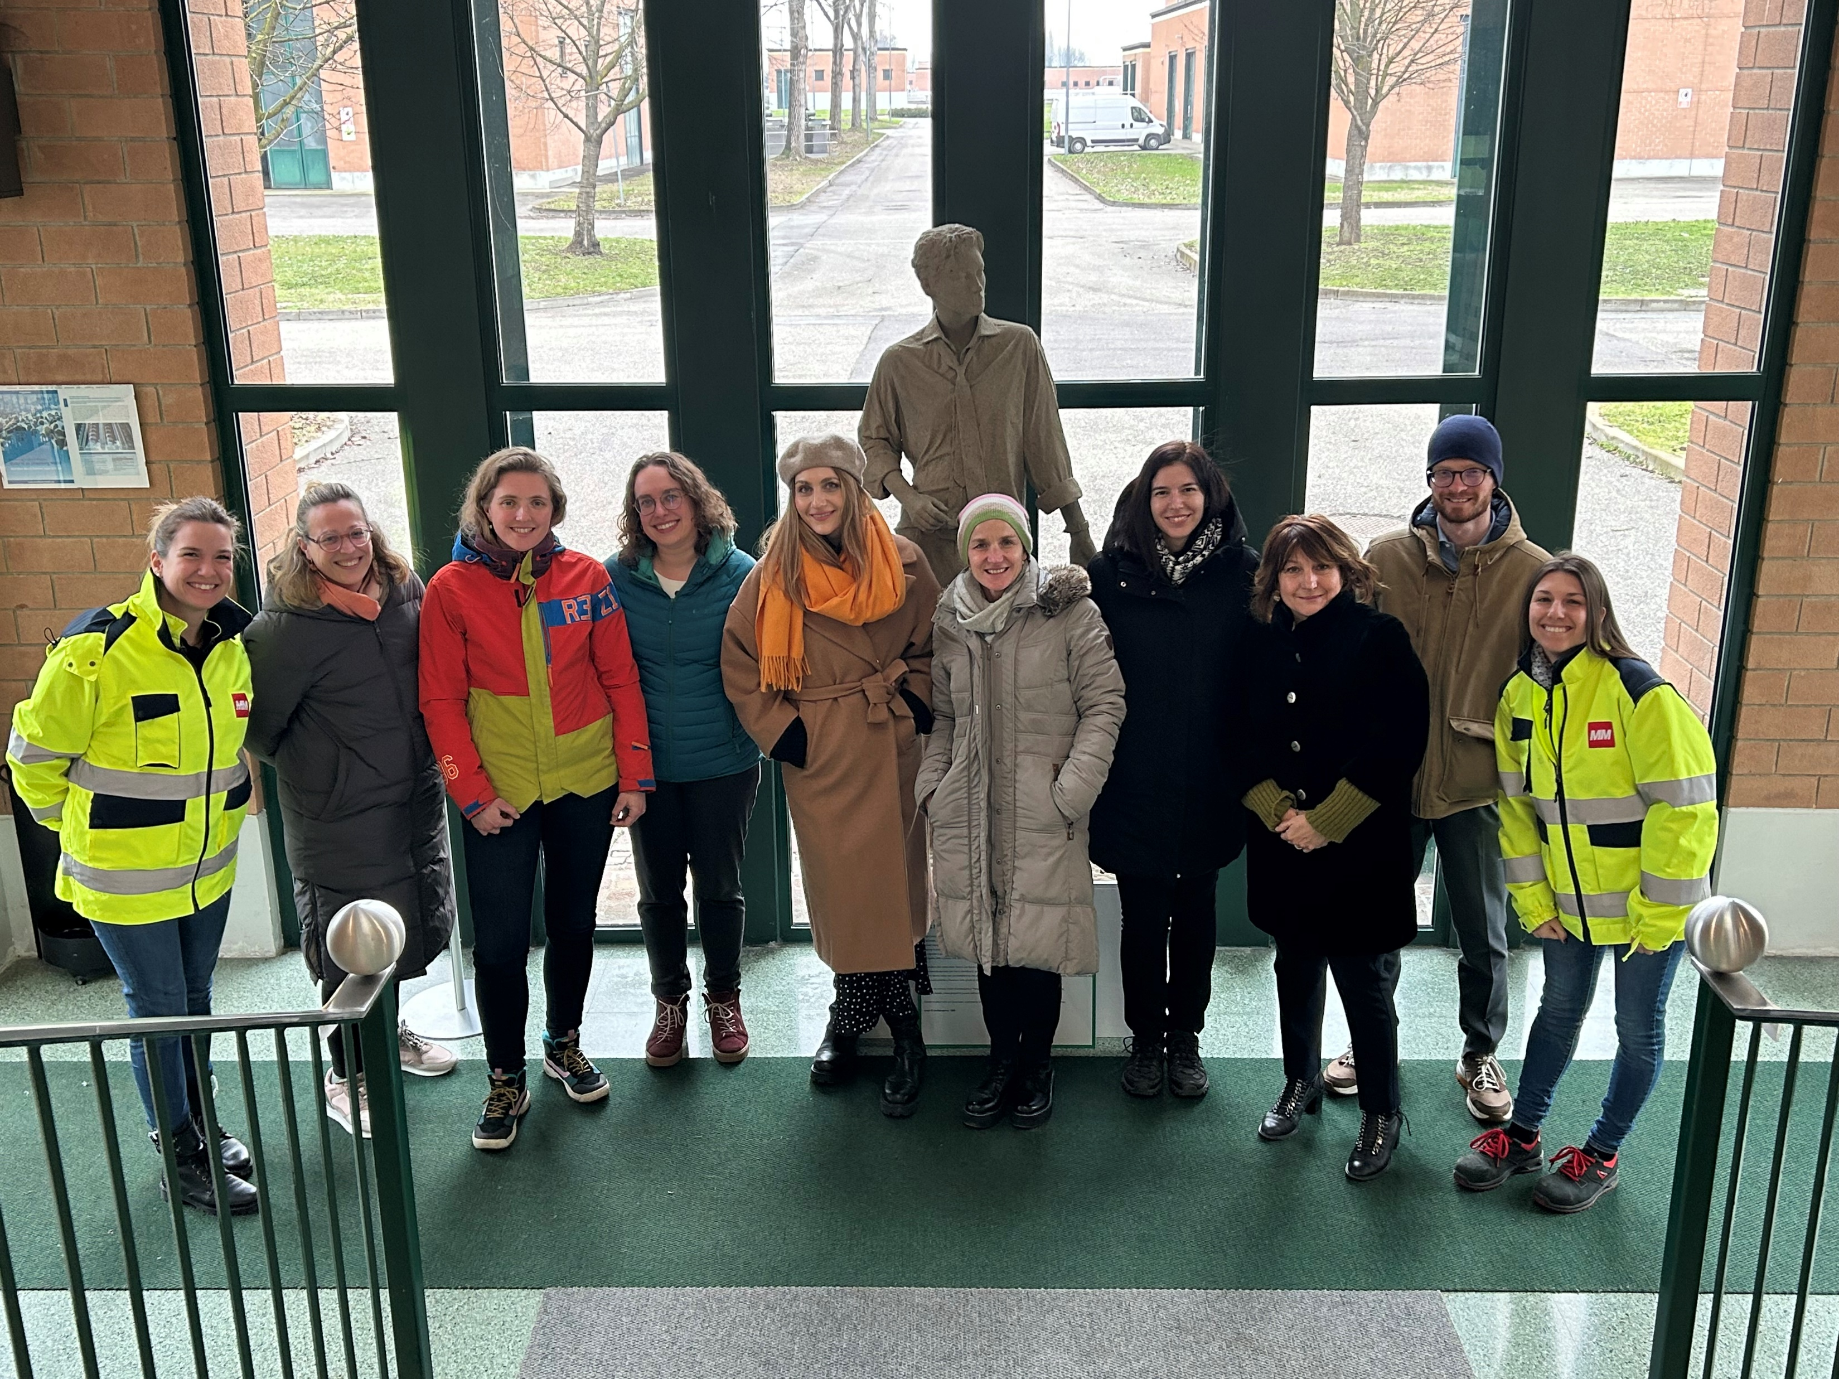
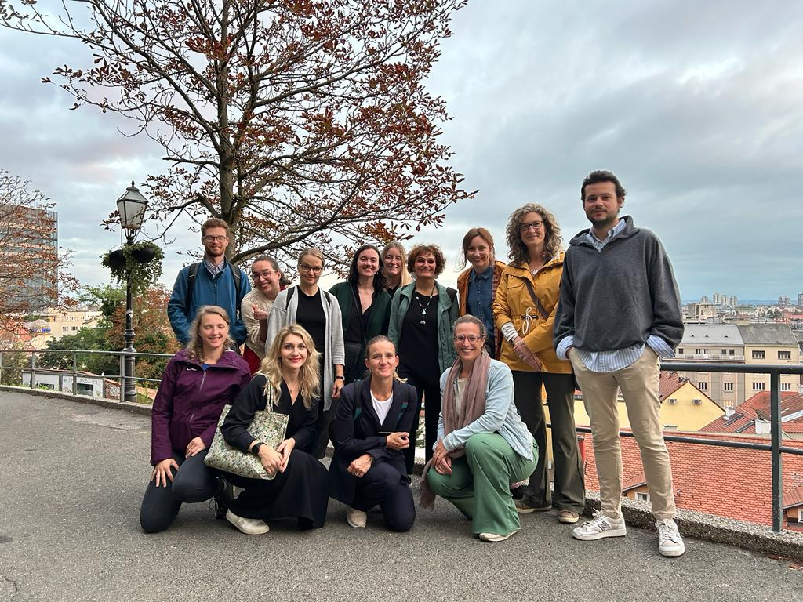
Welcome to the EJWP Community!
EJWP1: June 2029 – October 2021
EJWP3: November 2021 – October 2023
EJWP4: October 2022 – October 2023
EJWP2: October 2020 – December 2022
EJWP4: October 2022 – October 2024
EJWP5: September 2023 – October 2025
EJWP6: kick off May2024!
EJWP7: kick off March 2024!

Slide 80

What is interVision?
Definition interVision (co-worker consultation)
A systematic approach to work related issues.
With a small group of people.
It is a means to improve the quality of the profession.
The focus is on the personal aspects of the issue, not on the content. ,,Why is this an issue for me, at this moment in my career?’’

Slide 81
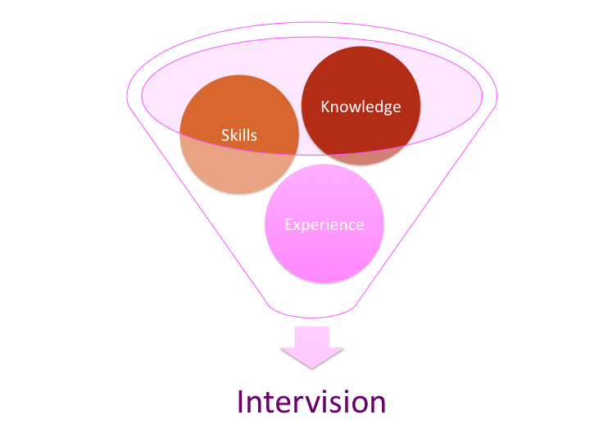
Objectives for interVision
Learning together.
Empowering a person by focussing on what lies within your circle of influence.
Signalling general issues and addressing them where they can be solved.

Slide 82

General structure for process
Choosing a case
Analysing the issue
Reflection on the core of the issue
Exploring possible actions/advice.
This structure ensures depth and prevents solving symptoms instead of dealing with the true issue at hand.

Slide 83
Five step-method
Phase | Description | Time indication:
 | Introduction to the method
0 | Inventory of the cases: The group does an inventory of the cases. A selection is made and prioritised on a flip chart. | 10 minutes
1 | Round 1: The case owner tells about the context of his/her case and concludes with a short formulation of the question. | 5 minutes
2 | Questioning: Participants ask questions that are directly answered by the case owner. After answering the questions, reflect as a group if the all levels of the Iceberg were covered. If not, additional questions can be asked. | 10-15 minutes
3 | Reflection: The participants give their view on the core of the issue. These are noted on a flip chart. The case owner reflects on these and gives his/her own (new) view on the core of the issue. Also, the case owner tells whether he/she wants advice in this. (It might already be enough to reframe the core of the issue. | 10 minutes
4 | If wanted: Advice: The participants give short, clear advices. These are noted on a flip chart. | 5 minutes
5 | Round up: The case owner shares what these advices mean to him/her and what (s)he is going to do now. Other participants share what they have learnt from the session. | 5 minutes
 | Time needed: | 45-60 minutes

Slide 84

Check out
2 min. in silence reflection
Circle.
When you recognize take one step forward.
Pop-it-when-you-re-hot.
- Biggest take away? - Needs to close this session?

