Slide 1

Training week 4
SKILLS4WATER Innovative Training Programme
EJWP7: March 2024 - August 2025
01-03 April 2025, Galati, Romania

Slide 2
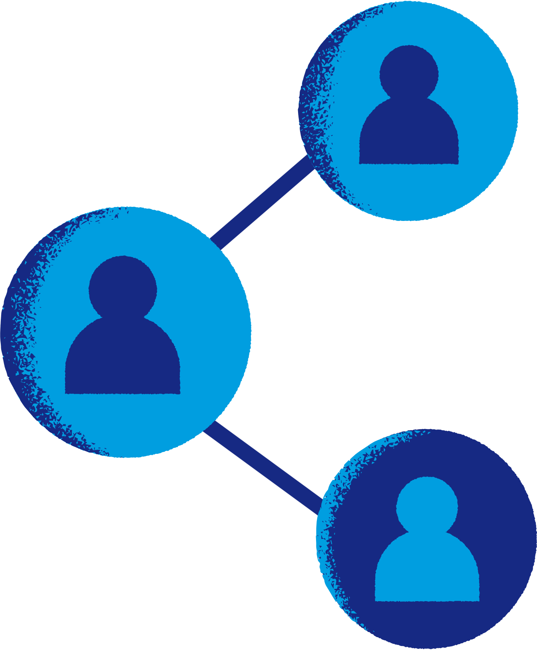


SKILLS4Water training program
Week 3
01-03 April 2025
Tuesday | Check in & Introduction Field Trip Jurilovca Fisherman Village
Wednesday | Training Dealing with Complexity InterVision
Thursday | My Personal Path, Creating Impact Closing Innovative Training Programme Consortium Meeting

Slide 3
Programme training Day 1
Programme training Day 2
Check in
Dealing with Complexity
InterVision
Programme training Day 3
Check in
Field Trip
My Personal Path, Closing Training Programme
Creating Impact
Consortium Meeting

Slide 4
Rules for these days:
Be proactive
Do what is important
Be focussed (make time for the programme)
Be prepared
Take care of oneself and the others
Confidentiality: what happens in the training, stays in the training

Slide 5
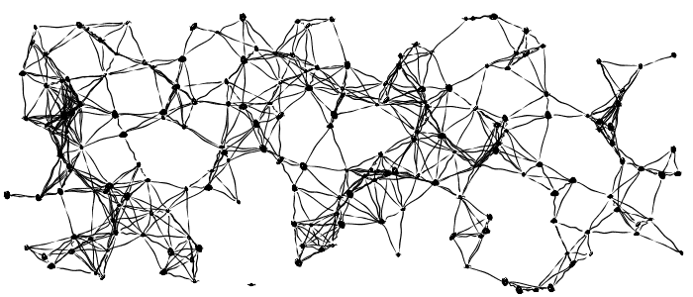
Dealing with complexity in a rapidly changing and complex world

Slide 6
Programme
Dealing with complexity: what, where, how?
Leadership in complex systems
Antifragility as necessary quality in dealing with complexity
Collaborating in this self-steering (complex) team
Mapping elements in a dimension
Gigamapping

Slide 7
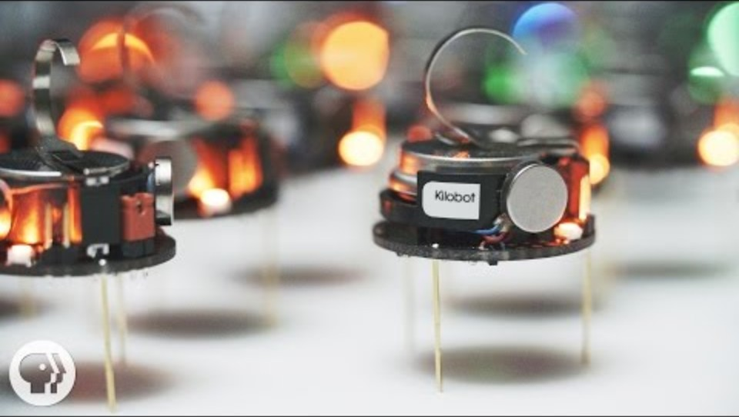

Slide 8
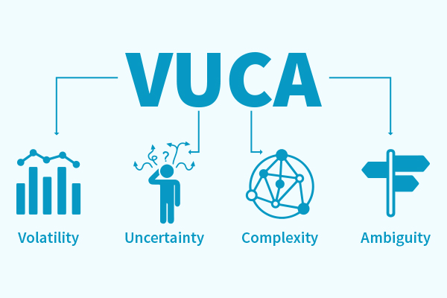

Slide 9
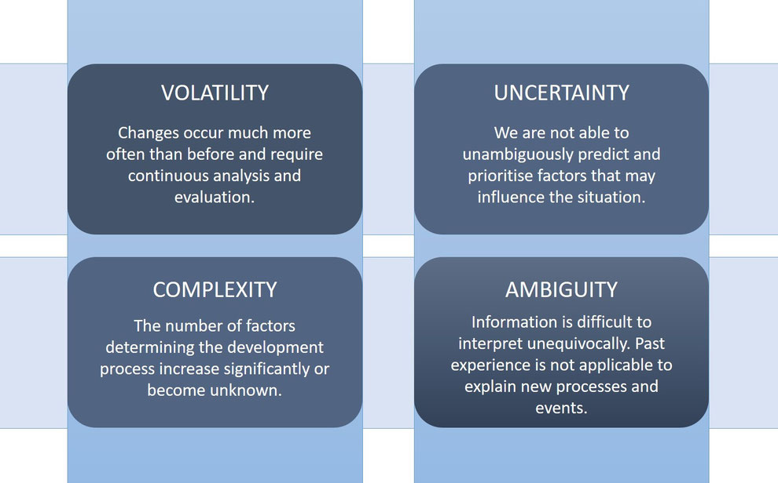

Slide 10
We react to external triggers
Take own control
Me
Role
Context
Balance
Obedient to the trigger
Trigger from outside

Slide 11

Our VUCA world
Dealing with Volatility
Which disruptions have you needed to deal with recently or currently in your line of work?

Slide 12
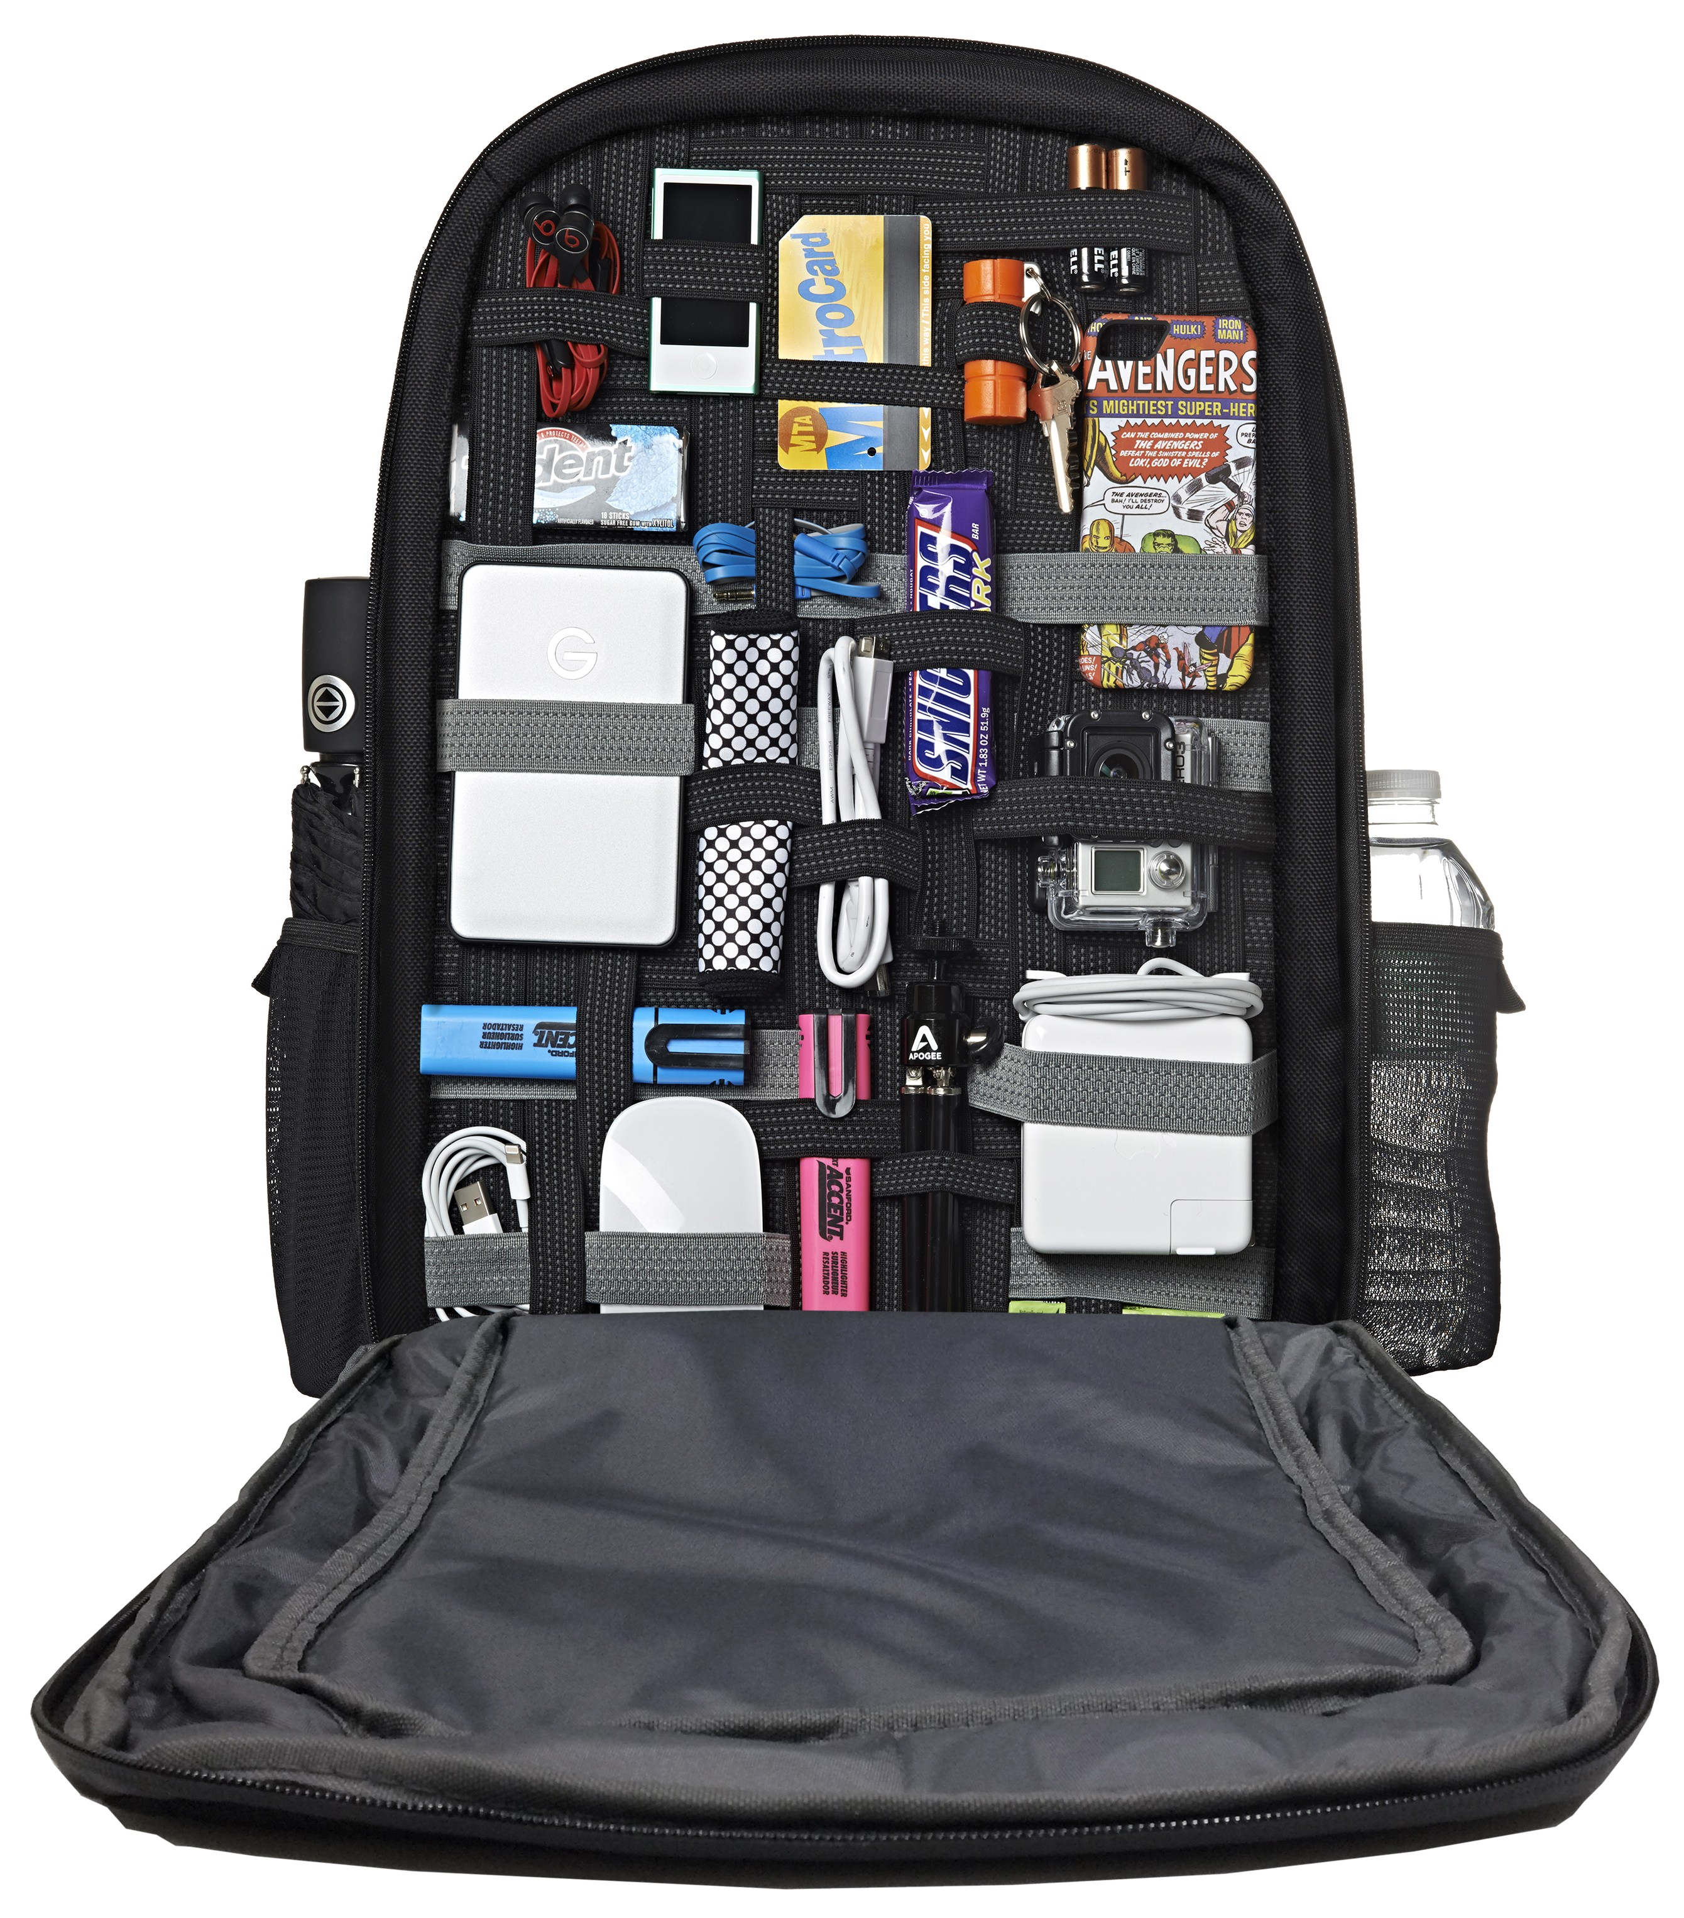
Personal characteristics to deal with a
VUCA environment
Cognitive strength
Emotional resilience
Insight and creativity
Sense making
Patience
Broad social network
Curiosity

Slide 13
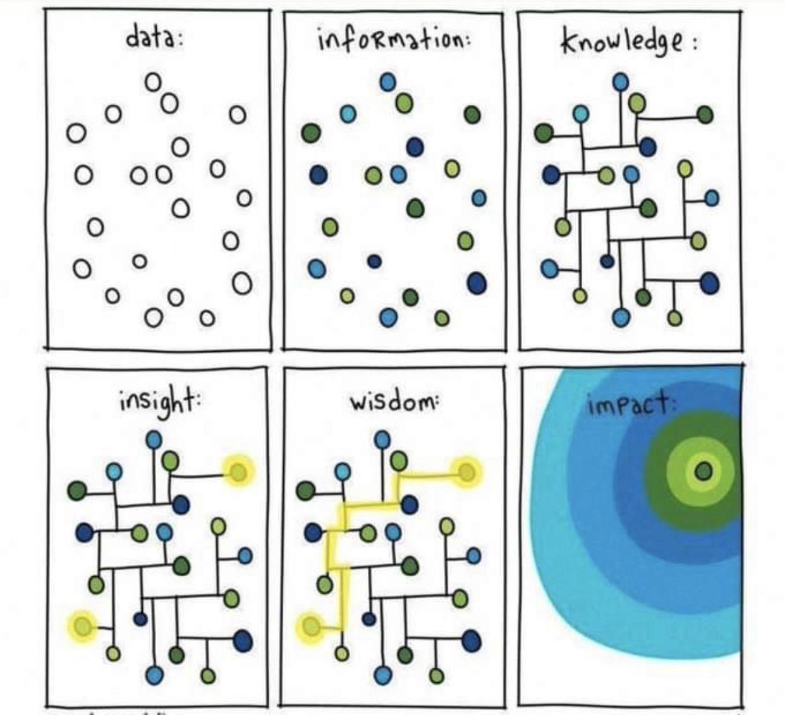

Slide 14

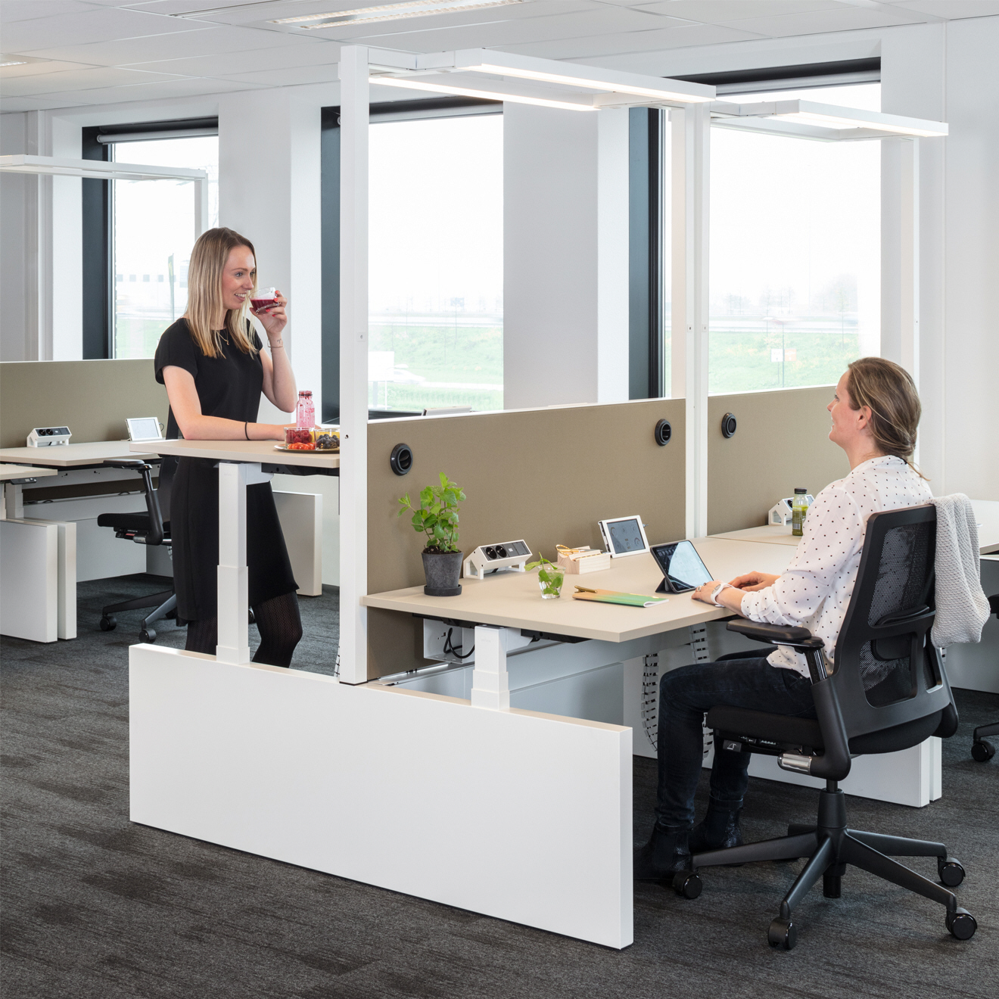
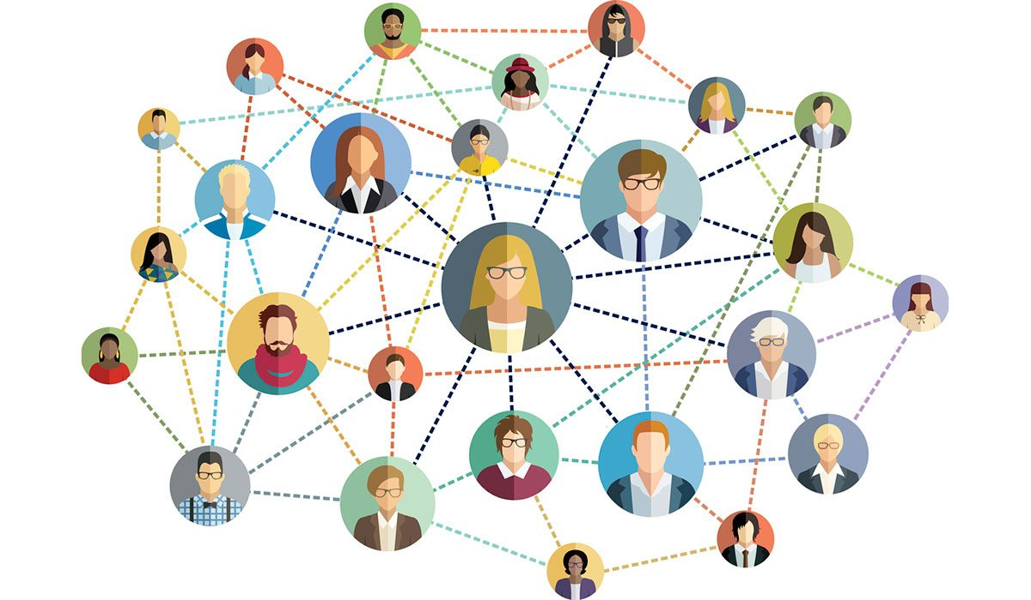
Role of Leader
THE SOCIAL TREND
Model 1.0: working for a boss
Model 2.0: working with a boss
Model 3.0: working for yourself

Slide 15

Effective leadership in complex systems
Style consists of focussed adaptation
and engaging leadership,
based on well informed
ánd intuitive decision making

Slide 16
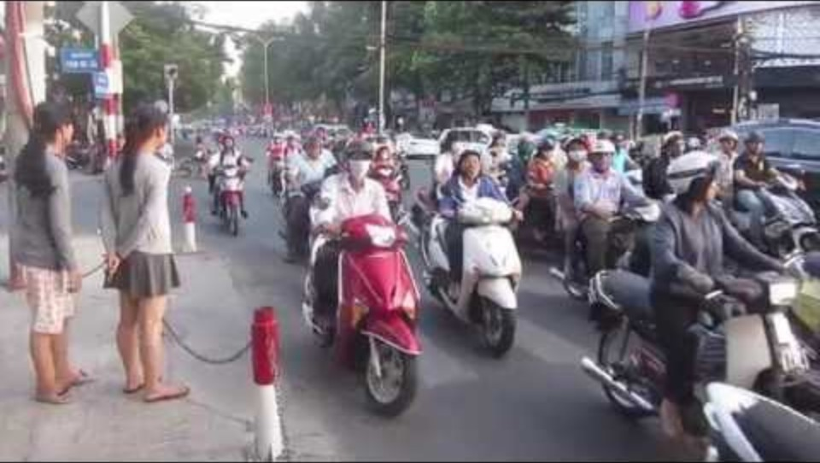

Slide 17
Design or develop?
Organizational cooperation
Design
Focused on sollutions
Unique liniar process
Top-down
Design and implementation phases are seperate
Possibilities to participate are limited
Problems and goals are known (or implied to be)
Develop
Focused on the now: what are we facing?
Continuous iterative process
Top-down and bottom-up
No clear distinction between the phases
As much participation as possible
Problems and goals are defined during the process (sharing)

Slide 18
Classic leadership qualities: direction and directive
Vision
Direction
Charisma
Autonomy
Power
prof. dr. Freek Peters

Slide 19
‘Leaders’ of the future: shifting and collaborating
Contextual perspective
Equifinality
Alto centered
Connectivity
Antifragility
prof. dr. Freek Peters

Slide 20
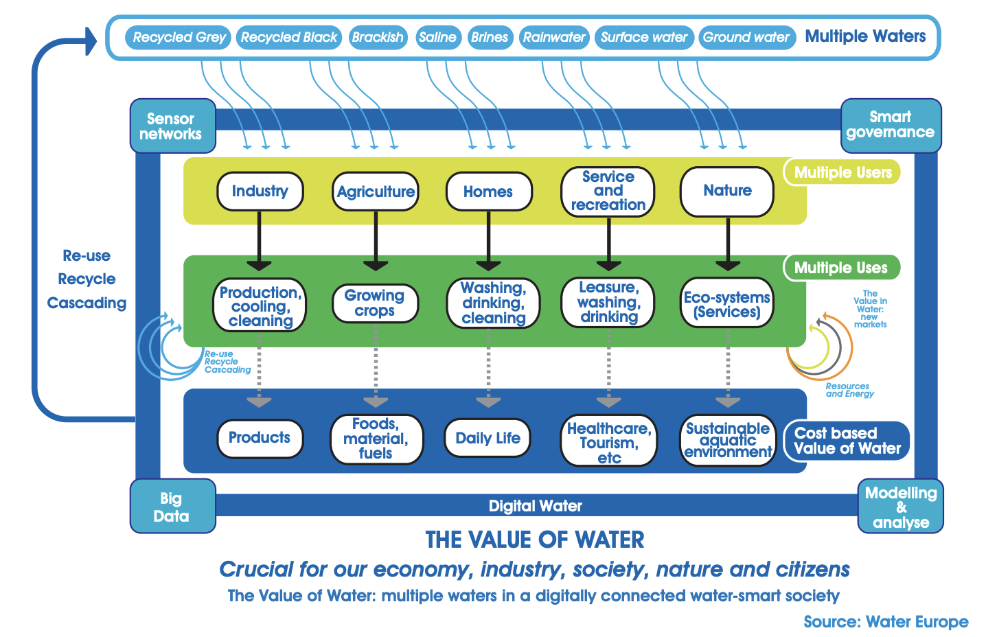
Contextual perspective
  Be an antenna for your organization.
  Think in different scenarios.
  What can happen, how can we act?

Slide 21
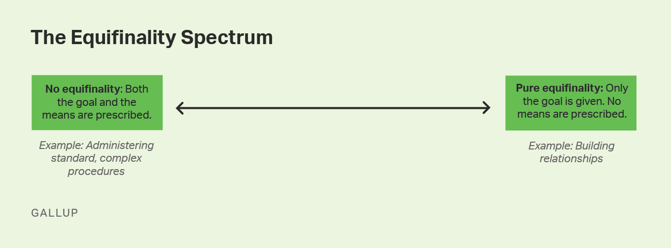
Equifinality
Equifinality refers to the ability of a system to arrive at the same destination from different paths or conditions, the concept that similar outcomes may stem from different developmental paths.

Slide 22

Alto-centered
  As a leader you are there to support your team. Their needs define your actions.
  Be the piece of a puzzle that connects others.

Slide 23

Connectivity
All is interconnected. Within your team, your suppliers, your customers, end users. Focus on cooperation.

Slide 24
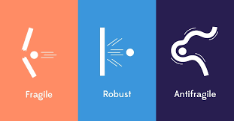
Antifragility
‘Happy under pressure’

Slide 25
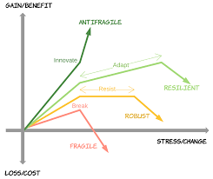

Slide 26
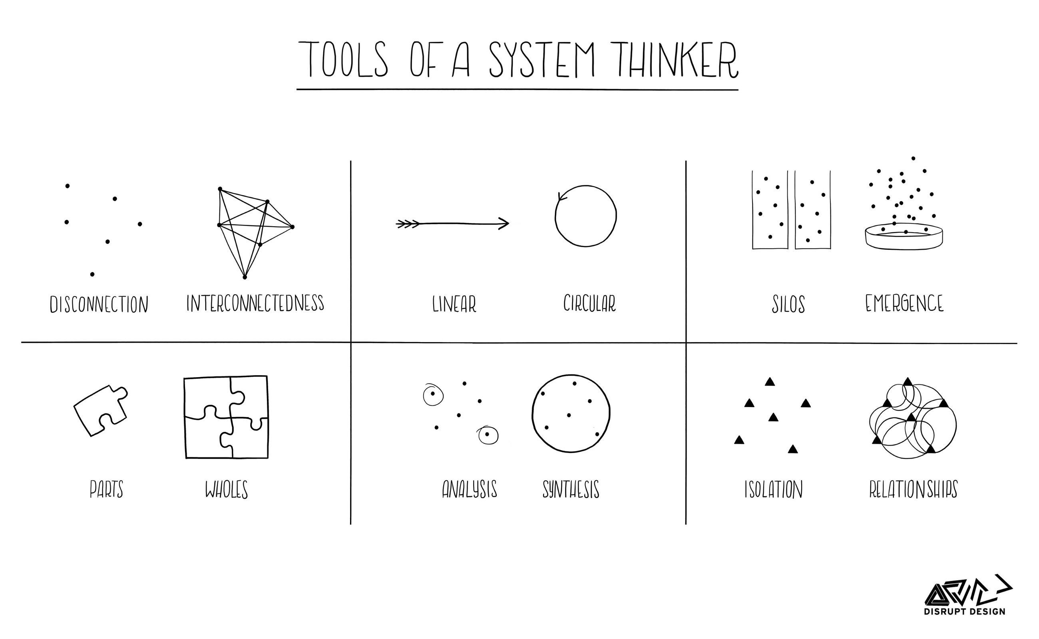

Slide 27
Demografic trends
Rules and regulations
Technological trends
Economy and environment
Organisation
Customer needs
Competition
Uncertainties

Slide 28
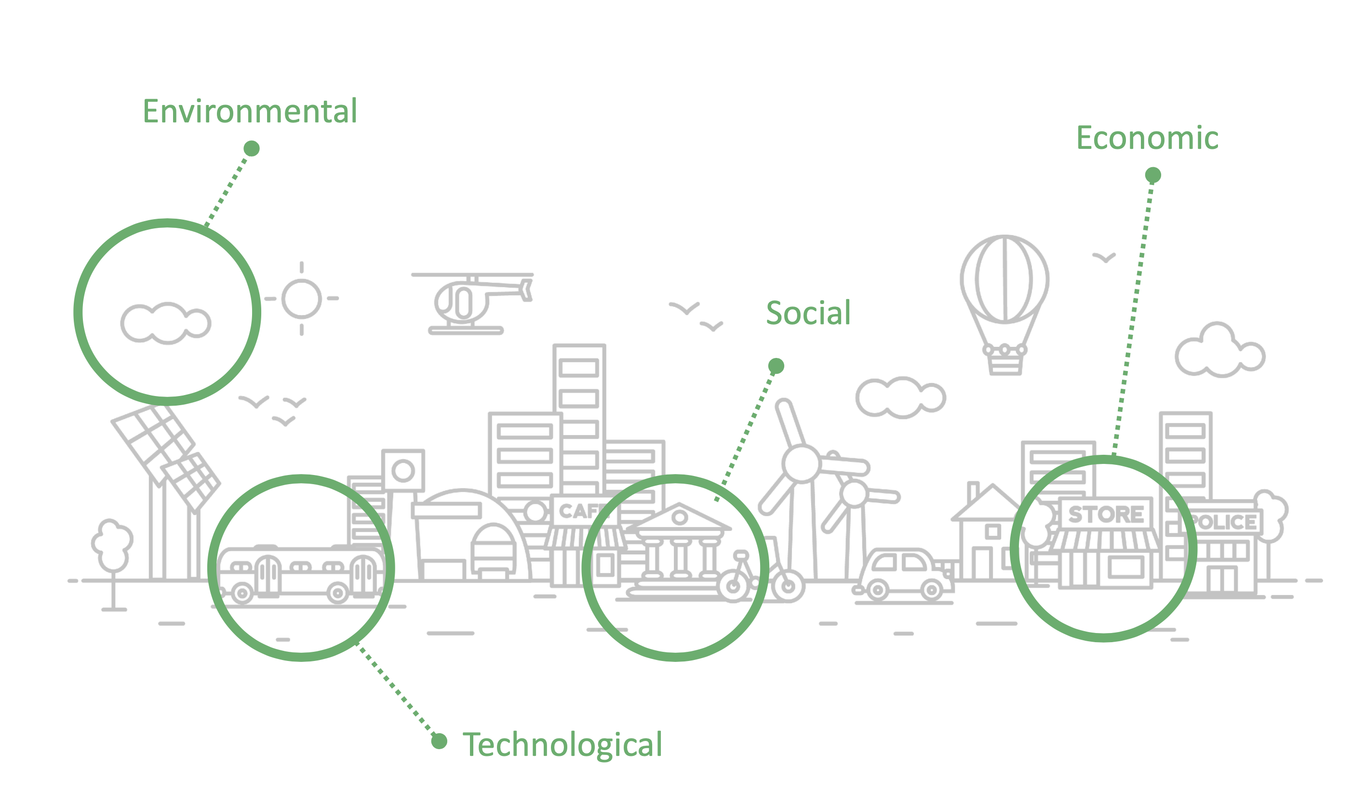
Mapping dimensions of ‘The Water system’

Slide 29
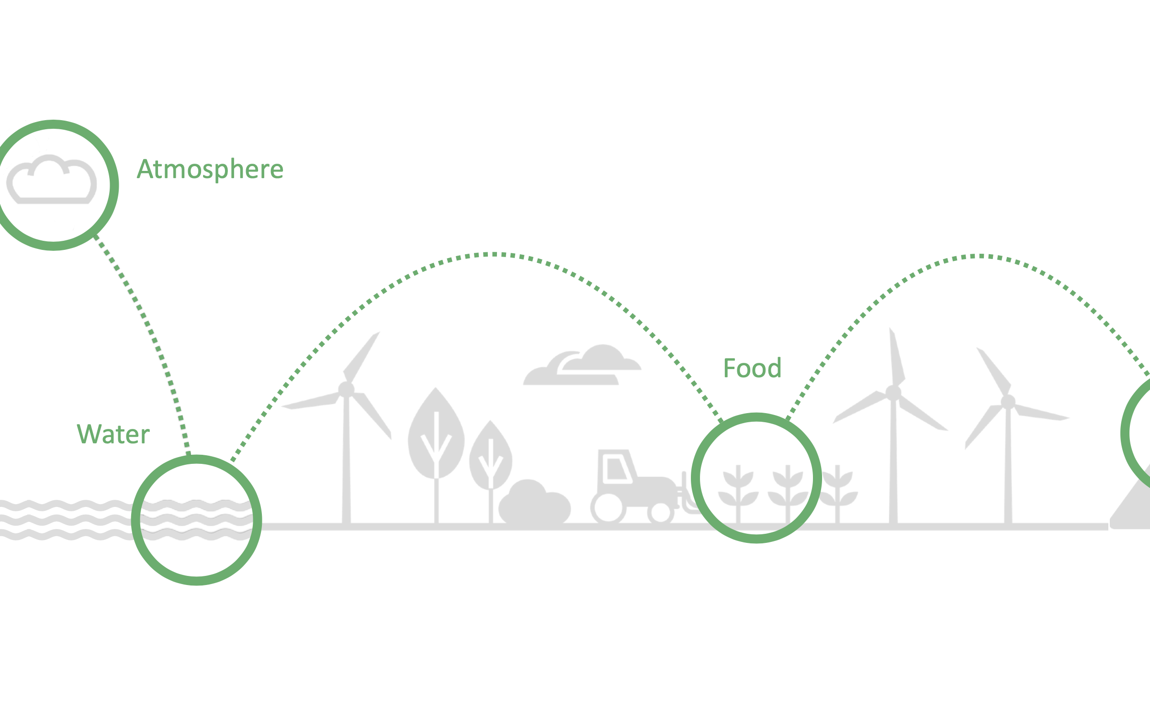
Mapping nodes and links in a dimension

Slide 30
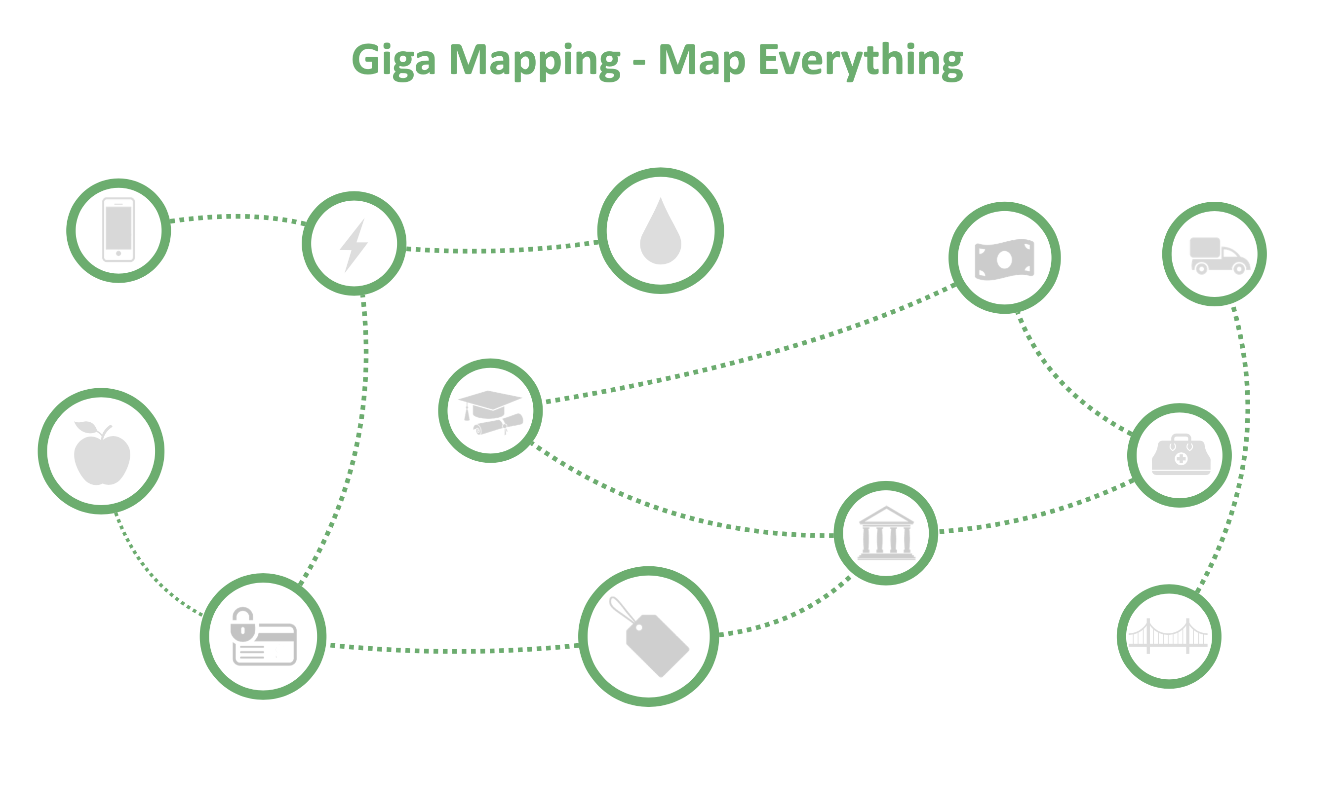

Slide 31
Exploration on 4 levels
External dynamics
Internal dynamics
Work itself
Personal dynamics

Slide 32
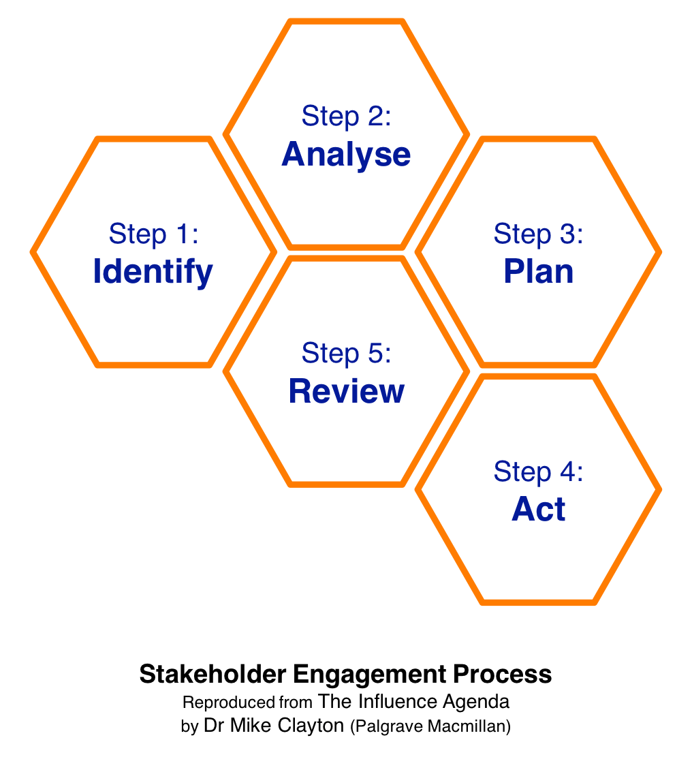
Stakeholder engagement
Step 0:
Set objectives

Slide 33
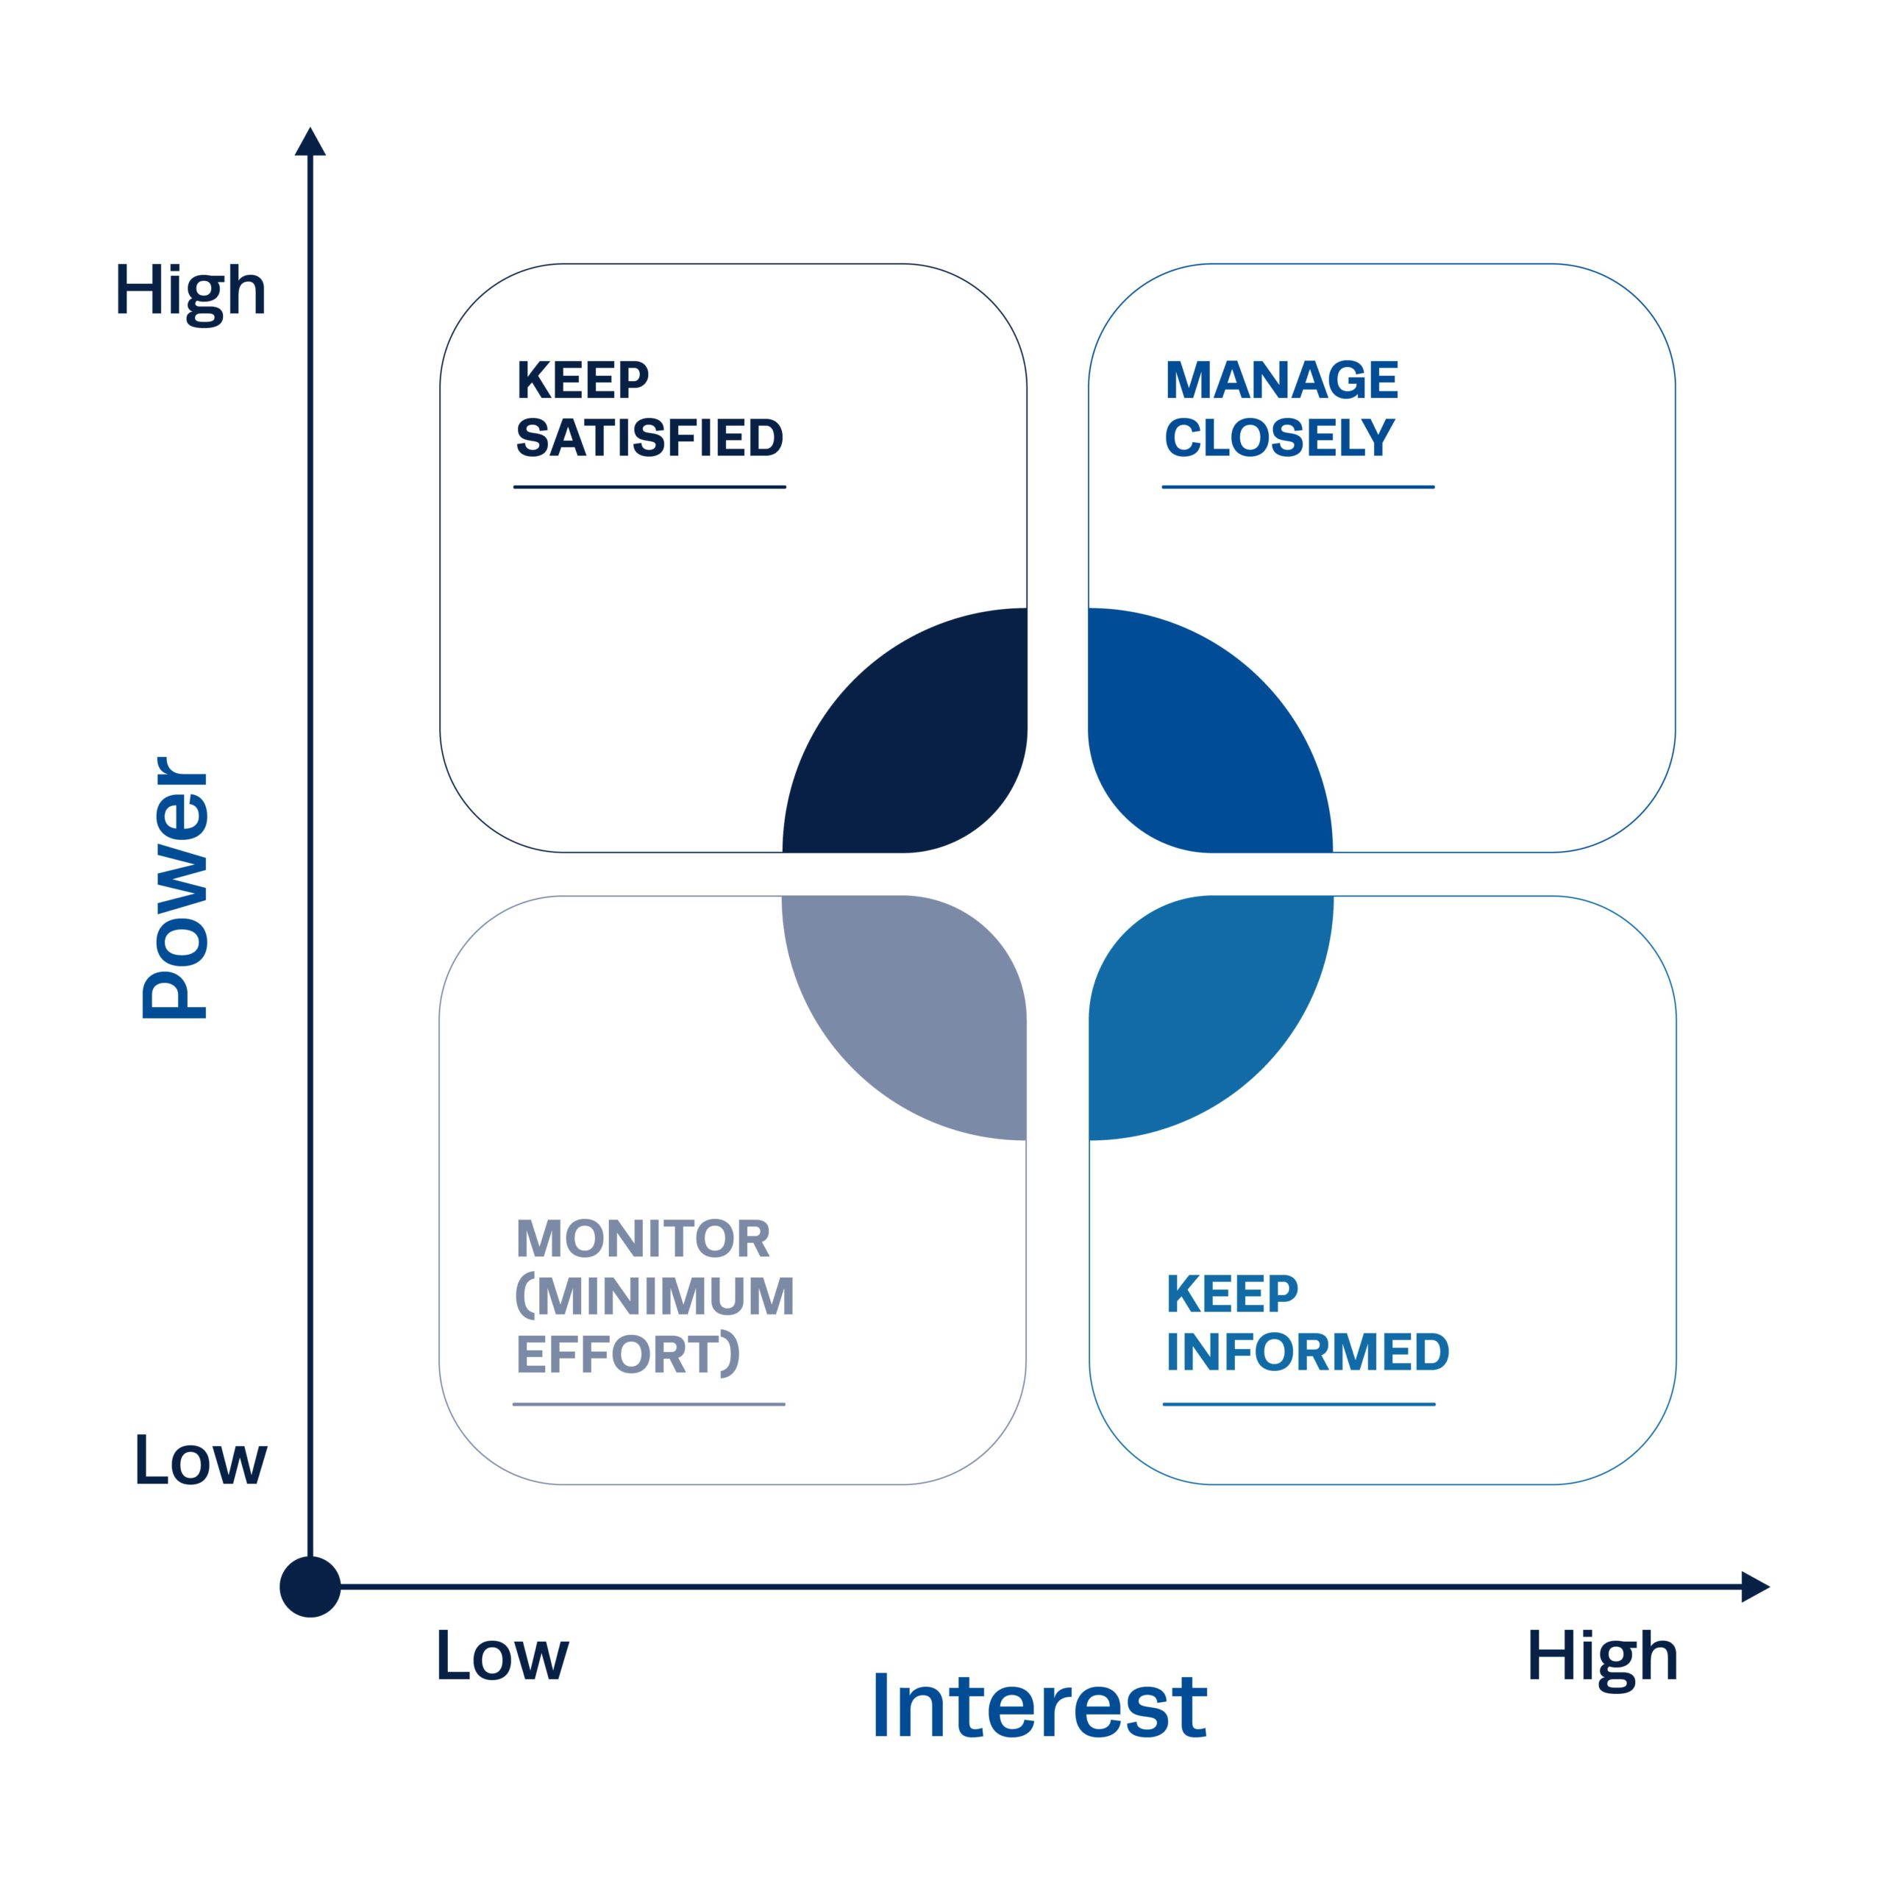
Stakeholder analysis

Slide 34
Dealing with your political arena

Slide 35
Managing expectations
(and your interests)
Start co-operation
carefully
Keep bond strong
Engage them
Request them to take a side, to speak their mind
Discuss,
try to persuade them
or be open to be
persuaded
Try to obstruct them,
or, if not influential:
ignore them

Slide 36
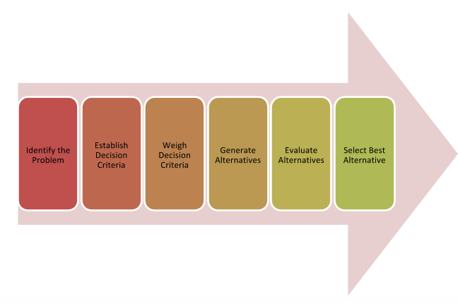
Decision making
Process

Slide 37
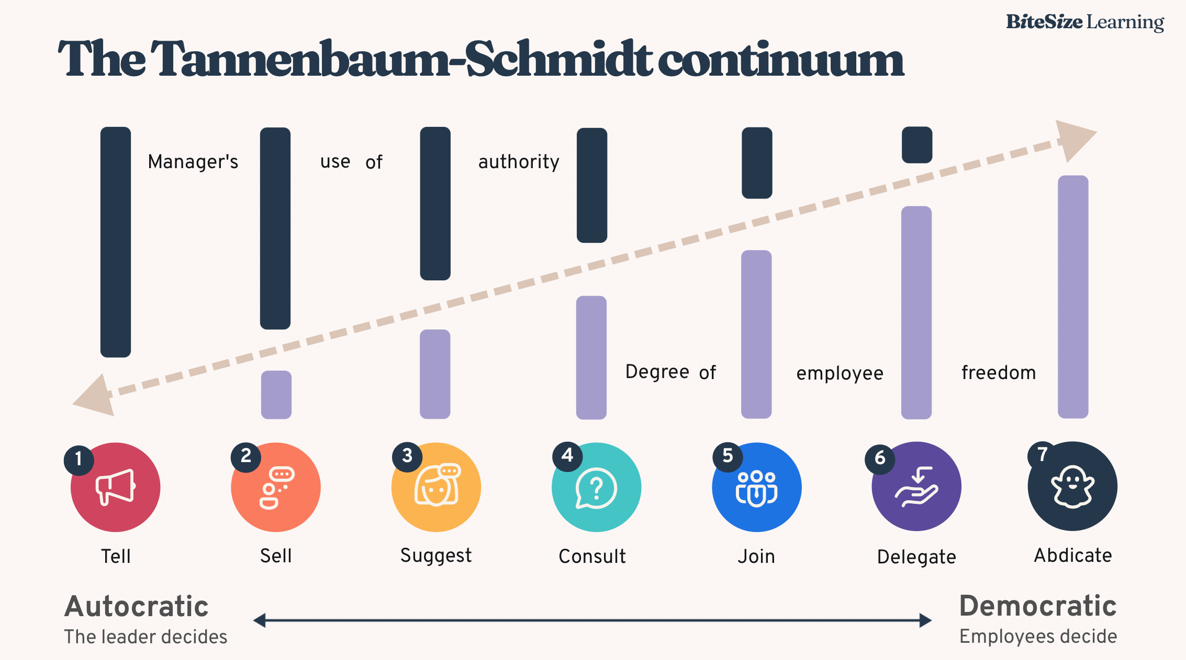
Decision making leadership styles

Slide 38
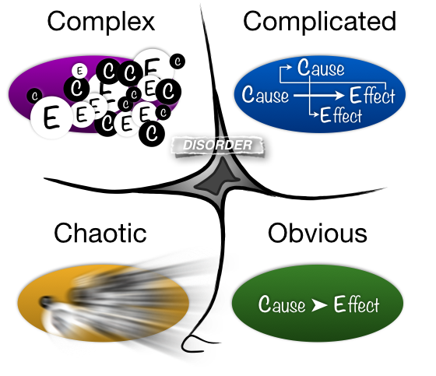
Cynefin model for decision making
Simple

Slide 39
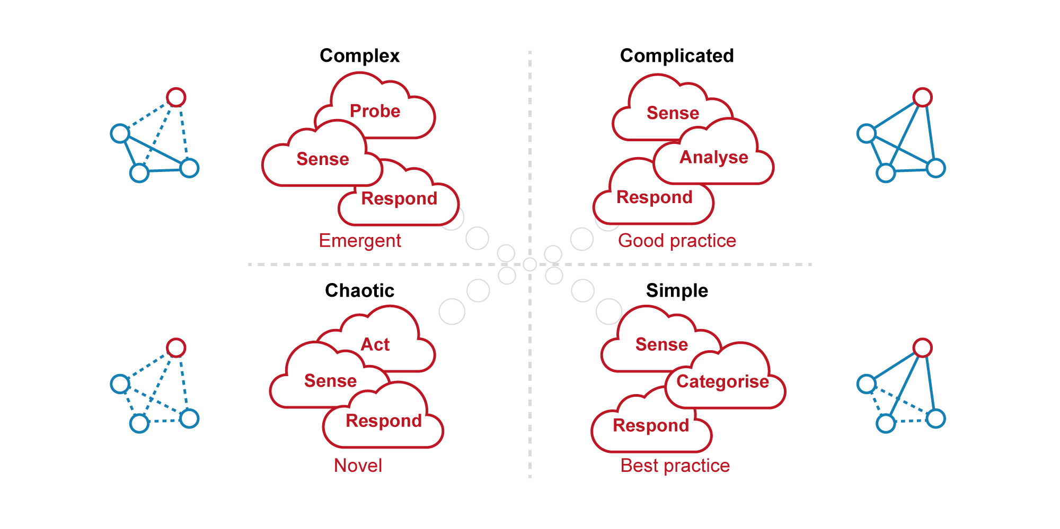
Cynefin framework, decision making

Slide 40
5 basic skills for personal resilience
To learn and to adapt (at a deeper level).
To maintain a sufficient energy level;
To stay balanced in case of tensions;
To know what to focus on;
To improve the quality and intensity of interaction with others;
Resilience
Adaptability
Fitness
Balance
Focus
Interaction

Slide 41
BALANCE
LOAD TO CARRY
<
1
COPING CAPACITY

Slide 42
CIRCLES OF INFLUENCE
Circle of concern
Circle of influence
Notes:
09-09-12
42

Slide 43
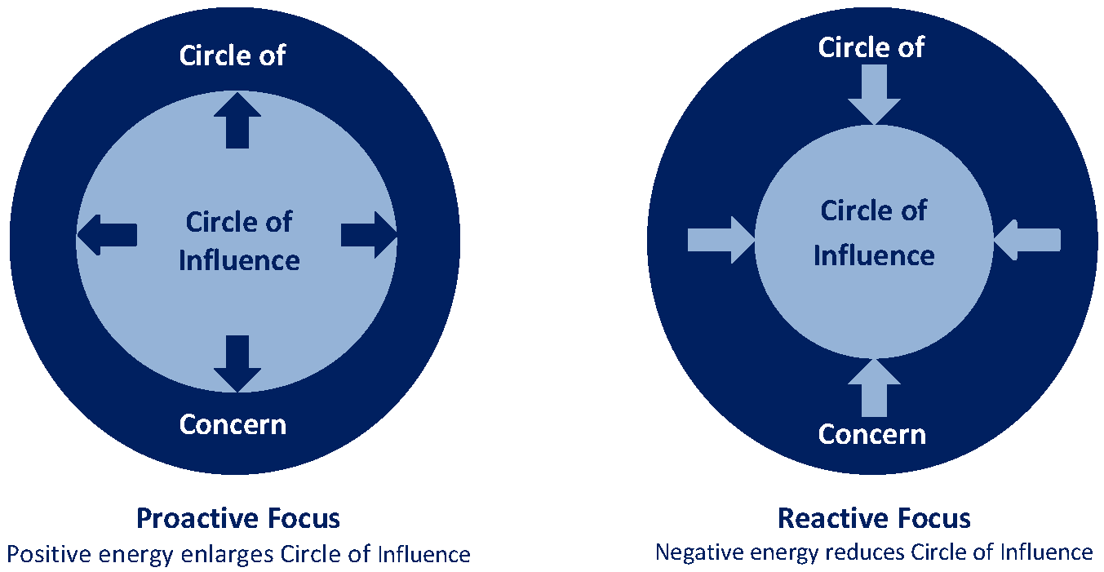

Slide 44
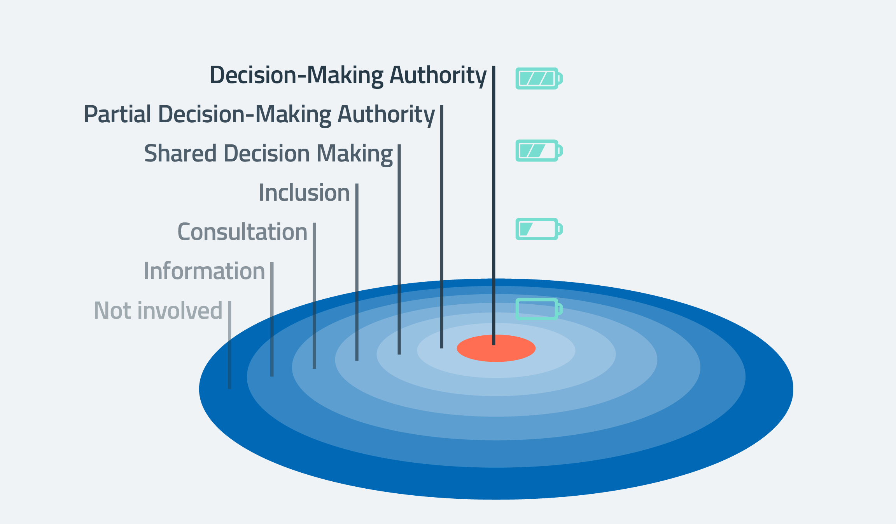

Slide 45
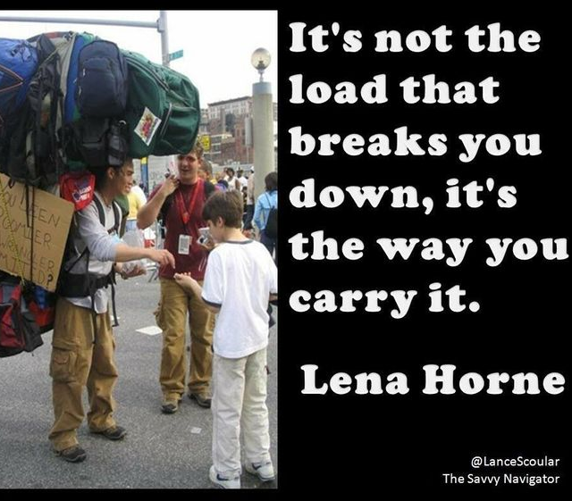
How is your personal resillience?
How are you going to take care of yourself and each other?
What does this mean from you personally?
What do you need from others?.

Slide 46
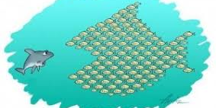
From resilience to antifragile

Slide 47

This group as a system

Slide 48
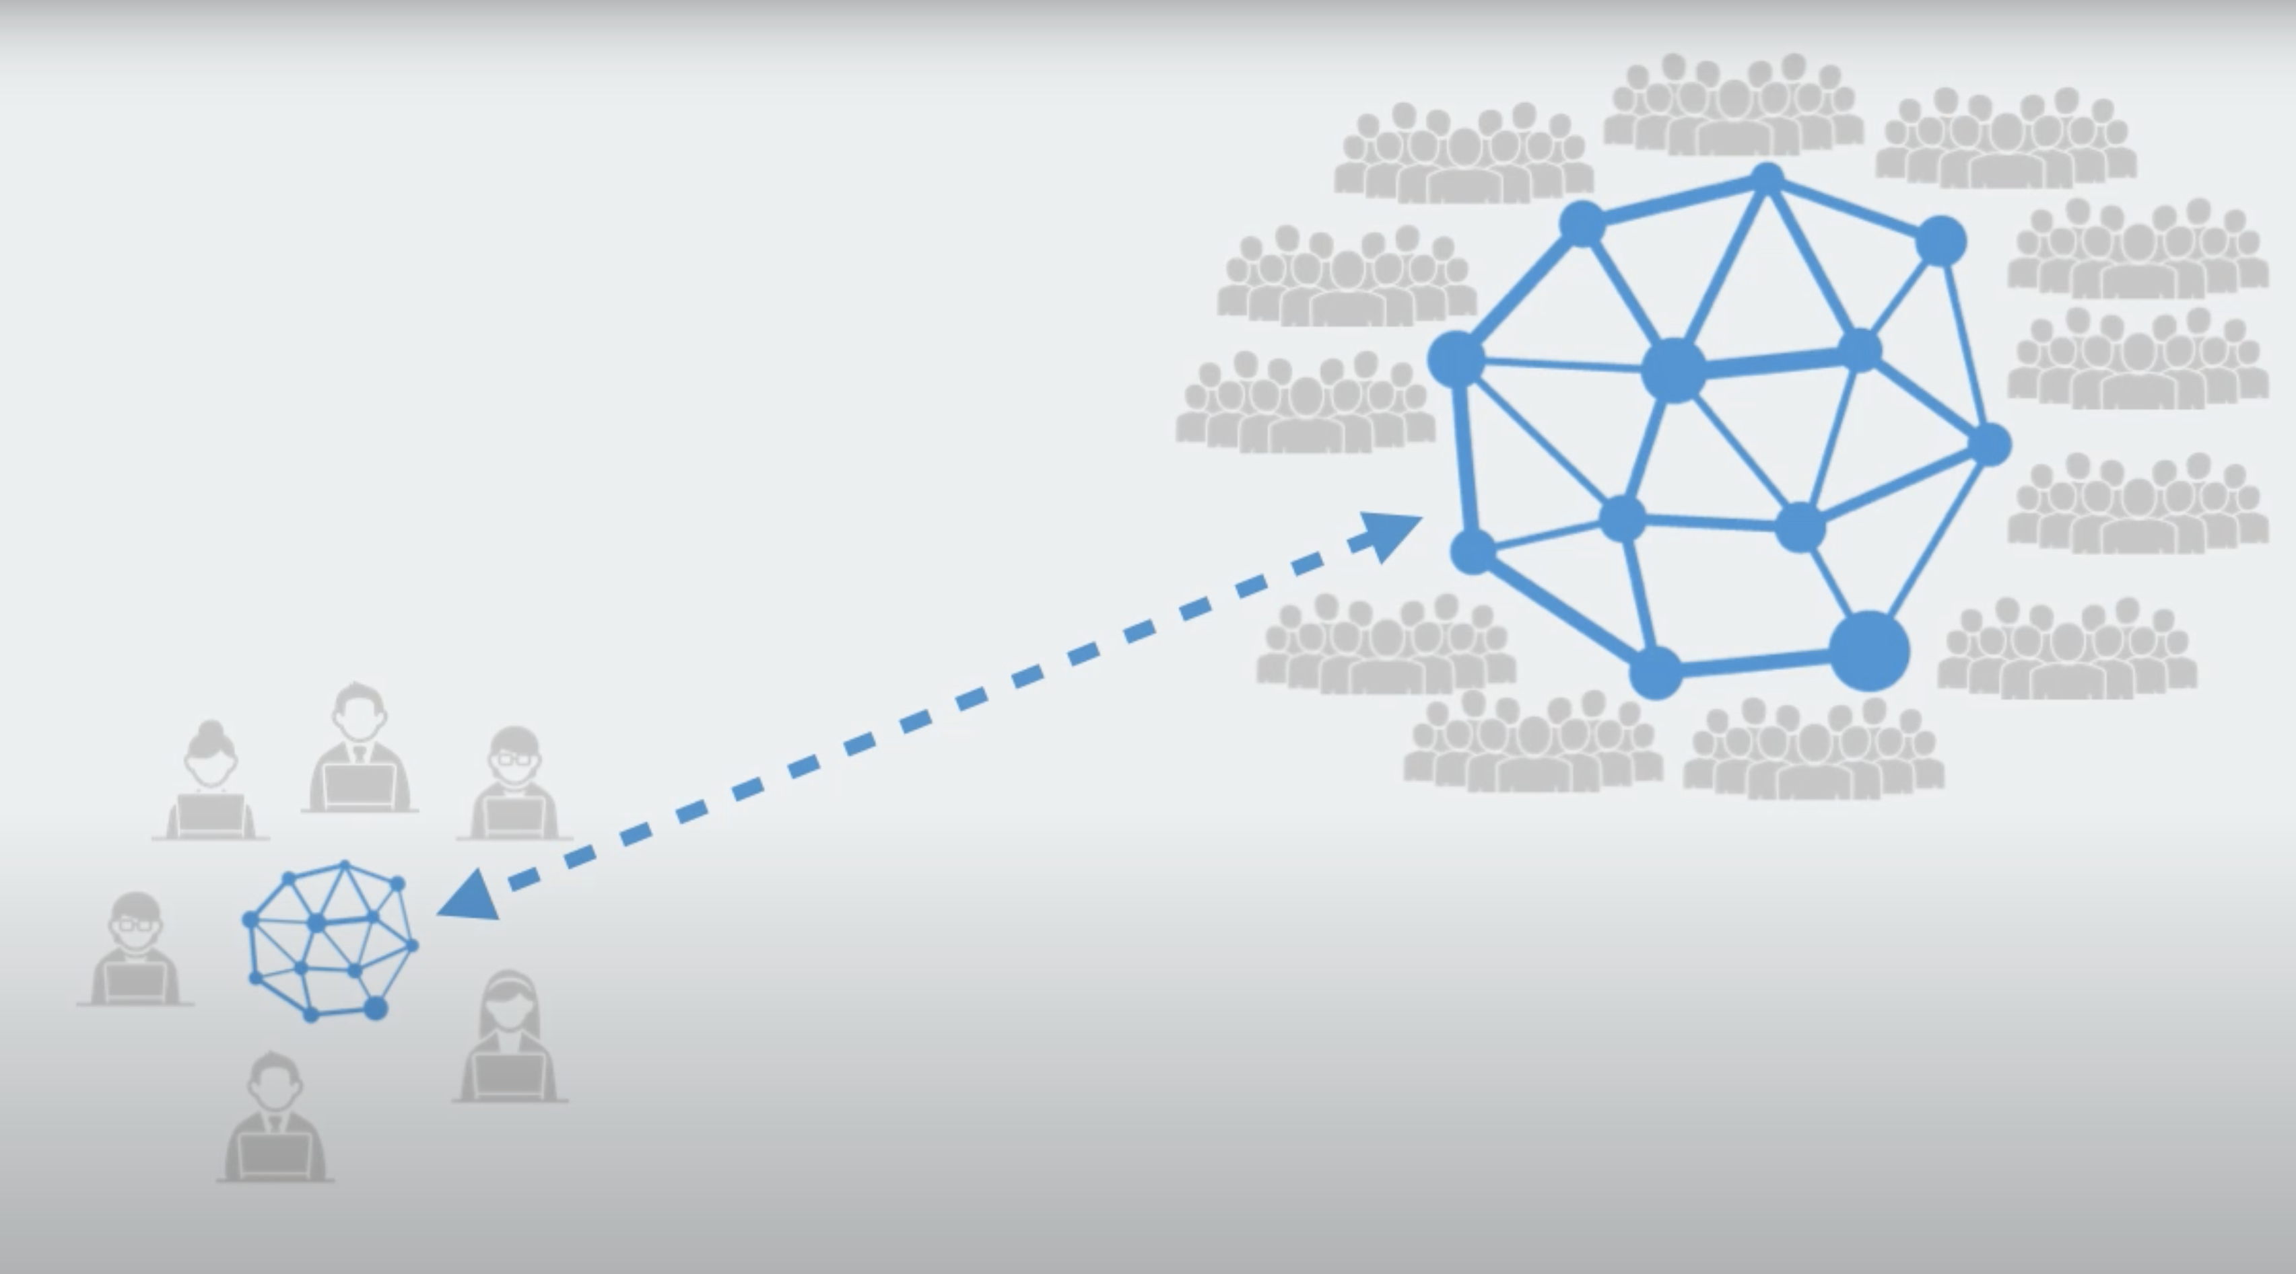
Self organisation within the project team

Slide 49
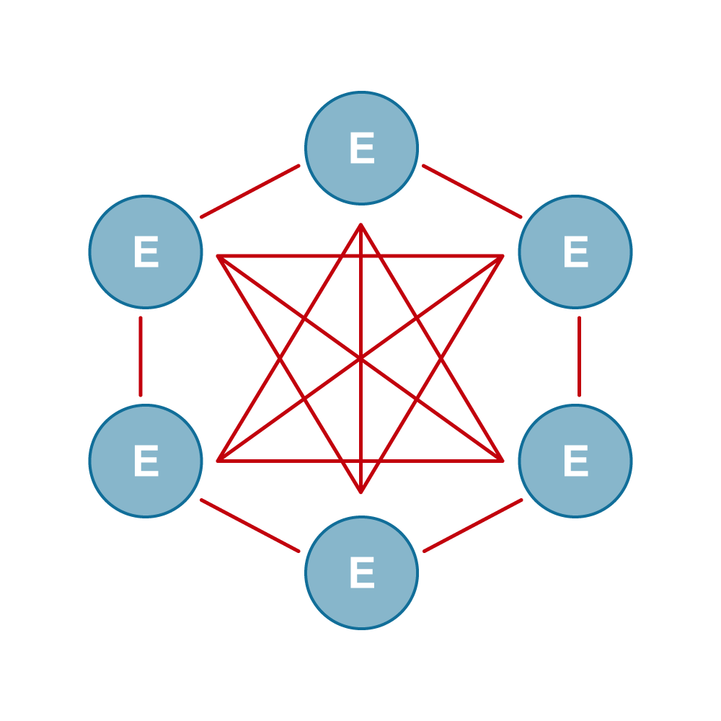
Self-organisation requires
Ownership
Autonomy
Interdependency
Personal Leadership
Social skills

Slide 50
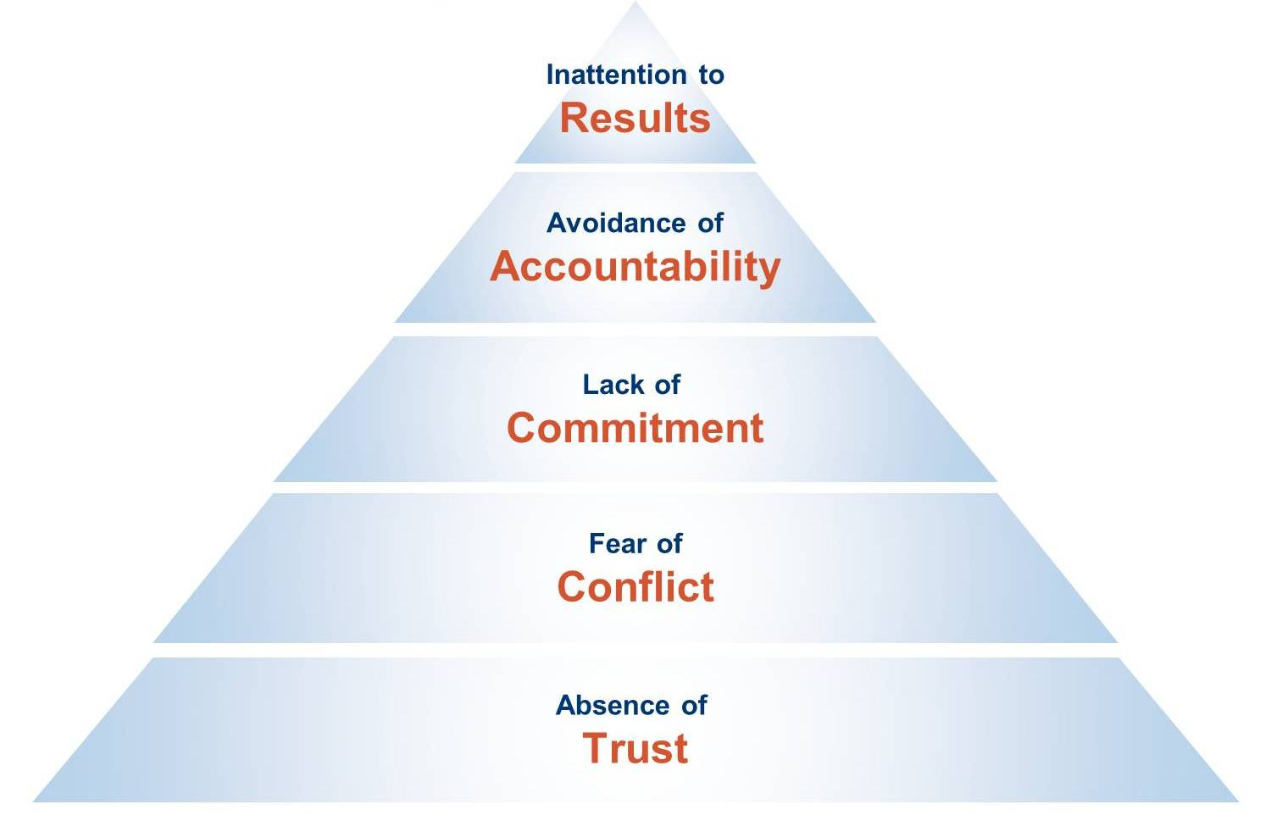
Lencioni

Slide 51
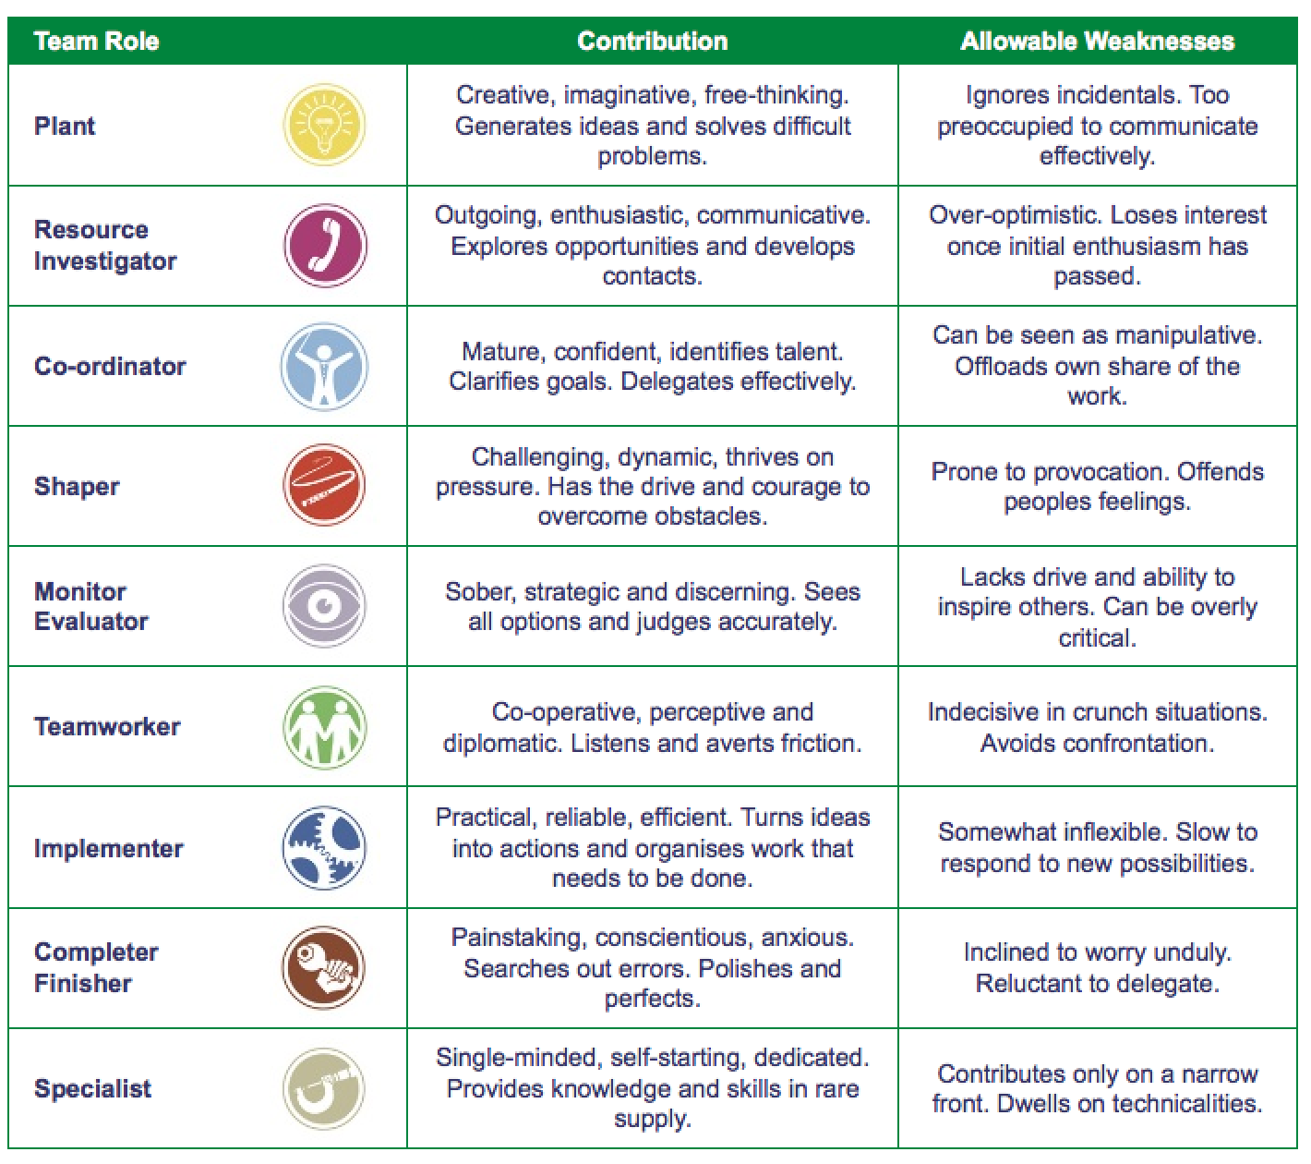

Slide 52

My take aways are …
Strength lies in differences, not in similarities
Stephen R. Covey.

Slide 53

Wrap up

Slide 54

What is interVision?
Definition interVision (co-worker consultation)
A systematic approach to work related issues.
With a small group of people.
It is a means to improve the quality of the profession.
The focus is on the personal aspects of the issue, not on the content. ,,Why is this an issue for me, at this moment in my career?’’

Slide 55
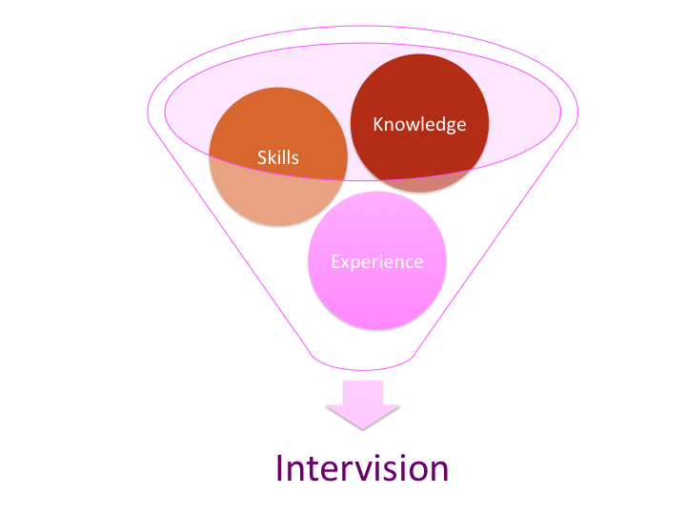
Objectives for interVision
Learning together.
Empowering a person by focussing on what lies within your circle of influence.
Signalling general issues and addressing them where they can be solved.

Slide 56

General structure for process
Choosing a case
Analysing the issue
Reflection on the core of the issue
Exploring possible actions/advice.
This structure ensures depth
and prevents solving
symptoms instead of
dealing with the true
issue at hand.

Slide 57
Five step-method
Phase | Description | Time indication:
 | Introduction to the method
0 | Inventory of the cases: The group does an inventory of the cases. A selection is made and prioritised on a flip chart. | 10 minutes
1 | Round 1: The case owner tells about the context of his/her case and concludes with a short formulation of the question. | 5 minutes
2 | Questioning: Participants ask questions that are directly answered by the case owner. After answering the questions, reflect as a group if the all levels of the Iceberg were covered. If not, additional questions can be asked. | 10-15 minutes
3 | Reflection: The participants give their view on the core of the issue. These are noted on a flip chart. The case owner reflects on these and gives his/her own (new) view on the core of the issue. Also, the case owner tells whether he/she wants advice in this. (It might already be enough to reframe the core of the issue. | 10 minutes
4 | If wanted: Advice: The participants give short, clear advices. These are noted on a flip chart. | 5 minutes
5 | Round up: The case owner shares what these advices mean to him/her and what (s)he is going to do now. Other participants share what they have learnt from the session. | 5 minutes
 | Time needed: | 45-60 minutes

Slide 58
Wrap up

Slide 59
Training week 4
SKILLS4WATER Innovative Training Programme
EJWP7: March 2024 - August 2025
01-03 April 2025, Galati, Romania

Slide 60

Check in
How do you sit here today?
What was your biggest take away of yesterday?
What would you like to be different then yesterday
What are your expectations, hopes & fears of today?

Slide 61
Programme training Day 3
My Personal Path, Closing Training Programme
Creating Impact
Consortium Meeting

Slide 62

My next adventure

Slide 63
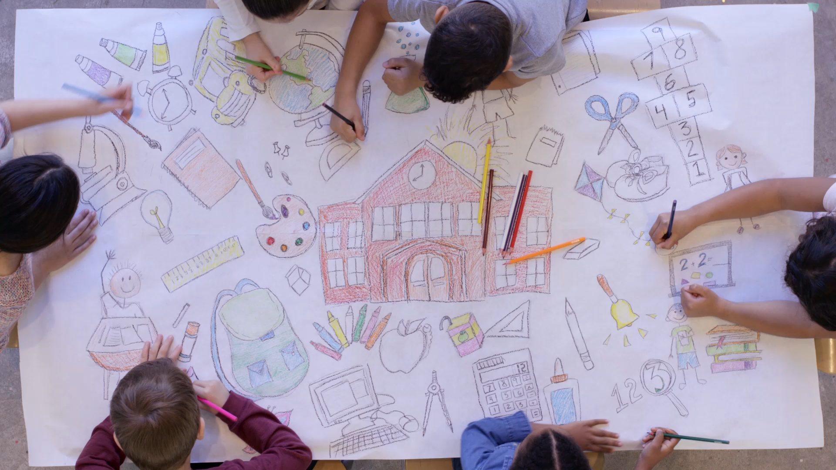
What do you aim for after this? Draw.

Slide 64
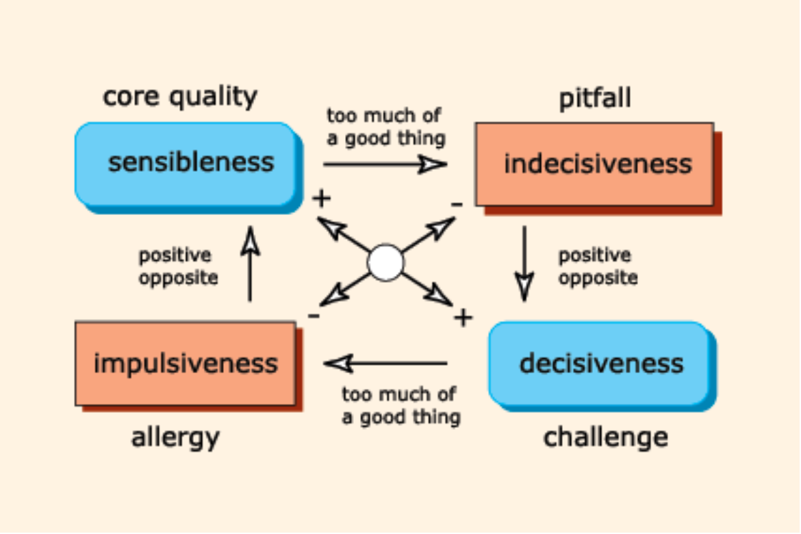
Core quadrants

Slide 65
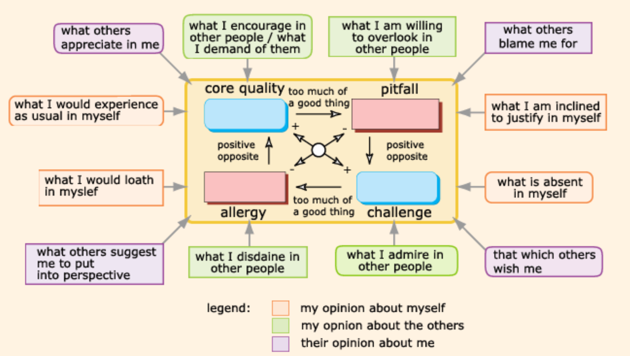

Slide 66

Networking

Slide 67
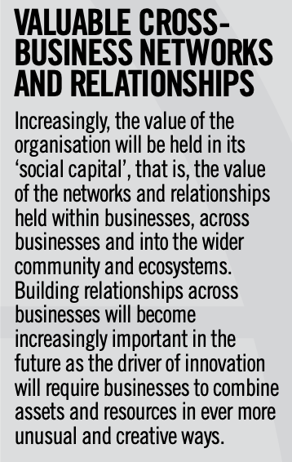
The need for building strong networks acording to Lynda Gratton
Why?

Slide 68

My aim is …

Slide 69
10 ways to boost your networking skills
Building relationships.
Keeping in contact.
Leverage on influential connections.
Staying positive.
Improve your emailing skills.
Go in with no expectations.
Focus your efforts.
Work on your communication skills. Listen more than talk.
Have an impressive elevator pitch.
Understand that position doesn’t always indicate influence

Slide 70

5 key principles for Networking from the NetworKing (Charles Ruffolo)

Slide 71

Start with your existing network

Slide 72

Get to know your network

Slide 73
Connect with your network
Activate
Exchange experiences

Slide 74

Feed your network

Slide 75
What can I do for you?

Slide 76

Your pitch

Slide 77
What is your Bottom line?

Slide 78

The main idea that you want your contact to go away with

Slide 79

25 words or less

Slide 80

A.M.E.N.
AUDIENCE: Know your audience
MESSAGE: What is the message that you want and need to tell them?
EXAMPLES: Use examples to illustrate what you mean
NEGATIVES: Anticipate any negative questions

Slide 81

ABC: How to deal with difficult questions
Answer/Acknowledge
Build a bridge
Communicate

Slide 82

Your experiences and questions

Slide 83
My take aways are …

Slide 84

Check out
2 min. in silence reflection
Circle.
When you recognize take one step forward.
Pop-it-when-you-re-hot.
- Biggest take away?
- Needs to close this session?

Slide 85
Wrap up

